Slide 1

Left Turn Opposing Through Analysis
Leveraging AASHTOWare Safety
Prepared By:
Ron Knezevich, PE RSP2i
GDOT State Safety Engineering Manager

Slide 2
Takeaways
GDOT had an older protected left turn phasing policy that needed modernizing
Service units were used to help us create a data driven policy
A new protected left turn query and network screening was created to expedite our network screenings, and permit reviews

Slide 3
Crash Type We are Looking For

Slide 4
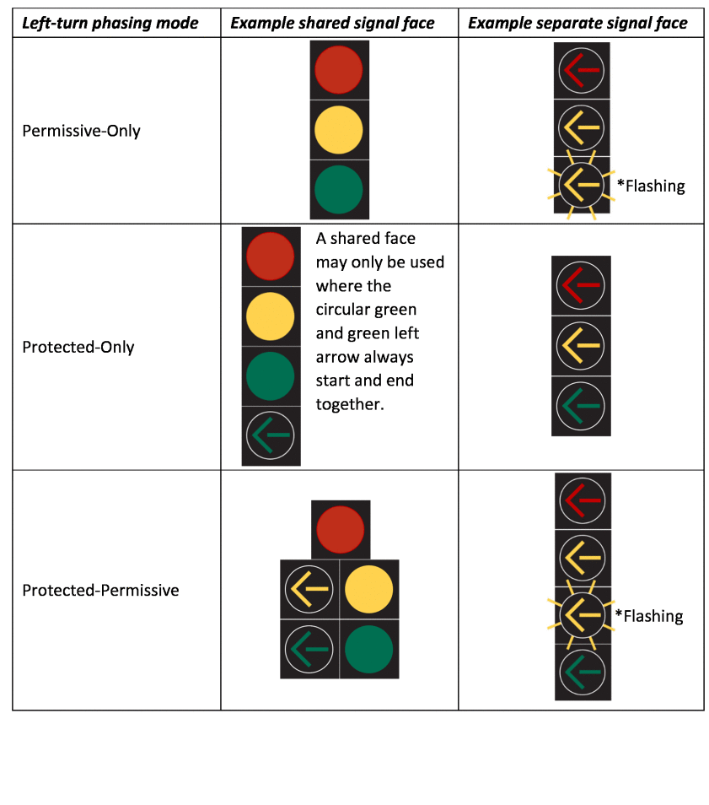
Protected Left Turns
22% of fatal and serious injury crashes at signals are left turn opposing through maneuver in Georgia
Protected left turns reduce 99% of opposing left turn crashes by when converting from permitted or permitted-protected phasing CMF ID: 333
Left turn signalization options
Image source: https://www.nationalacademies.org/read/25905/chapter/6

Slide 5
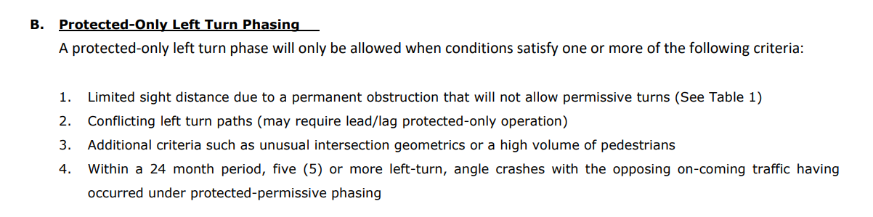
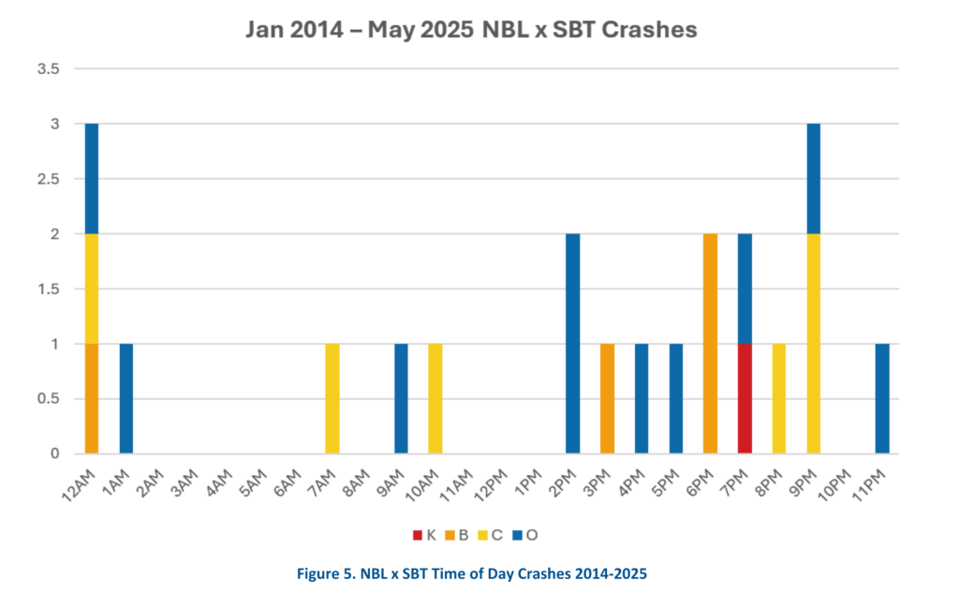
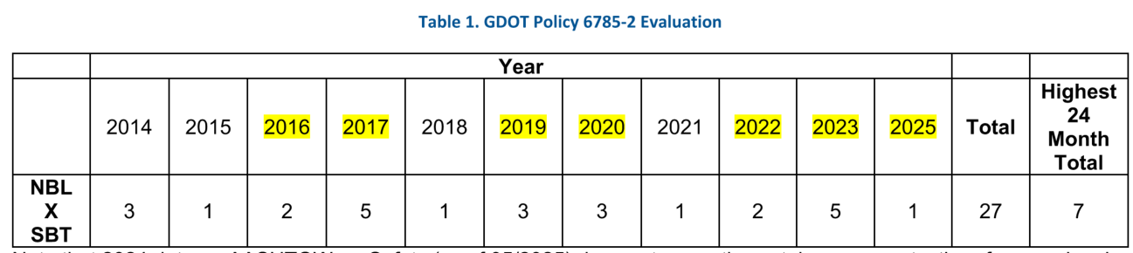
Traditional GDOT Analysis
Left turn opposing through crashes each year
Left turn opposing through
crashes each hour

Slide 6
When Do We Do this Analysis
Network screenings (proactively)
During signal permit revisions (reactive)

Slide 7
Issues with GDOT Policy
Only considers crash frequency
Definitive language (lack of engineering judgement & open to liability)
No way to do a network screening for these locations
Difficult to quickly identify if the intersection meets policy in a signal permit review

Slide 8
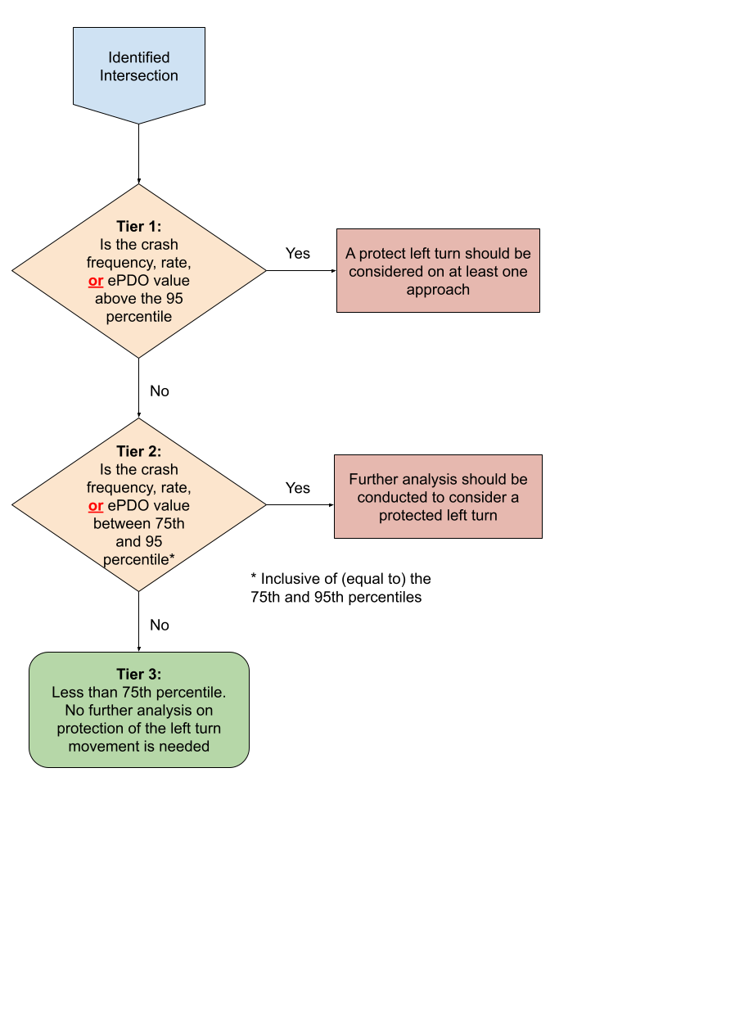
New GDOT Guidance
Filter Crash data at Intersections
Protected Left Turn Evaluation Filter Logic
Captures a broad crash type that may be left turn opposing
Traffic Signal = Yes
Vehicle Maneuver = Turn Left
Manner of Collision = Angle or Head On
Location at Impact is not On Roadway - Driveway Intersection
The number of Vehicles involved in a crash is 2 or more.

Slide 9
Analysis Numetric Did with Service Units
Thanks Derek
Area Type = Urban |  | District
Safety Performance Measure | Percentile | 1 | 2 | 3 | 4 | 5 | 6 | 7
Observed Crashes | 75th | 13 | 11 | 10 | 6 | 11 | 11 | 13
Observed Crashes | 95th | 34 | 30.9 | 27 | 19 | 31 | 29 | 36
Crash Rate | 75th | 0.032 | 0.024 | 0.032 | 0.014 | 0.083 | 0.054 | 0.04
Crash Rate | 95th | 0.095 | 0.233 | 0.158 | 0.048 | 0.266 | 0.277 | 0.128
ePDO | 75th | 107.7 | 92.5 | 74.7 | 29.7 | 108.0 | 115.2 | 107.7
ePDO | 95th | 447.6 | 303.5 | 316.4 | 210.1 | 375.7 | 509.3 | 437.3

Slide 10
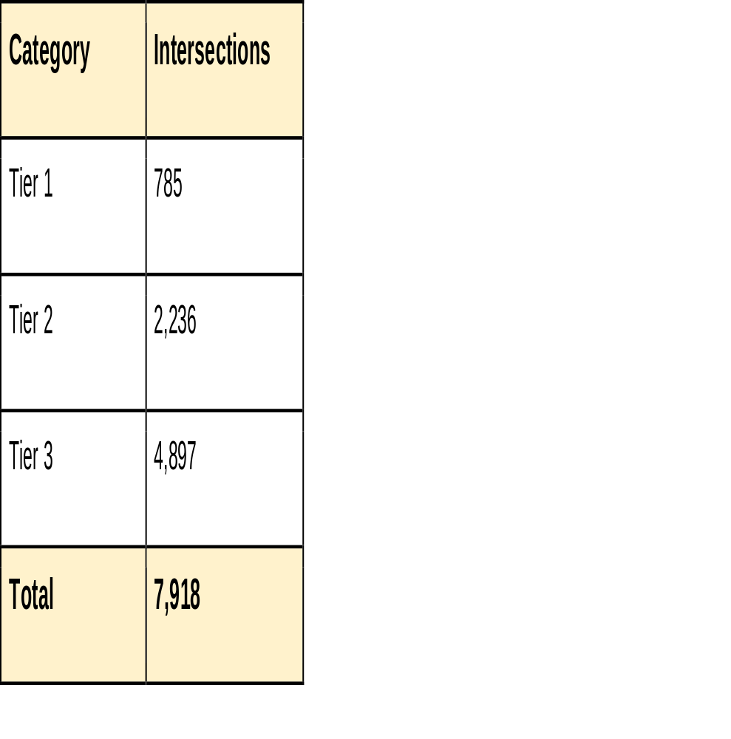
Number of intersections by Evaluation Tier

Slide 11
Filters Used in Analysis

Slide 12
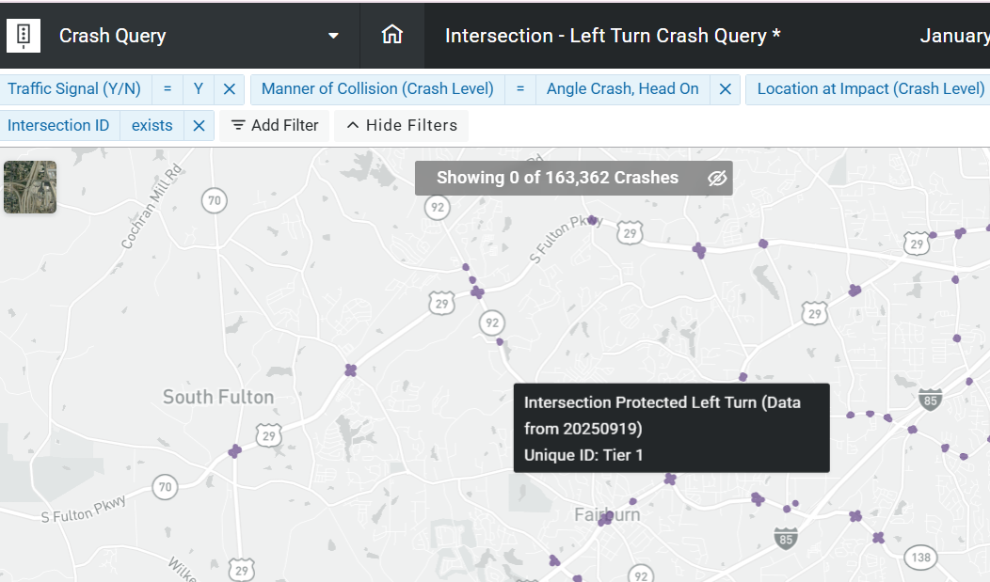
Scanning Intersections on Crash Query

Slide 13
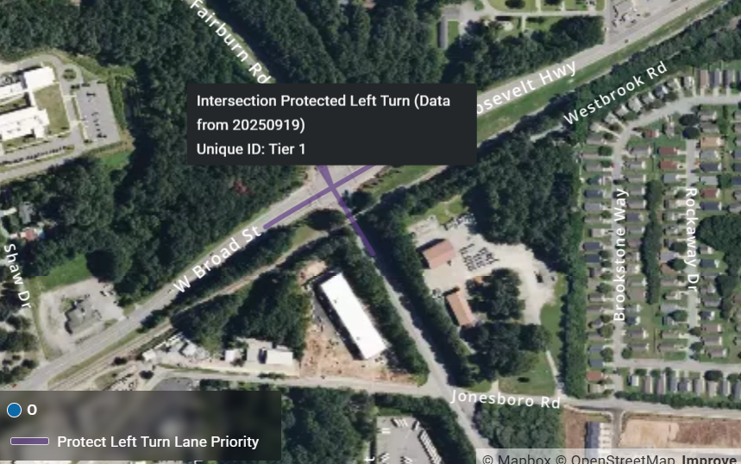
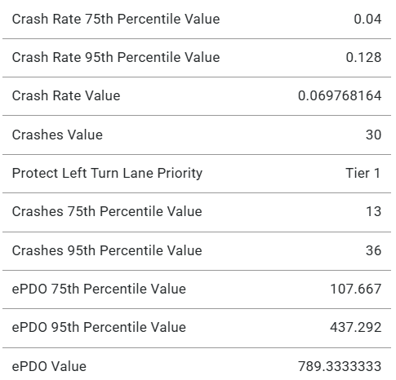
Inspecting an Intersection on Crash Query

Slide 14
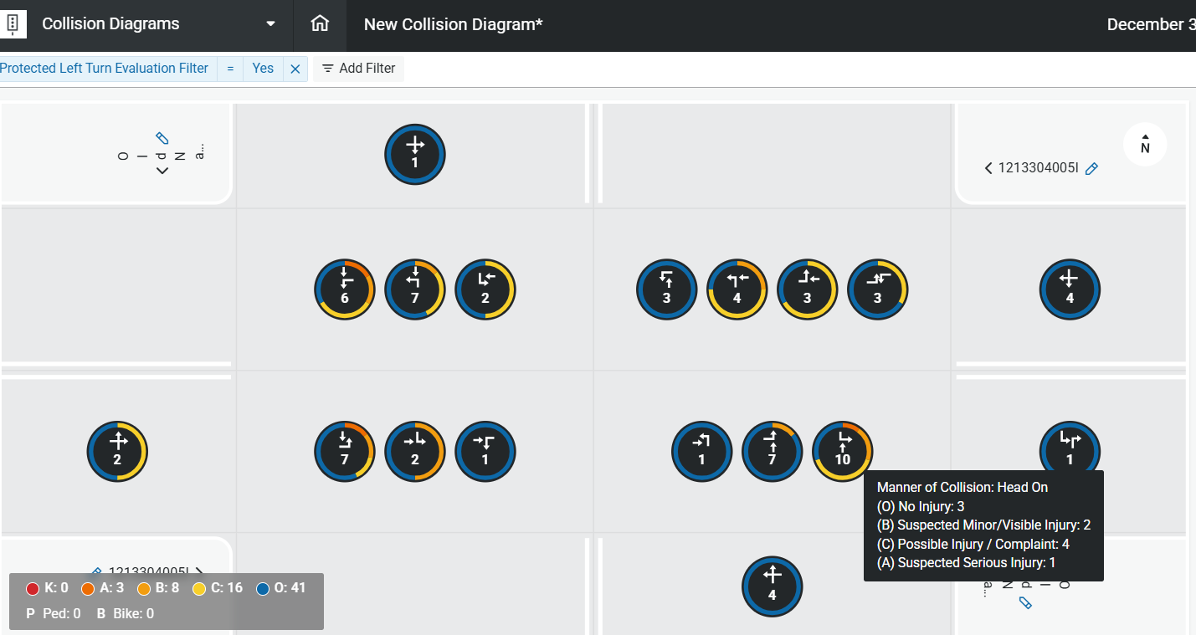
Further Inspection on Collision Diagrams for Project Specific Recommendations

Slide 15
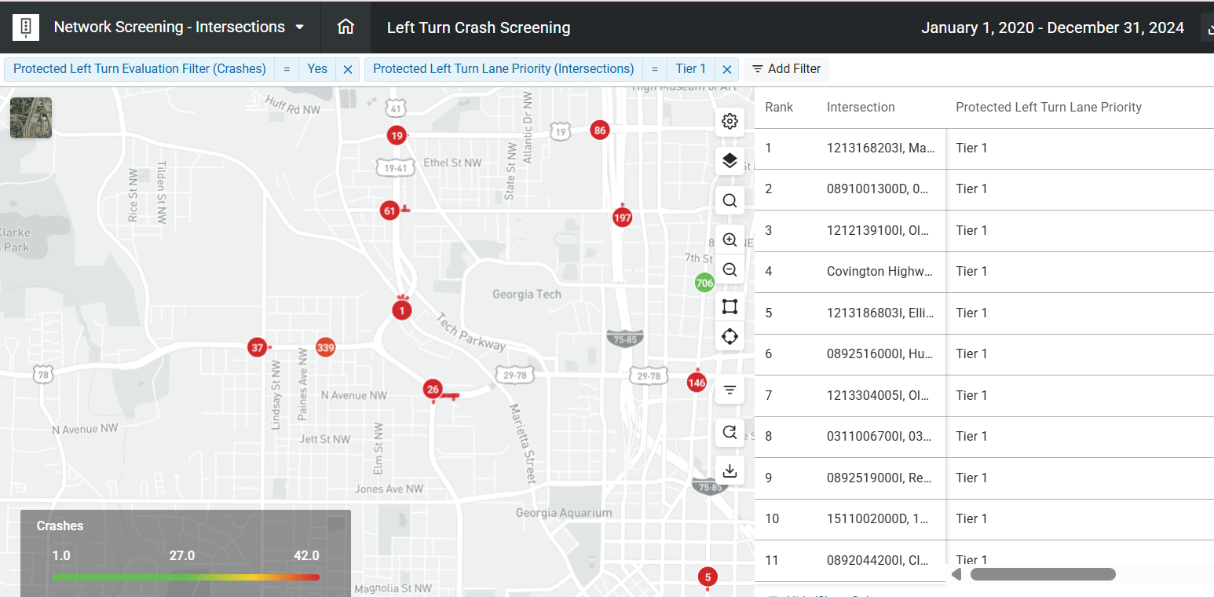
Protected Left Turn Network Screening

Slide 16
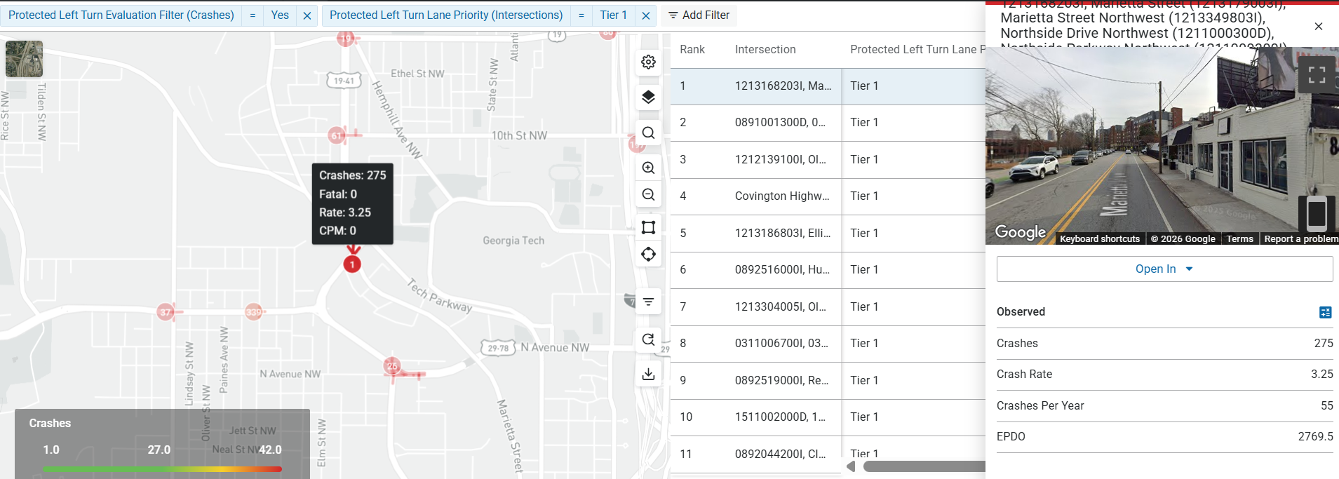
Protected Left Turn Network Screening

Slide 17
Takeaways
GDOT had an older protected left turn phasing policy that needed modernizing
Service units were used to help us create a data driven policy
A new Protected left turn query and network screening was created to expedite our network screenings, and permit reviews

Slide 18
Thank you
Questions?
Ideas?
Ron Knezevich, PE RSP2i
GDOT State Safety Engineering Manager
Rknezevich@dot.ga.gov

