Slide 1

NMDOT & University of New Mexico
University of New Mexico Geospatial and Population Studies
Maintain NMDOT Crash Data Base
Contracted by NMDOT Traffic Safety Division
Geocode, clean and standardize
Some dashboards
Crash data available primarily in Excel

Slide 2
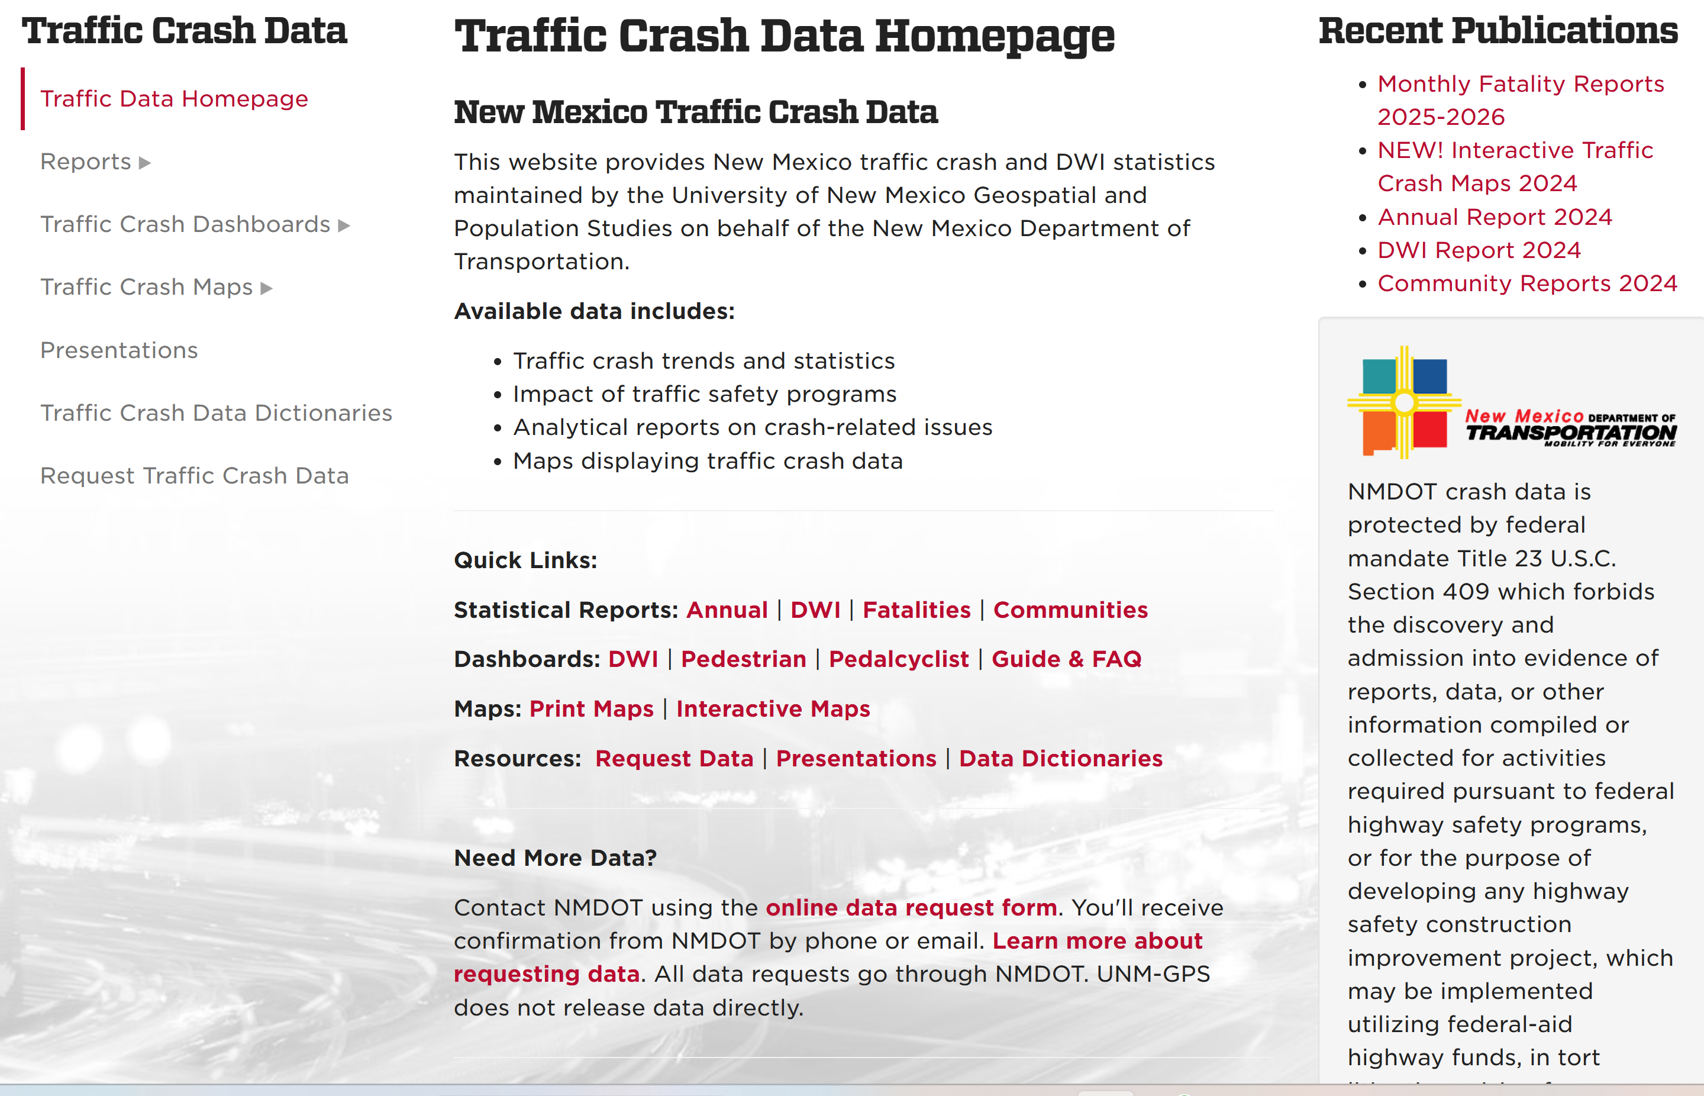
NMDOT Crash Data History

Slide 3
NMDOT & AASHTOWare Safety
Purchased Segments & Trends August 2023
Fully implemented by mid 2024
200-300 users (NMDOT & consultants
Offered access to RPOs and MPOs
Recently allowed access to some cities
Law Enforcement?

Slide 4
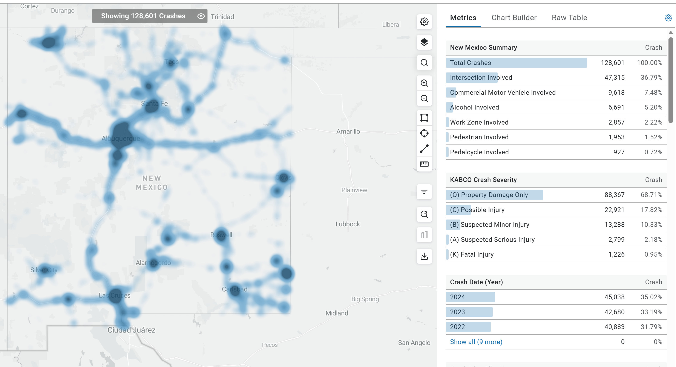
AASHTOWare Safety for New Mexico

Slide 5
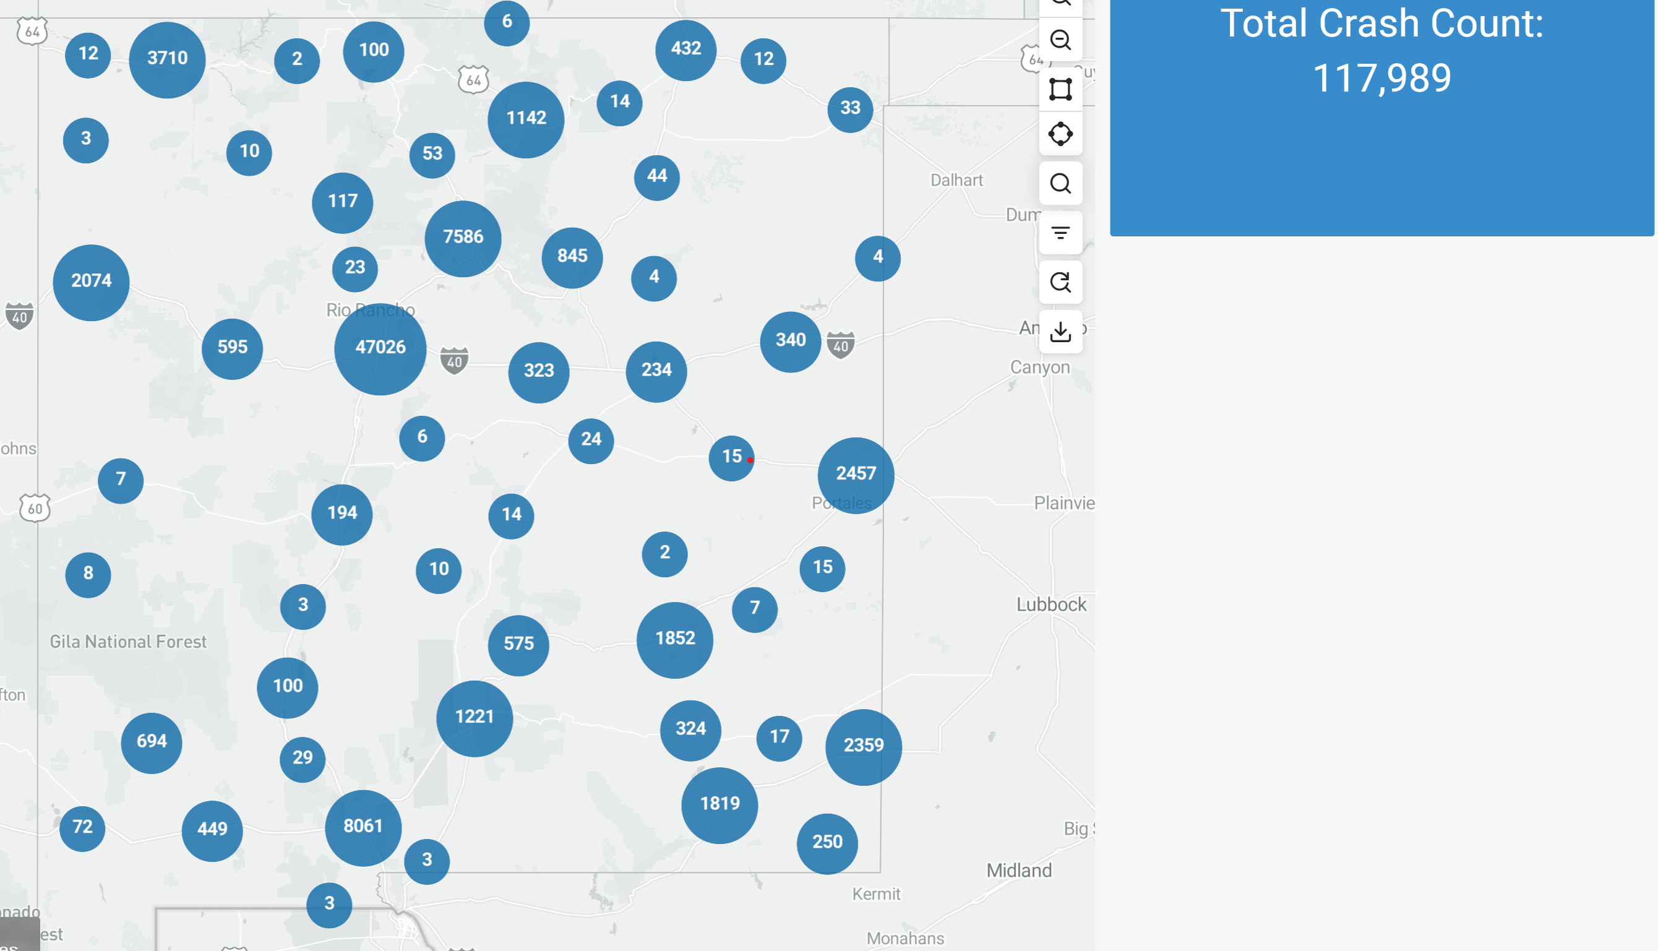
NMDOT SHSP Dashboards

Slide 6
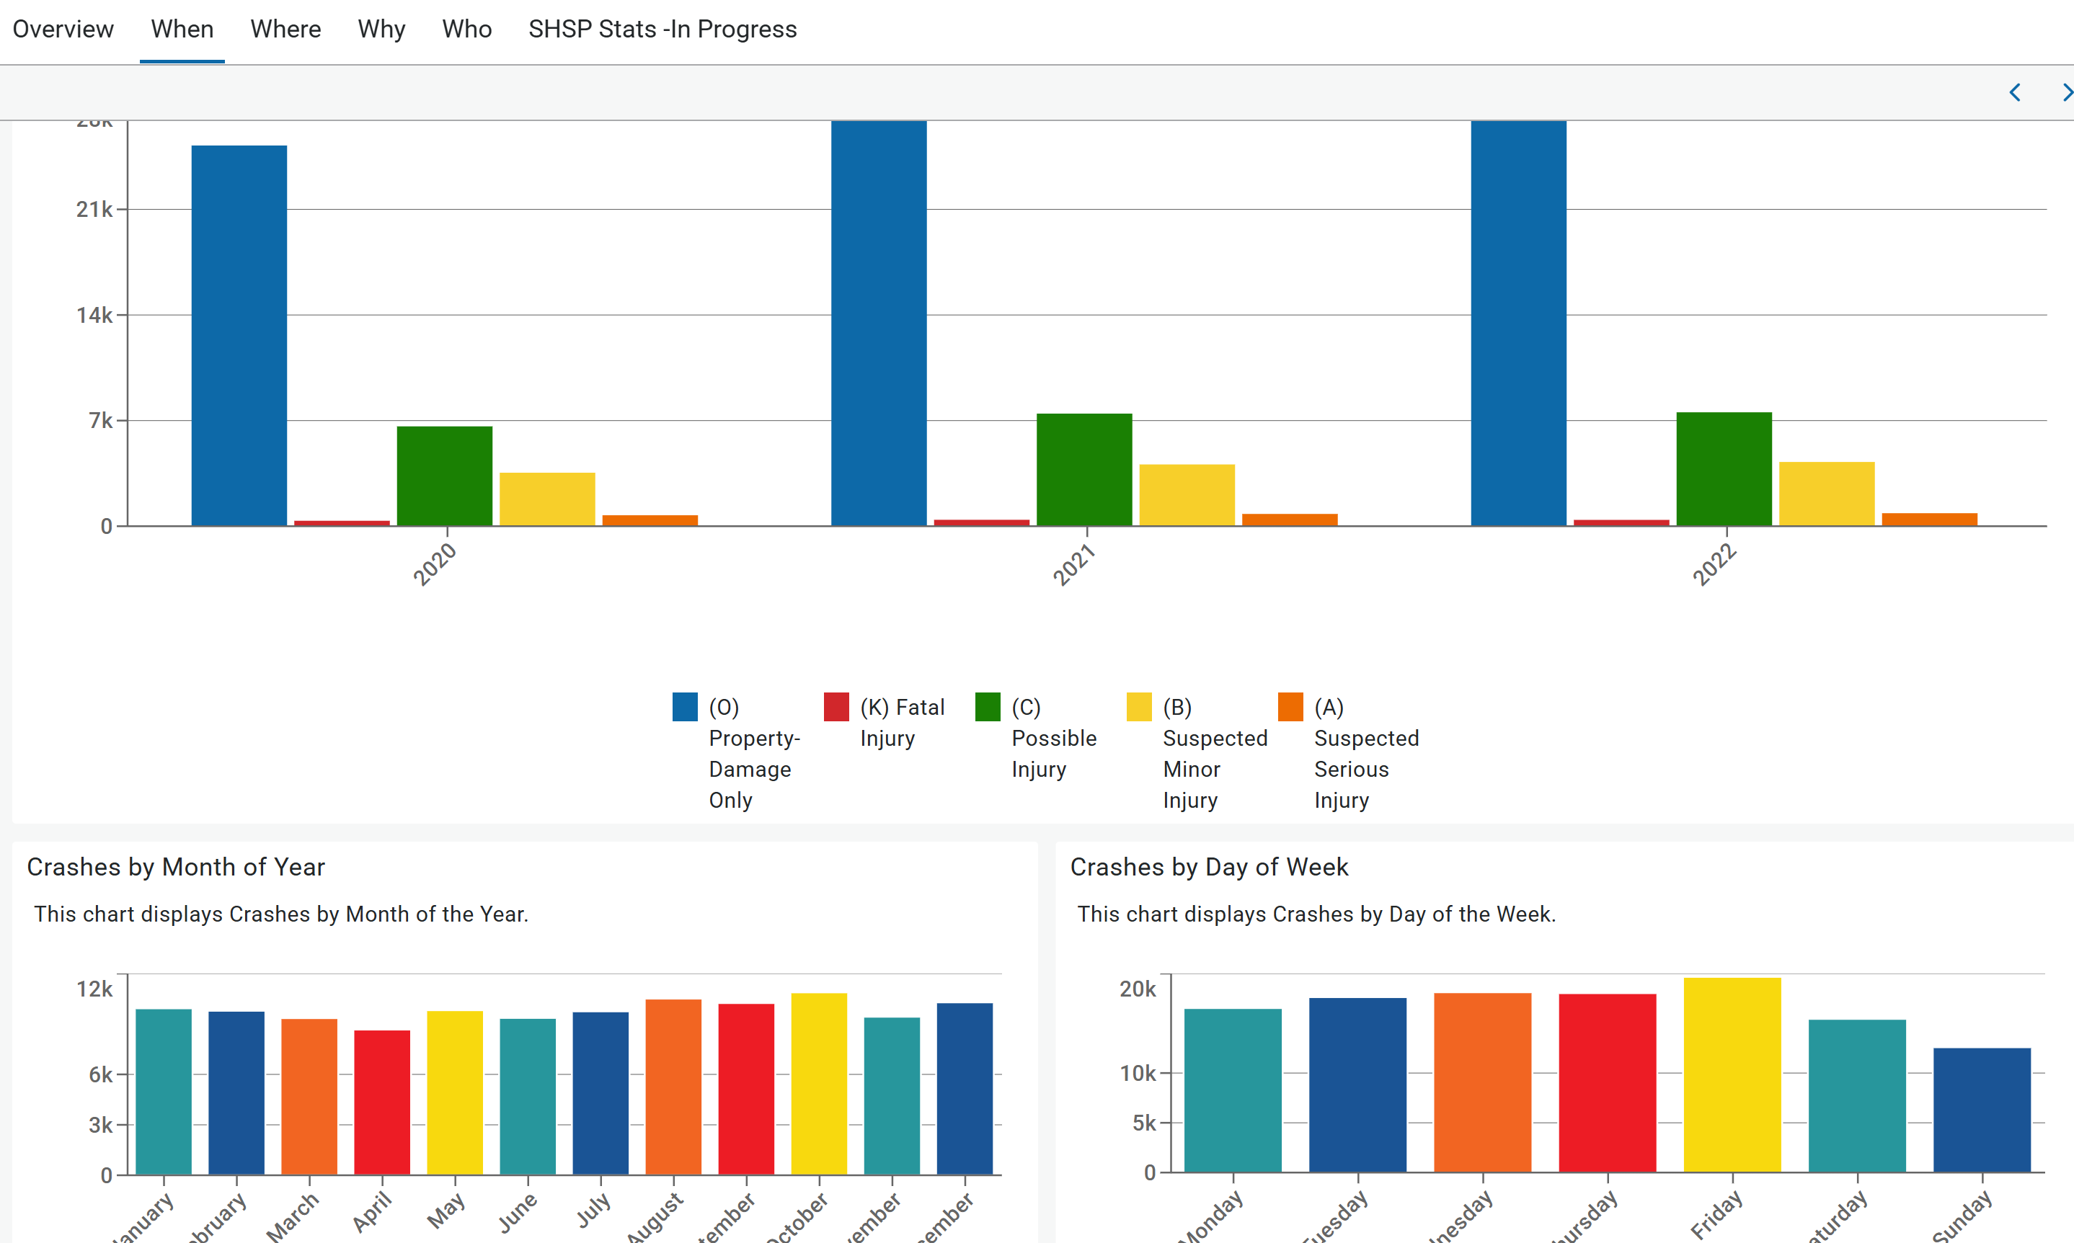
NMDOT SHSP Dashboards

Slide 7
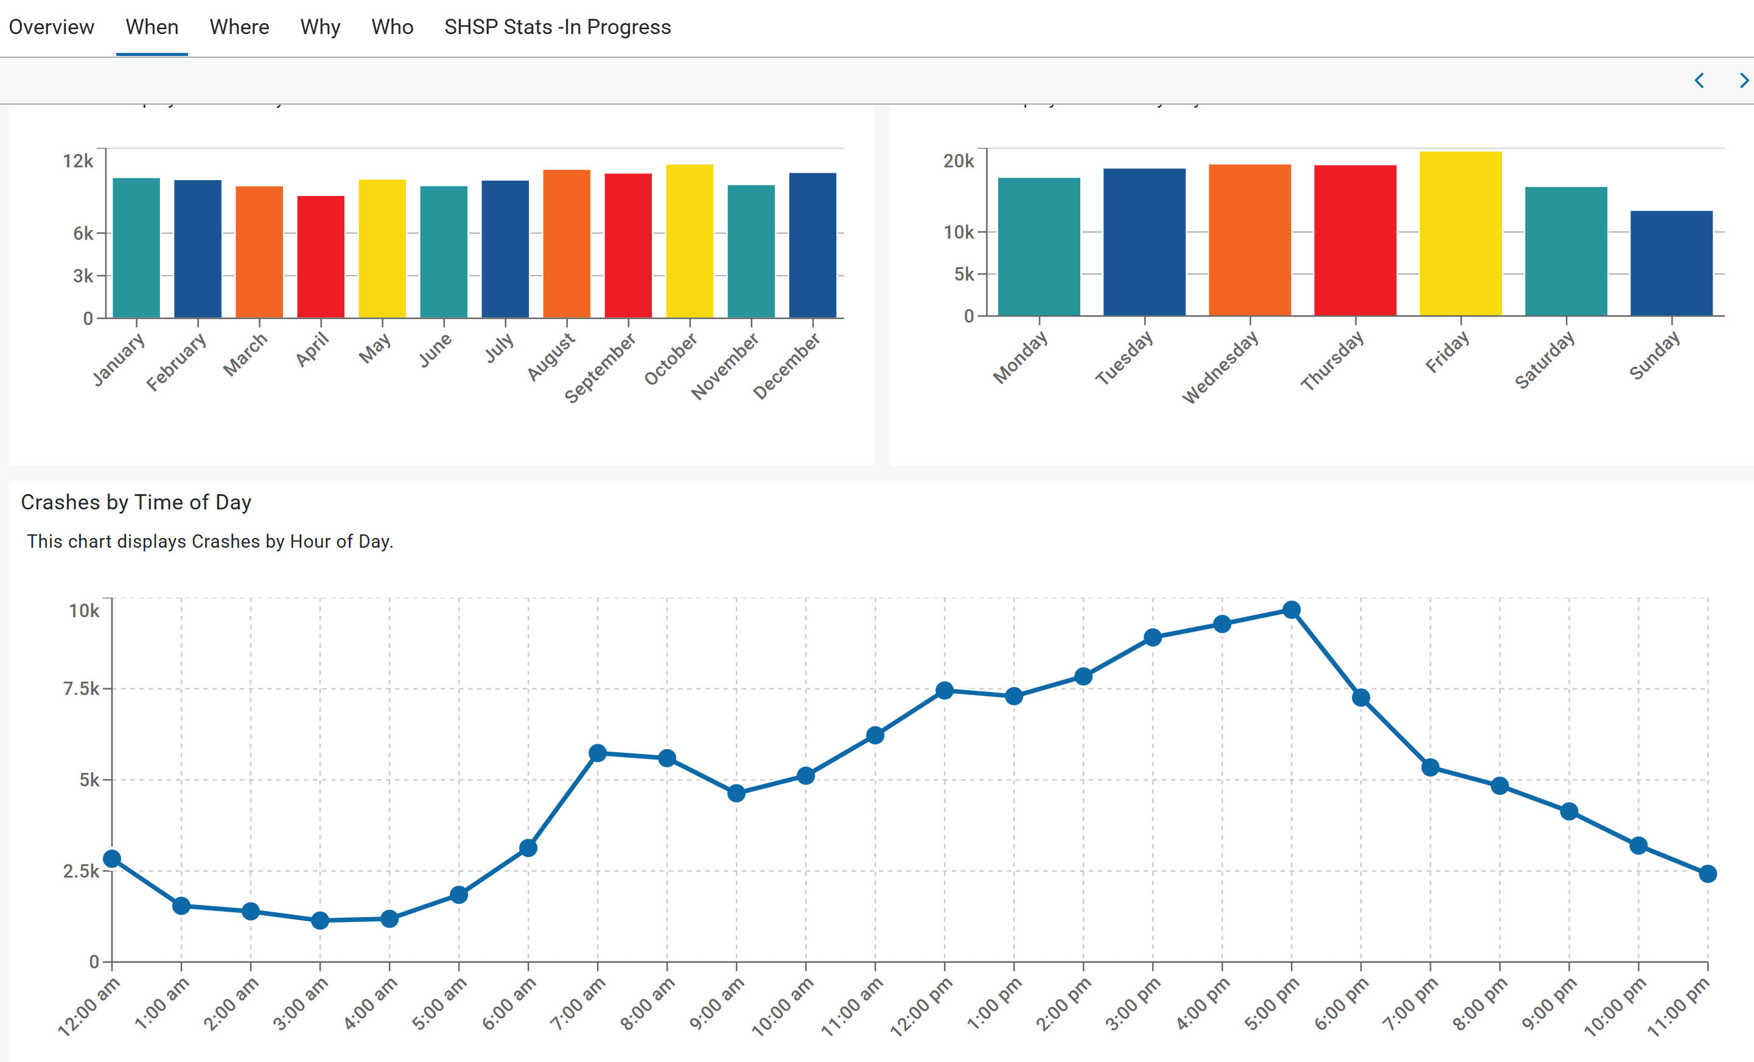
NMDOT SHSP Dashboards

Slide 8
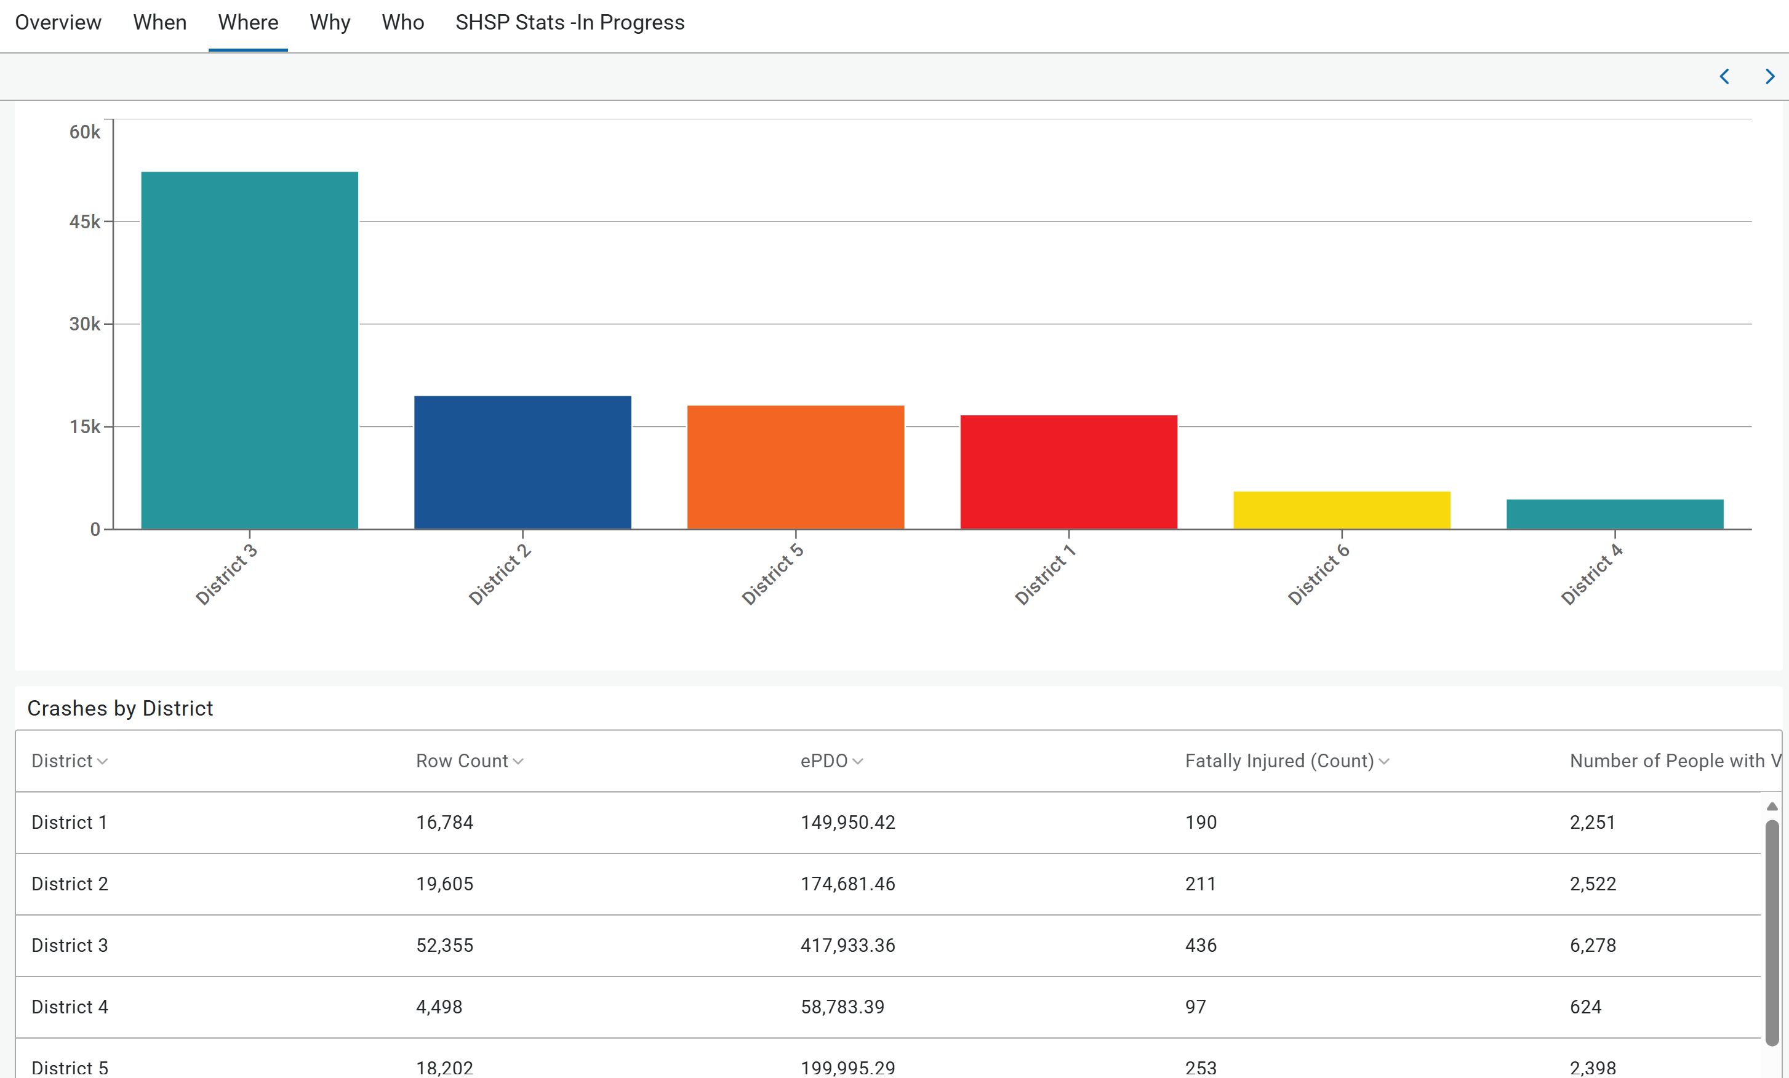
NMDOT SHSP Dashboards

Slide 9
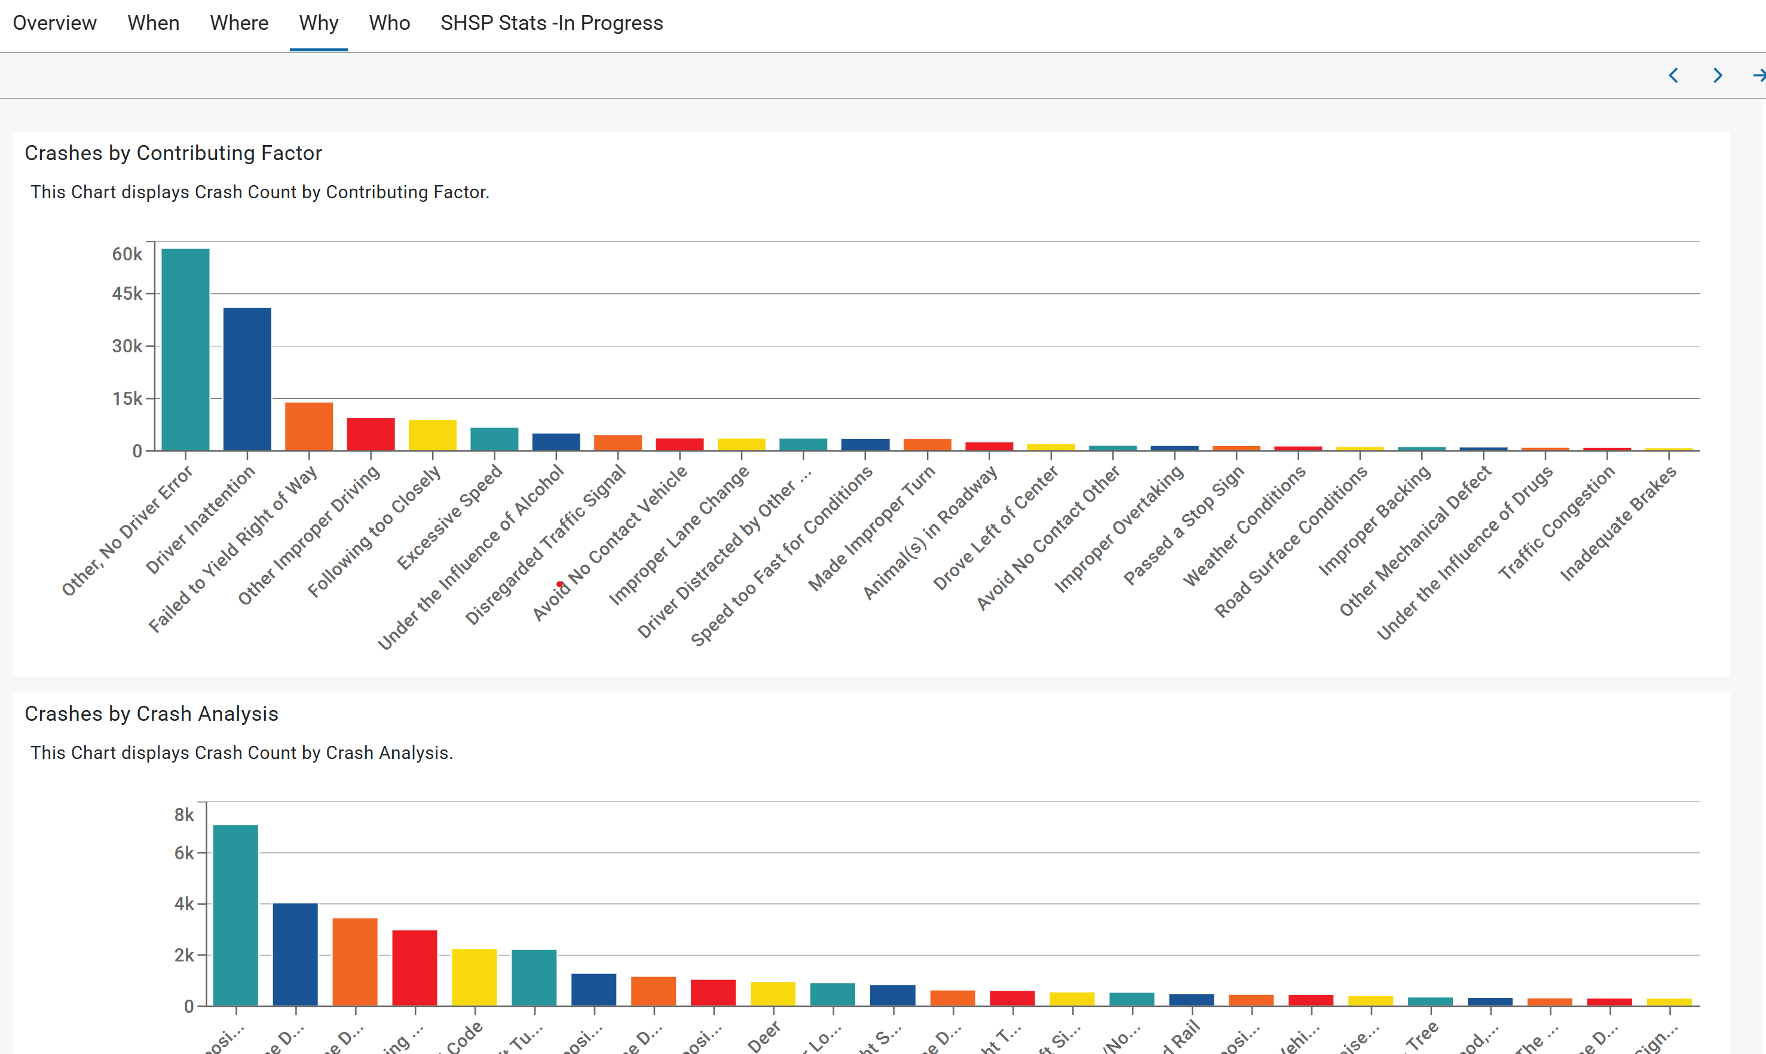
NMDOT SHSP Dashboards

Slide 10
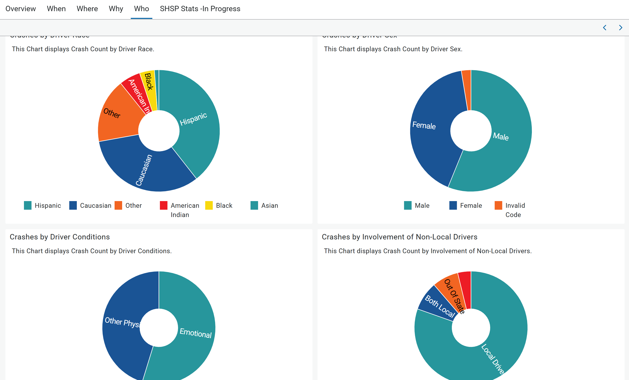
NMDOT SHSP Dashboards

Slide 11
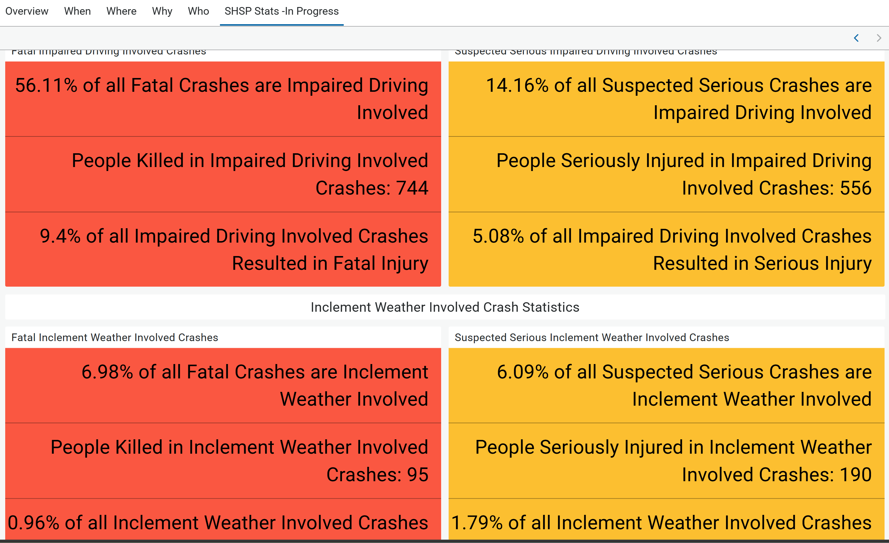
NMDOT SHSP Dashboards

Slide 12
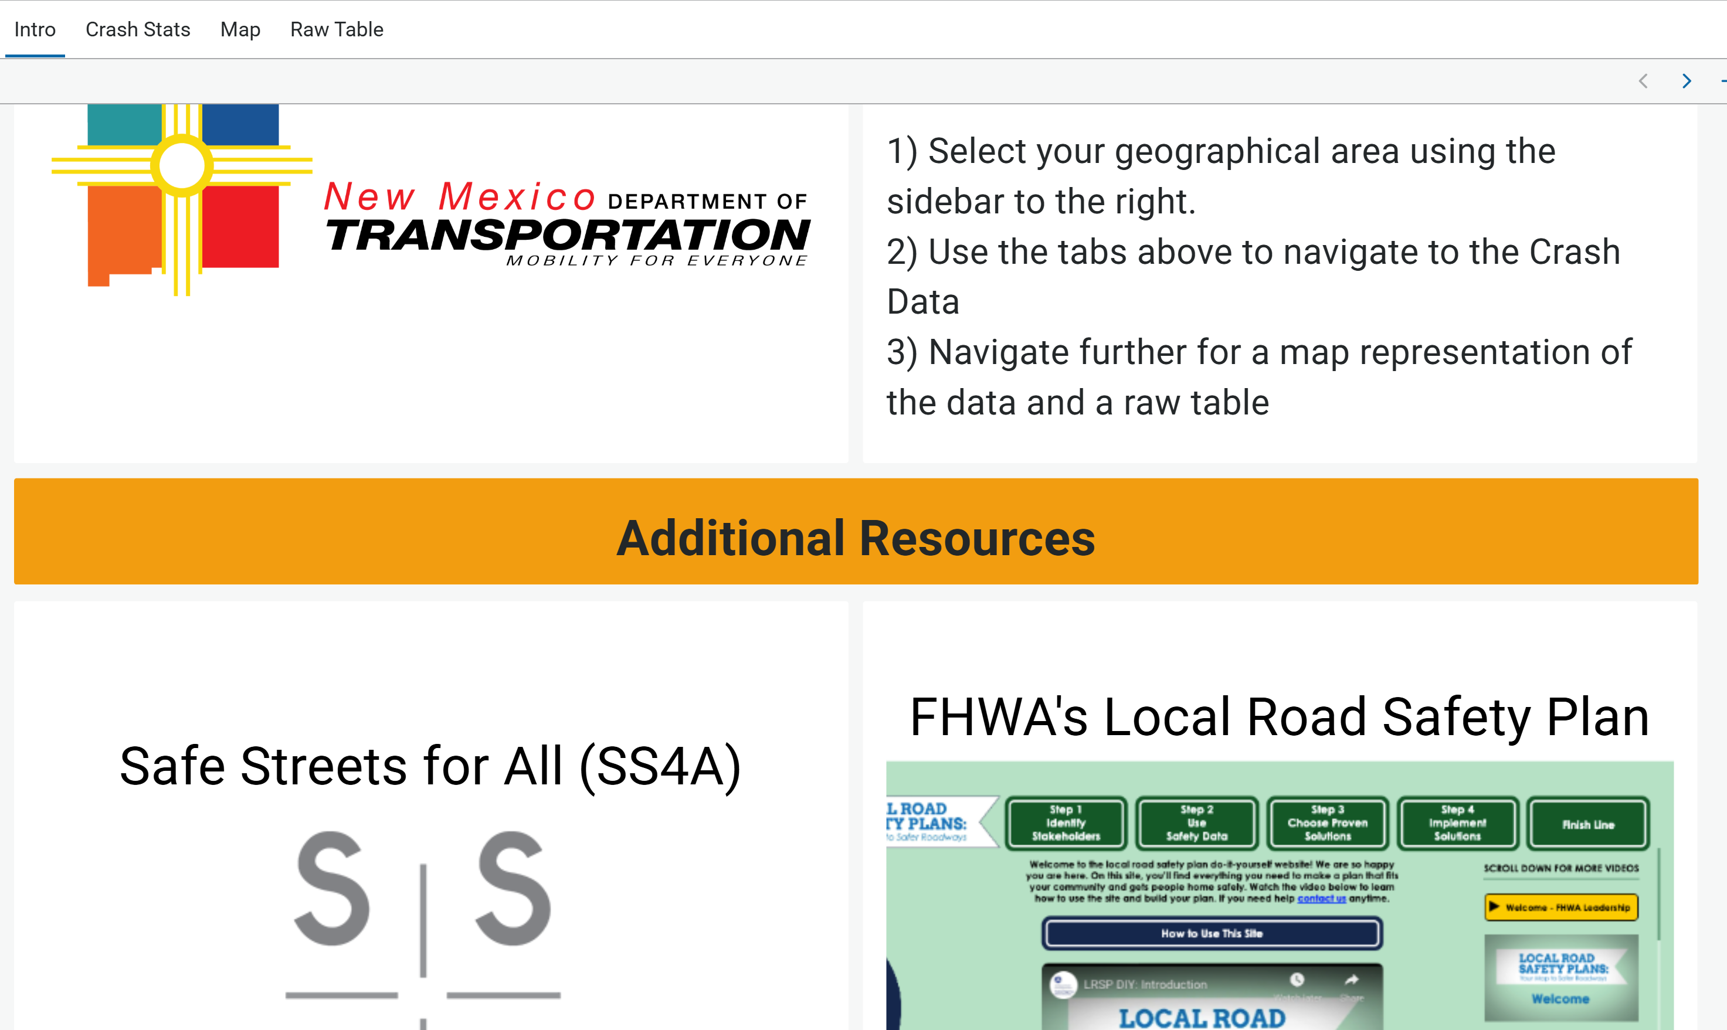
NMDOT LRSP Dashboards

Slide 13
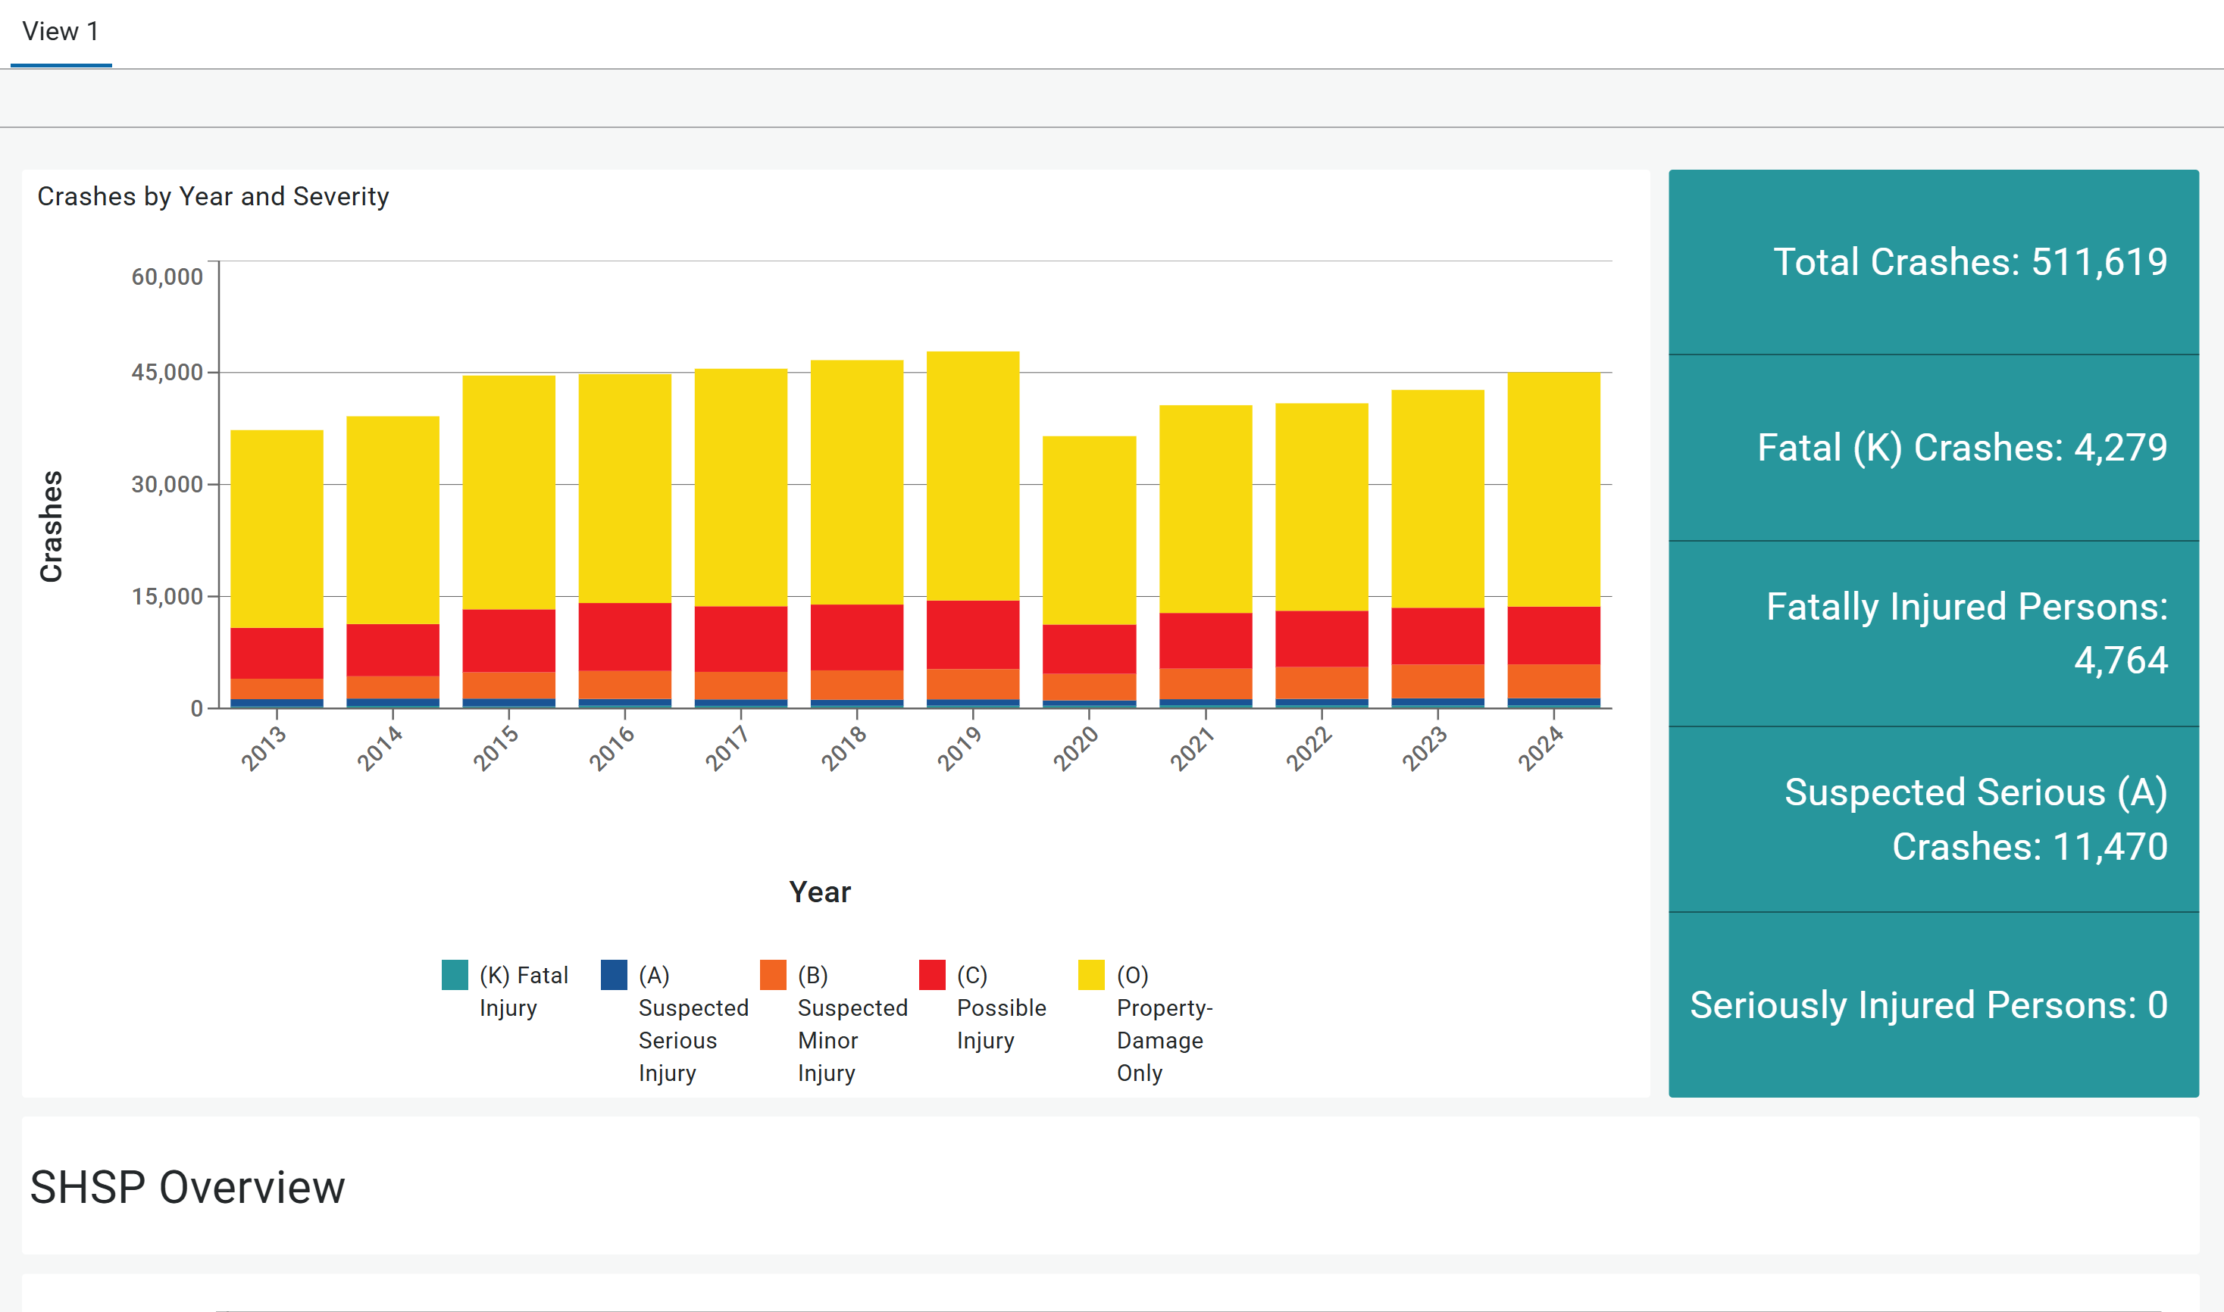
NMDOT LRSP Dashboards

Slide 14
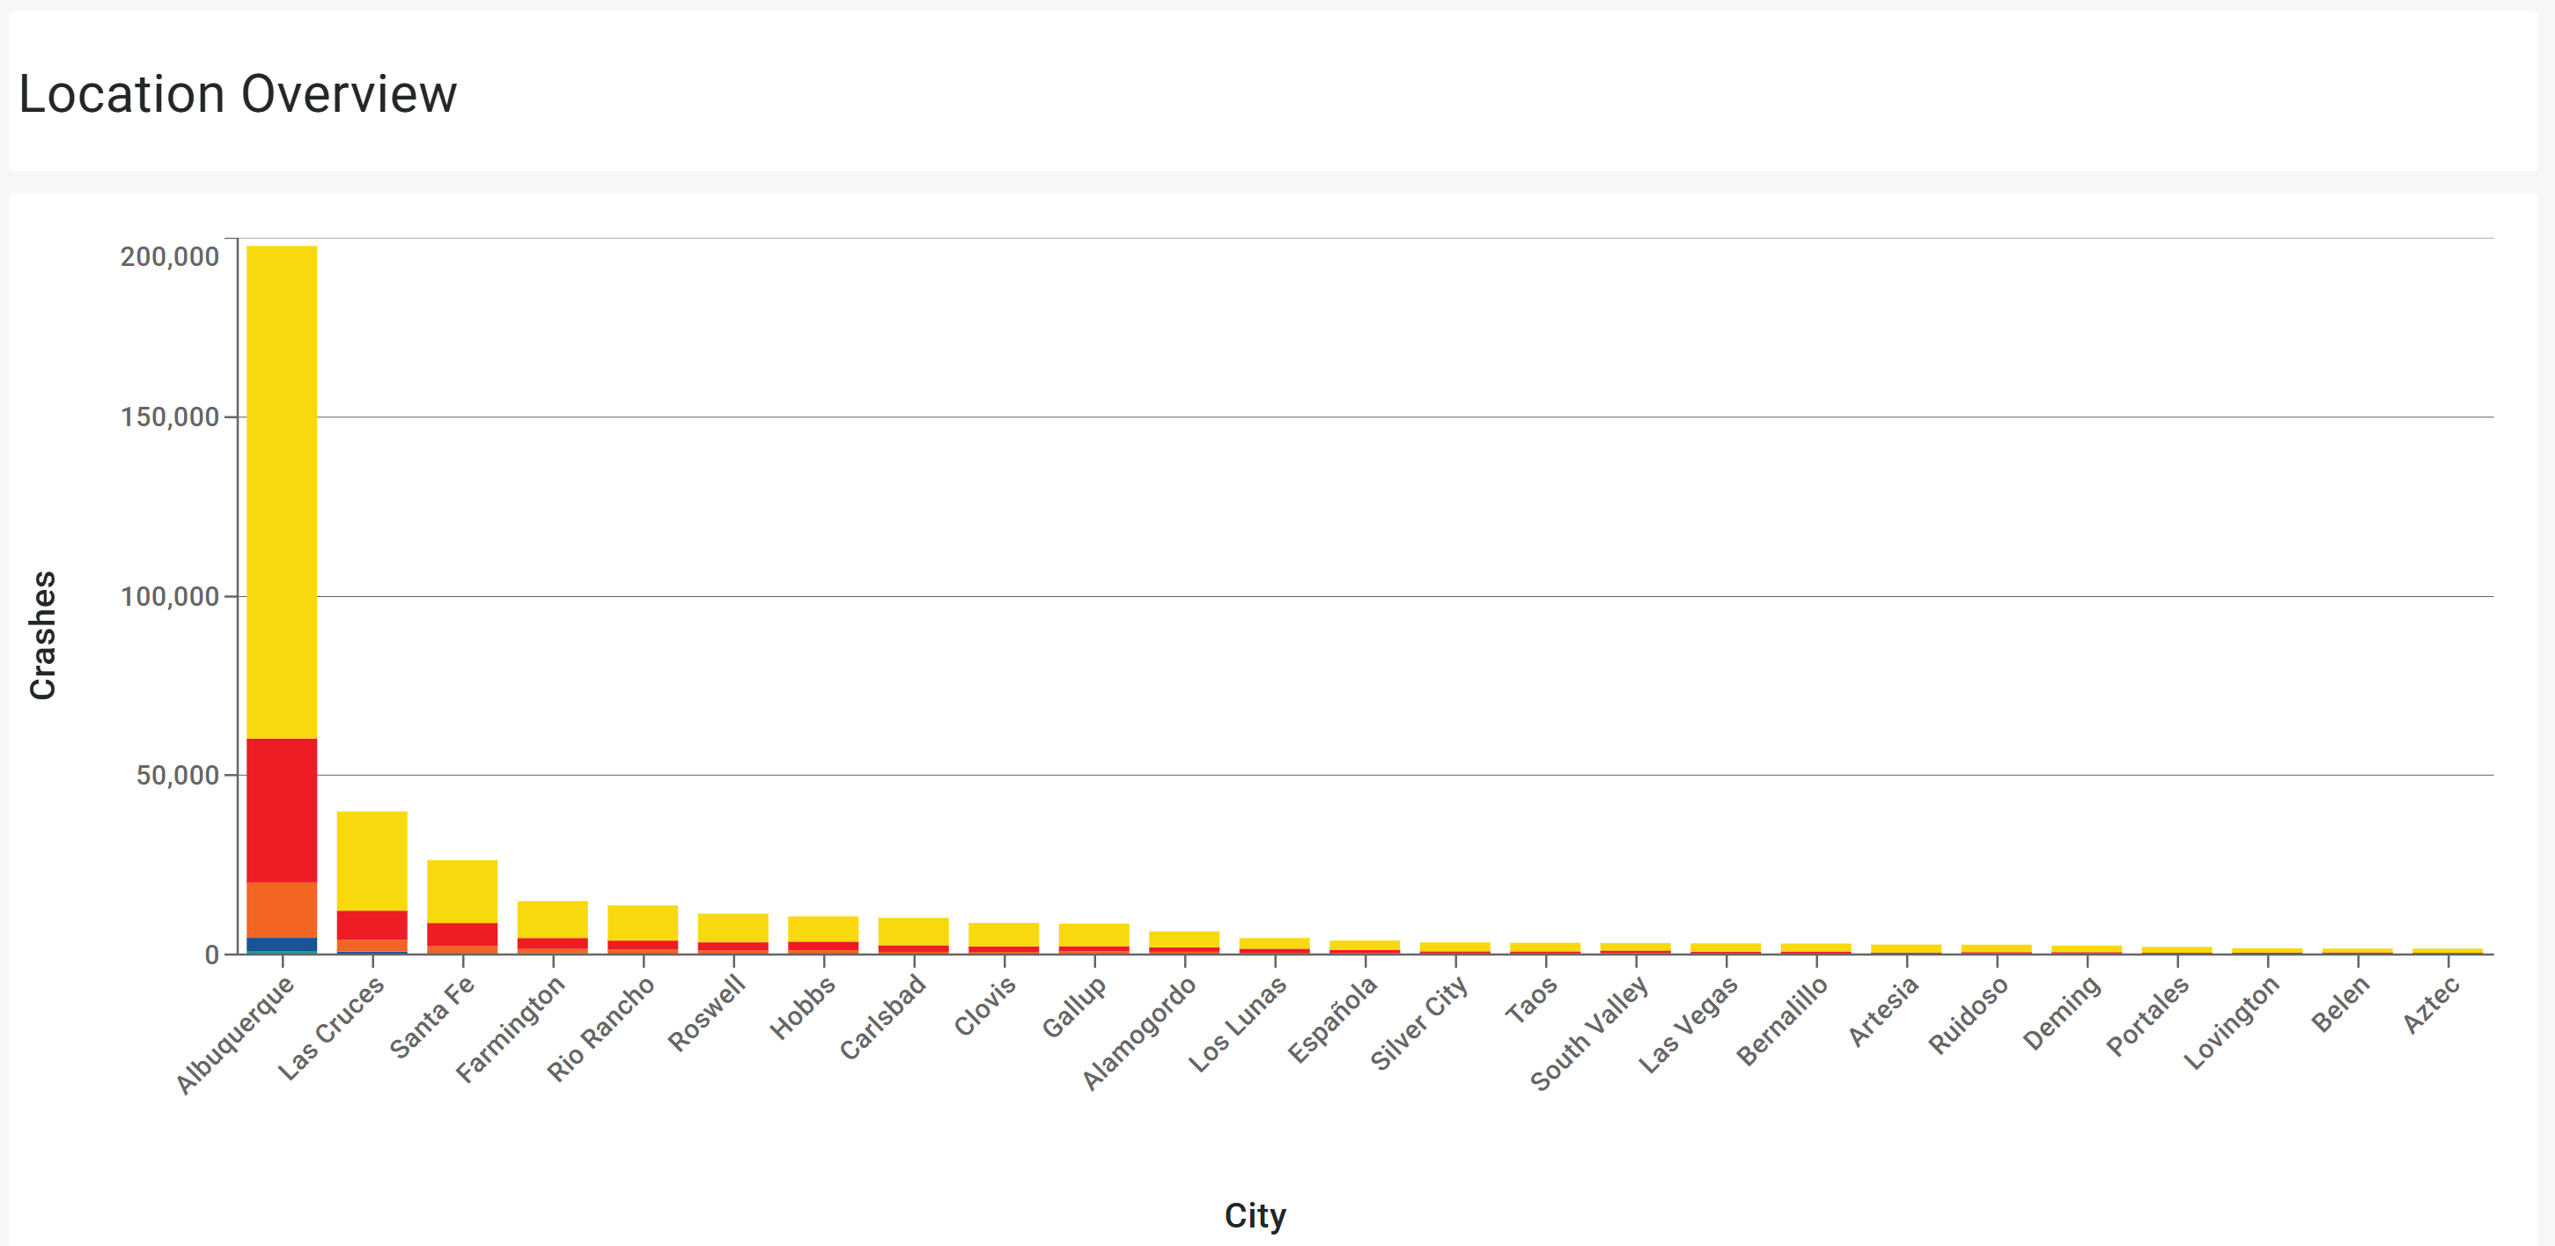
NMDOT LRSP Dashboards

Slide 15
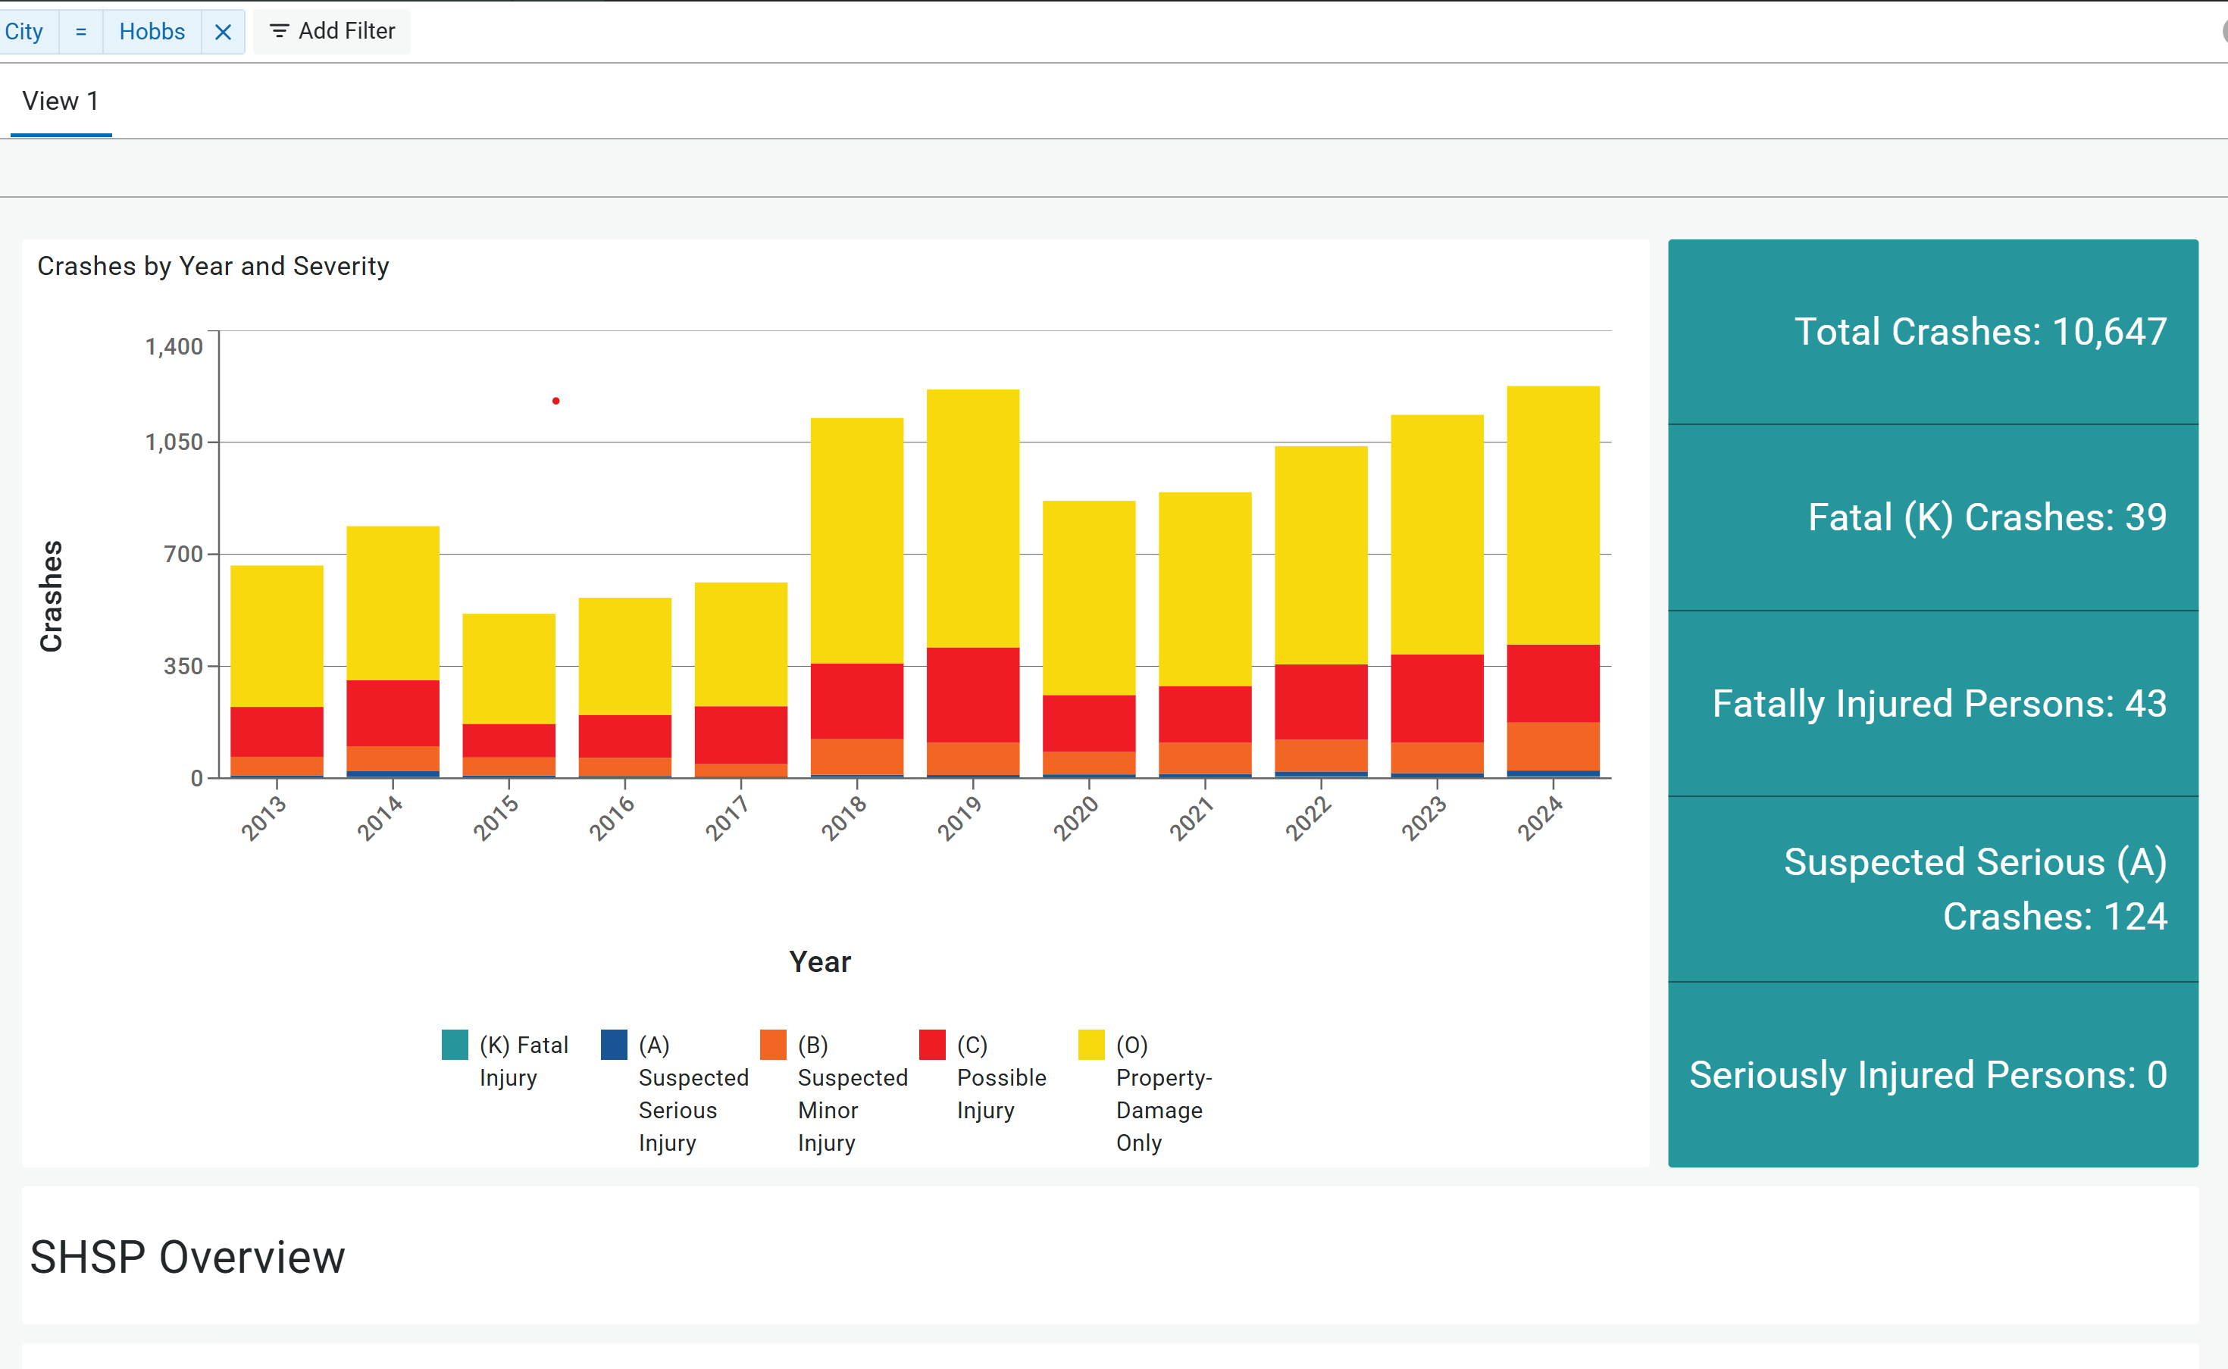
NMDOT LRSP Dashboards

Slide 16
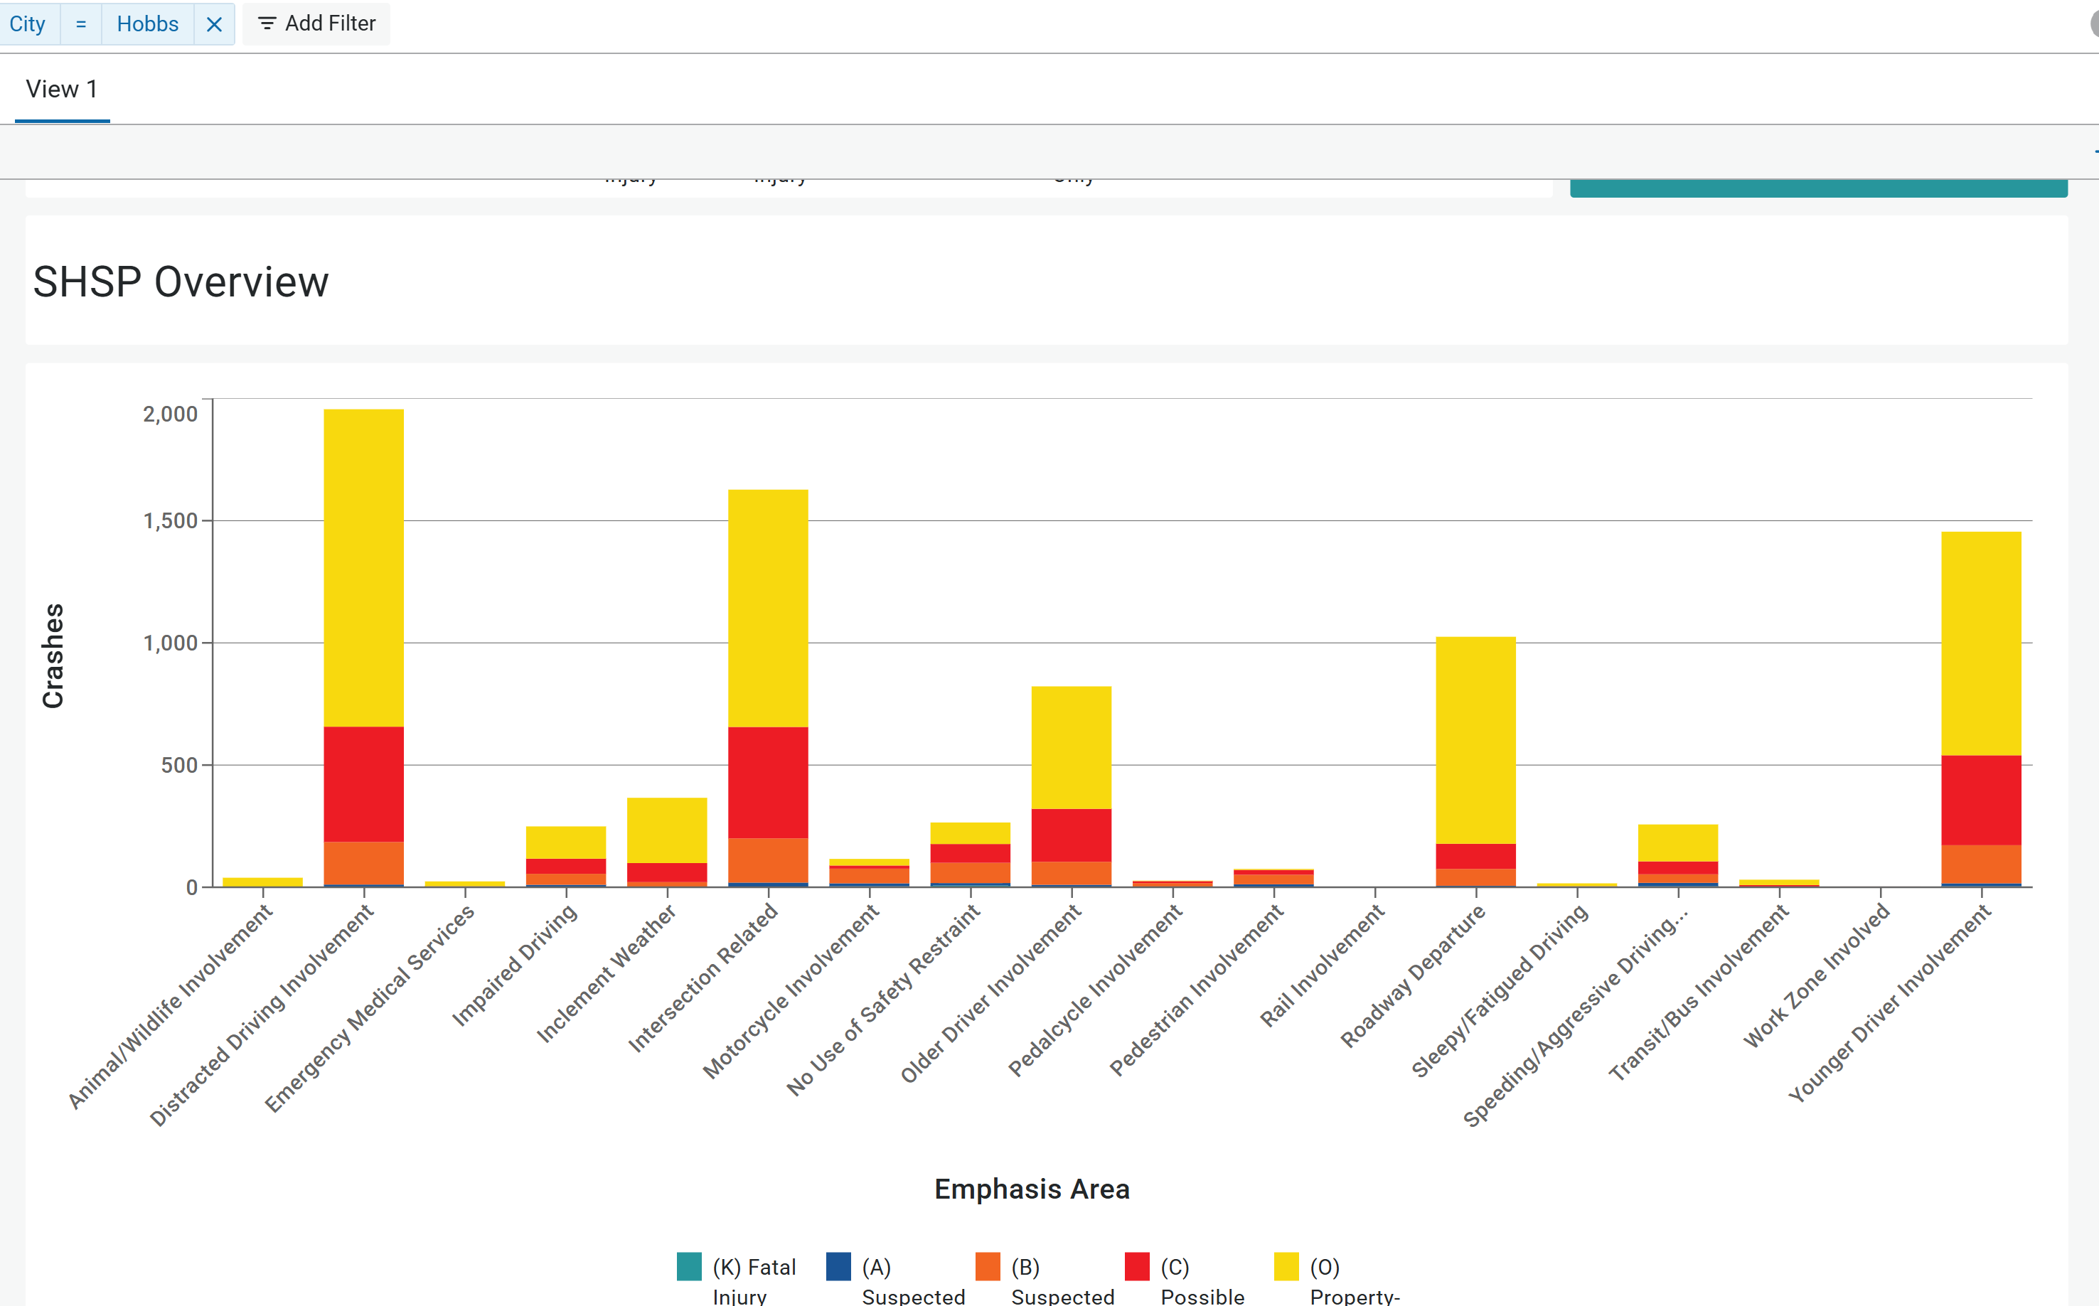
NMDOT LRSP Dashboards

Slide 17
NMDOT Future Dashboards
Speed Camera Locations
Two Way to Four Way Stop Conversions
Work Zones
Centerline & Edge Line Rumble Strips
Horizontal Curve Delineation
RSA Before & After
Retroreflective Backplates
Leading Pedestrian Indicators

Slide 18
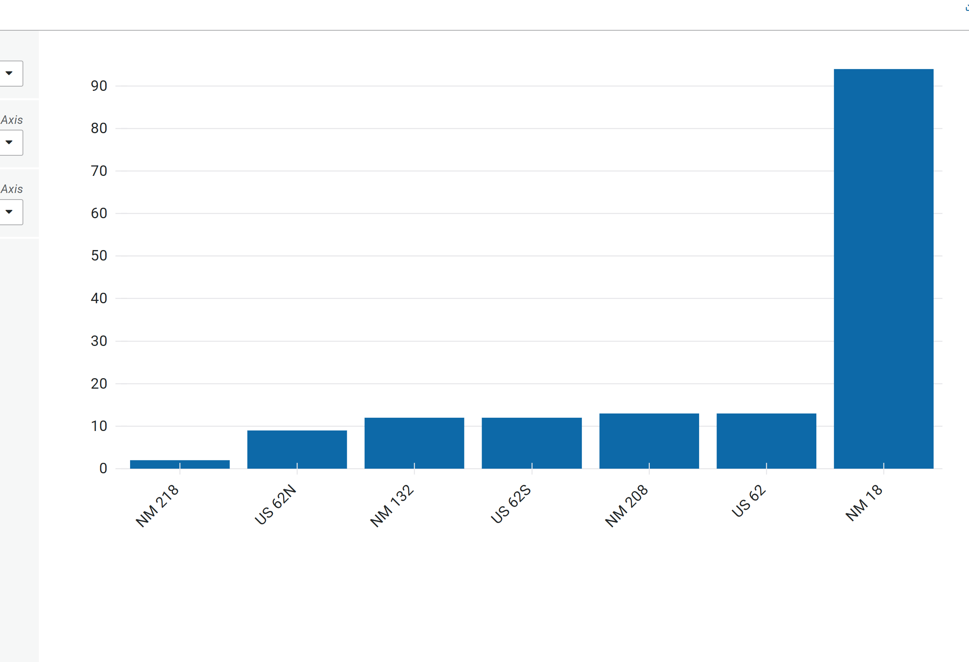
NMDOT Future Dashboards

