Slide 1
Wisconsin’s Executive Business Review (EBR) meeting strategy, goals and successes
Dan Brugman
Matthew Johnson-Gast
State Safety Engineer – Improvement Program
Highway Safety Improvement Program Manager
AASHTOWare Safety User Experience Committee Meeting
September 9, 2026

Slide 2


What is an EBR?
Annual meeting between licensed state, Numetric and AASHTO Staff
Typical agenda
  Introductions
  AASHTOWare Safety overview
  State Successes, Challenges and Usage
  Next Steps / Goals
  Upcoming Product Development

Slide 3
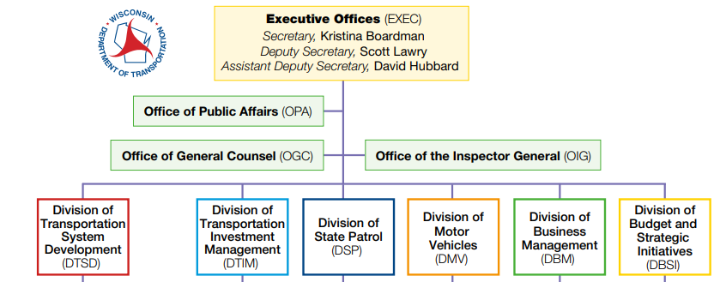
WisDOT’s Approach
Region Safety Engineers
Safety Engineering
Policies, Processes
HSIP
Funding policy, Federal reporting
Behavioral Safety & Enforcement
Crash Records, FARS reporting, etc.
Research and Initiatives
Research Program

Slide 4
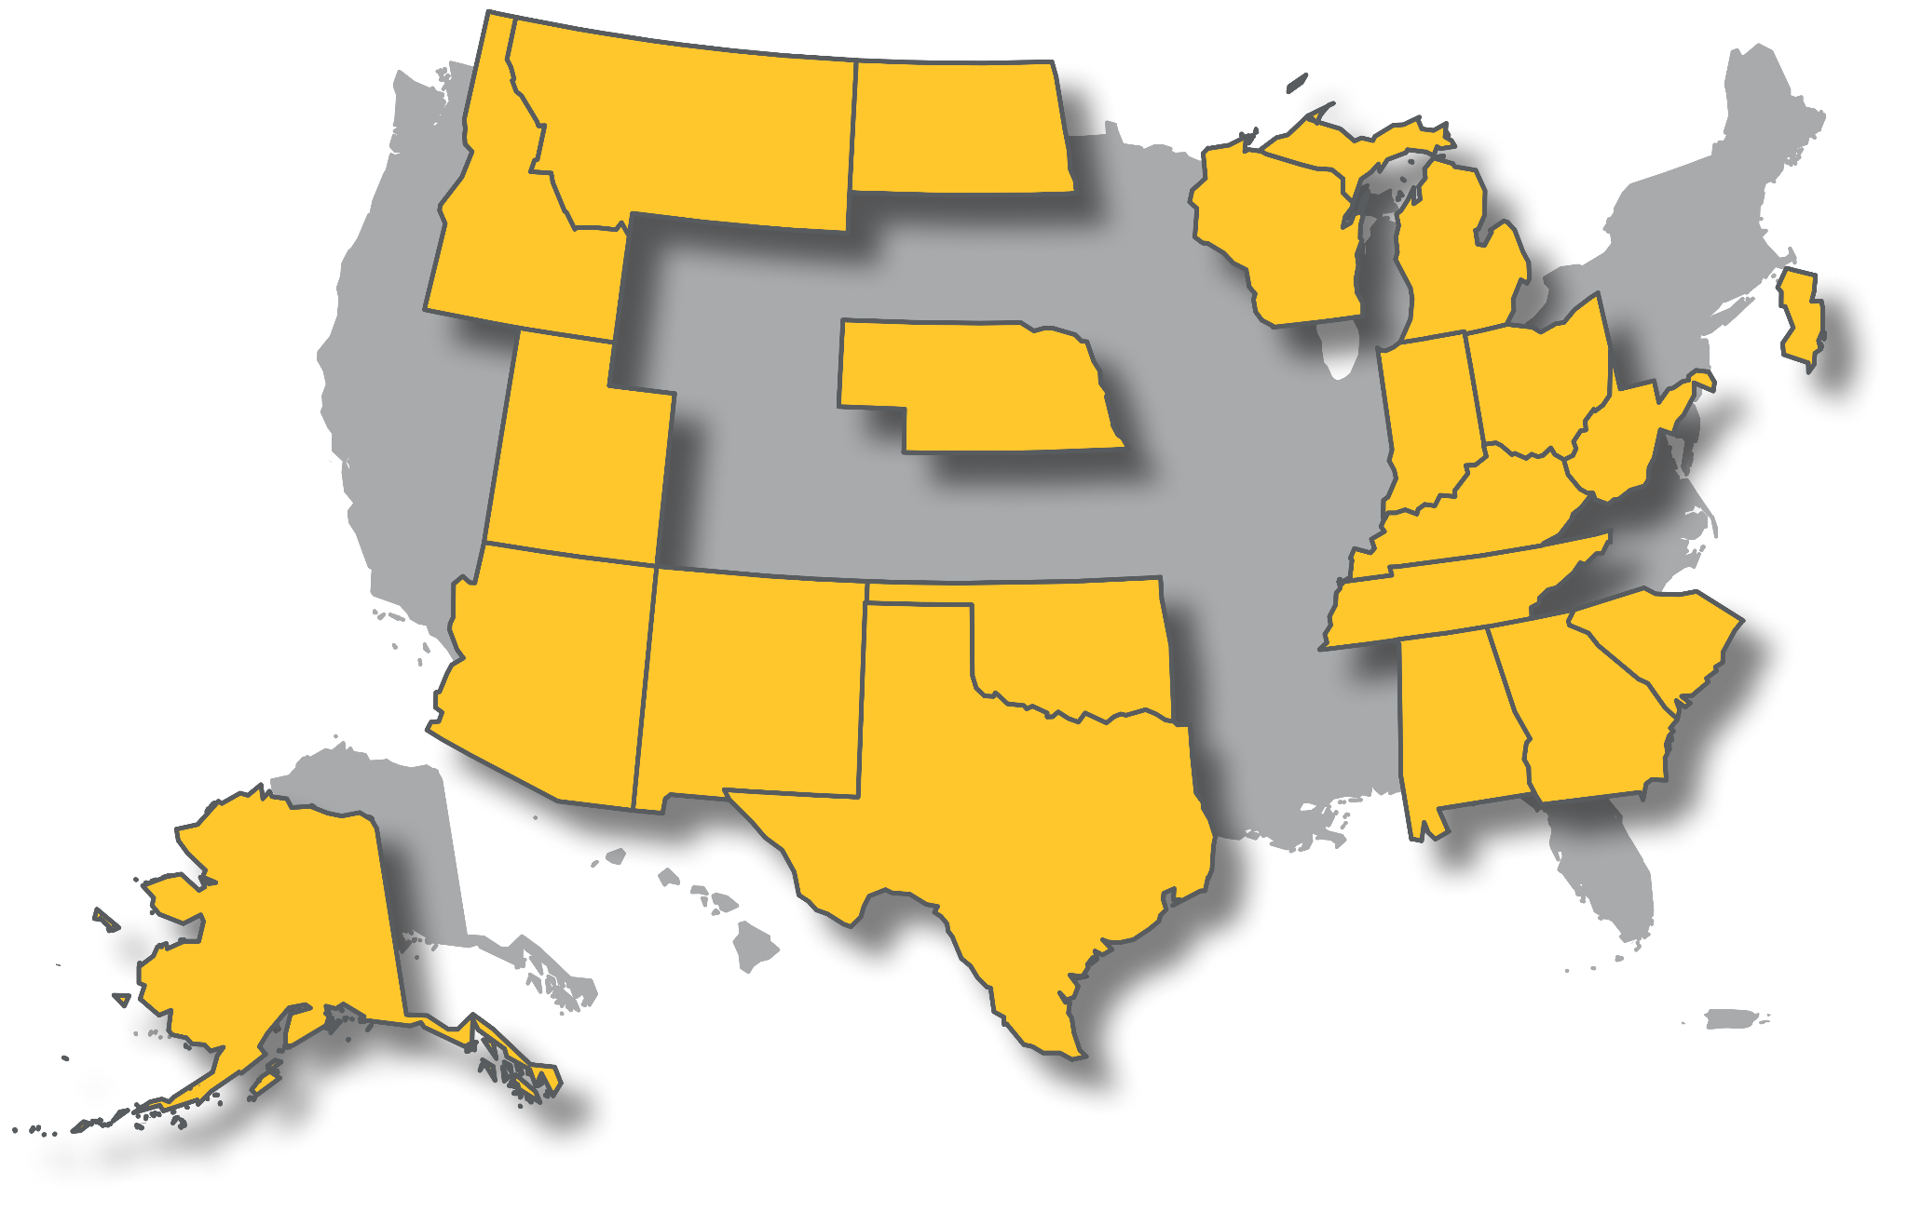

WisDOT’s Approach
Invited Division Administrator, Bureau Management and staff
  Planning to bring in other divisions in future meetings
Wanted to highlight Division initiatives and concerns
  Implementation of the Highway Safety Manual and using performance-based practical design
  Are we the only agency using it?
  “Gaining Efficiency through growing consistency”
  Collaboration
  Training newer staff

Slide 5
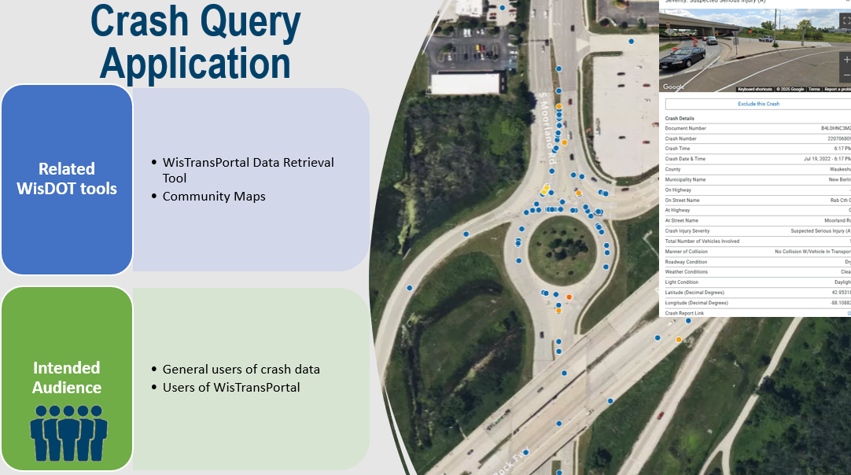
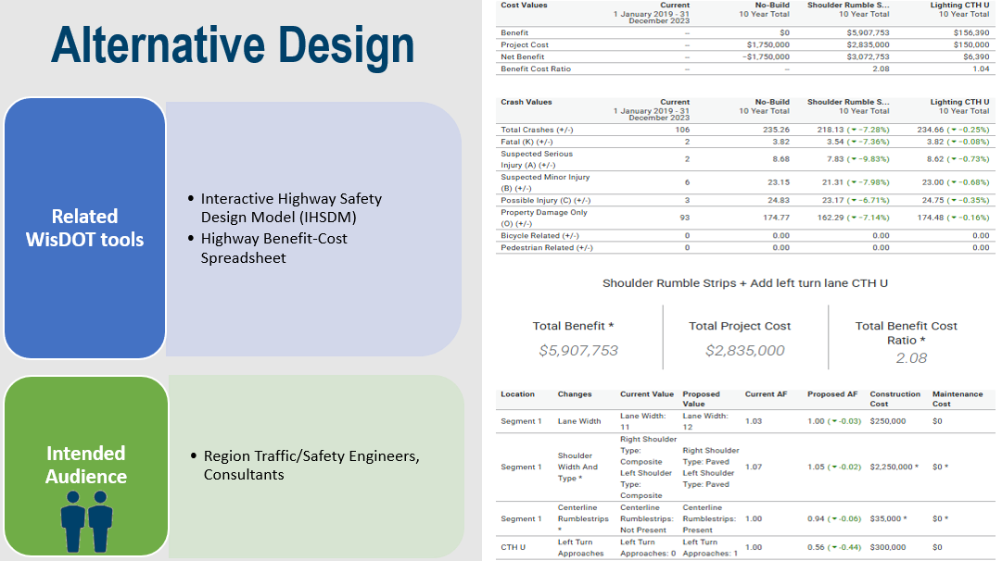
WisDOT’s Approach
WisDOT-led discussion
  Reinforced background of purchase
  How AASHTOWare fit within safety engineering program goals
  Provided an overview of the applications and intended audiences
  Training Overview
    Licensing agreement
    How it fits with WisDOT training program
    # of users trained
AASHTO/Numetric-led discussion
  What AASHTOWare is, who Numetric is
  Product background
  # of users, access
  Product roadmap and ties to goals

Slide 6

WisDOT’s Approach
Highlighted key benefits:
  Organization-wide, Central office and End Users (Region/External)
    Web-based and accessible
    Encourages collaboration and consistent application of safety processes
    Unlimited licenses
    Dedicated software team continuously working on updates
    More regular training
    Supported by AASHTO - Gain knowledge and experience from other states
    Allows automatic annual updates without use of consultant resources
    Provides readily accessible how-to-use guides on the tools
    More reliable/predictable updates to tools & crash data used for projects

Slide 7
WisDOT’s Goals
Outlined short to long-term goals
  Continue to onboard/implement Alternative Design to replace IHSDM
  Identify local agencies to pilot use cases to support local road safety needs
  Develop dashboards to support needs (Intersection & Roadway Trends, SHSP Update)
  Prepare for Linear Reference System Update (2028+)
  Investigate ways to incorporate more refined bicycle/pedestrian screening data and telematics data
  Continue to coordinate with other divisions on data integration and use cases
    Local program uses, HSIP support

Slide 8
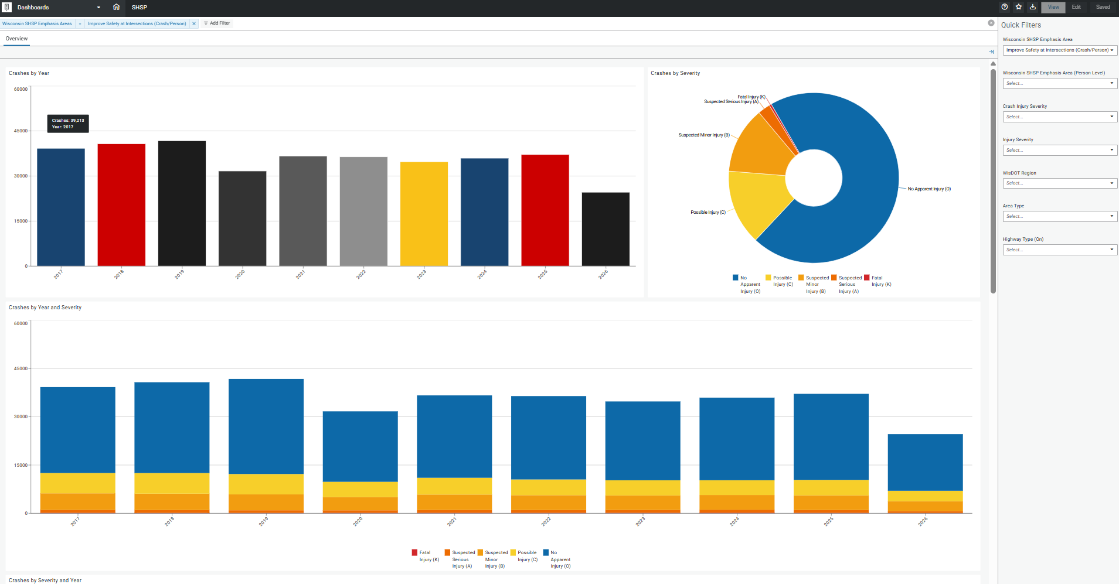
WisDOT’s Goals: SHSP
Current SHSP:
11 Emphasis Areas
  76 tasks
Lacks data visualization
Lacks implementation
Current dashboard:
Used for HSIP reporting
Crash and person level

Slide 9
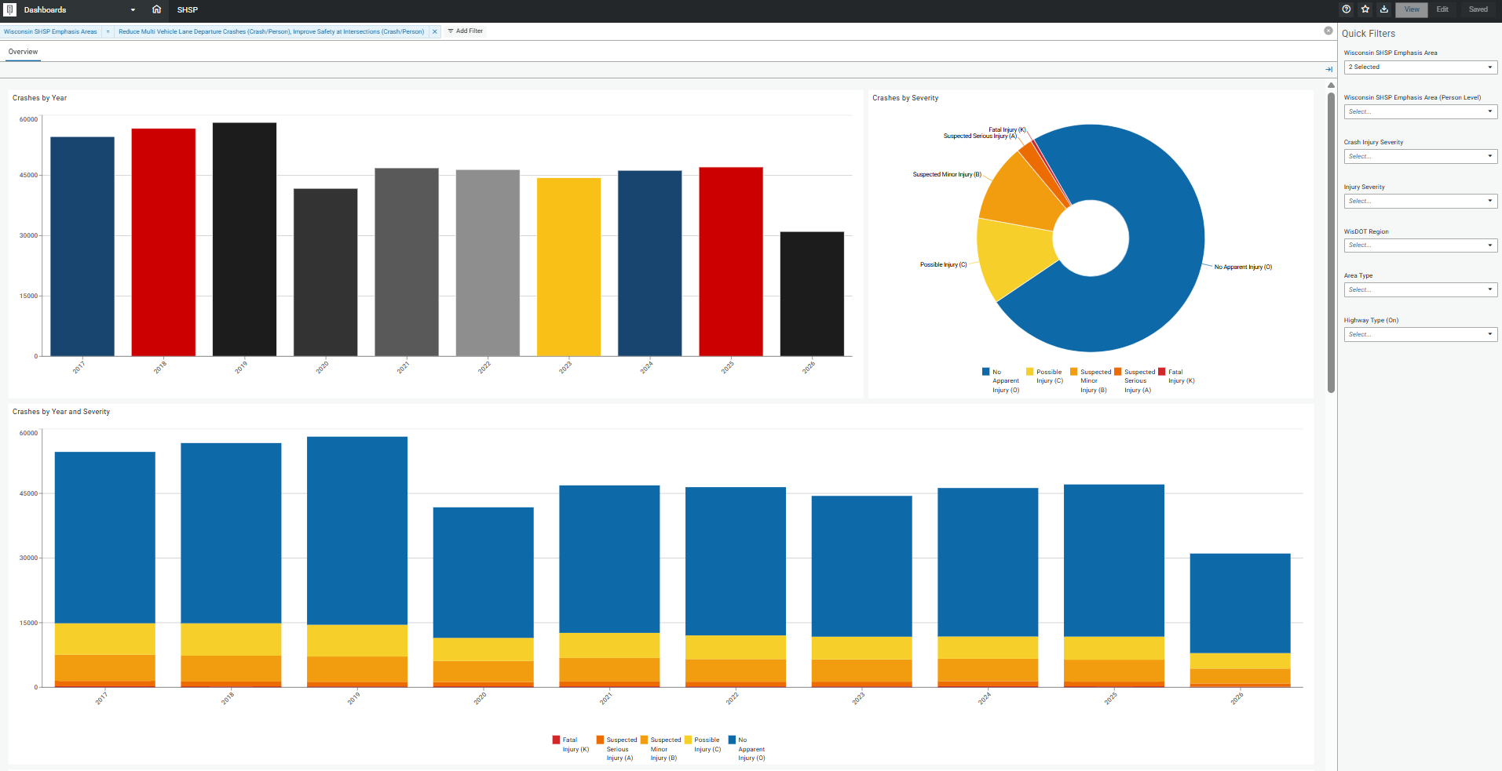
WisDOT’s Goals: SHSP
SHSP Update:
12 Emphasis Areas (EAs)
New dashboards
  Compare EAs
  Support implementation
    Utilize reporting function
  Gauge performance
  over SHSP lifecycle

