Slide 1
Network Screening with I_{CC} and I_{CF}
David Reed & Mark Muenz, P.E.

Slide 2
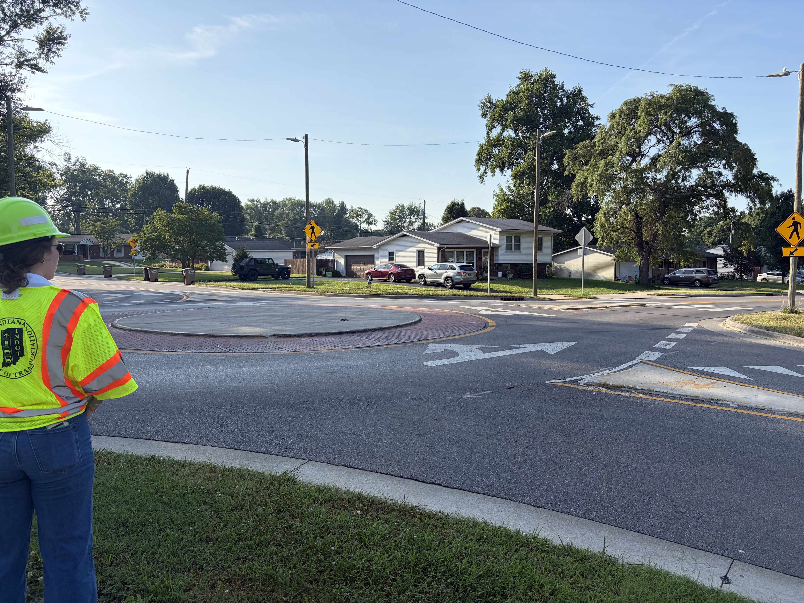
An Introduction

Slide 3
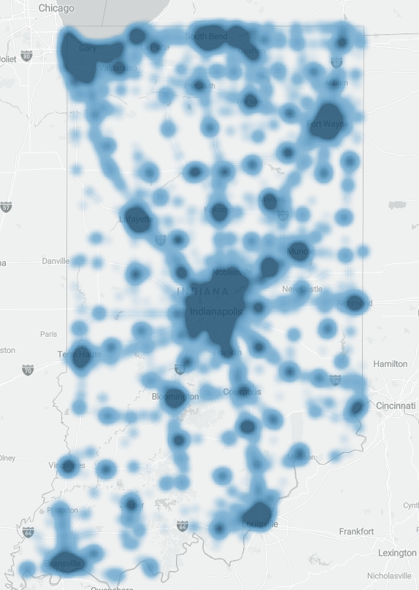
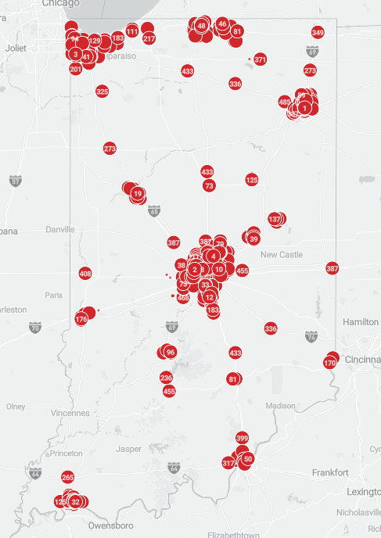
Notes:
Where do we start?

Slide 4
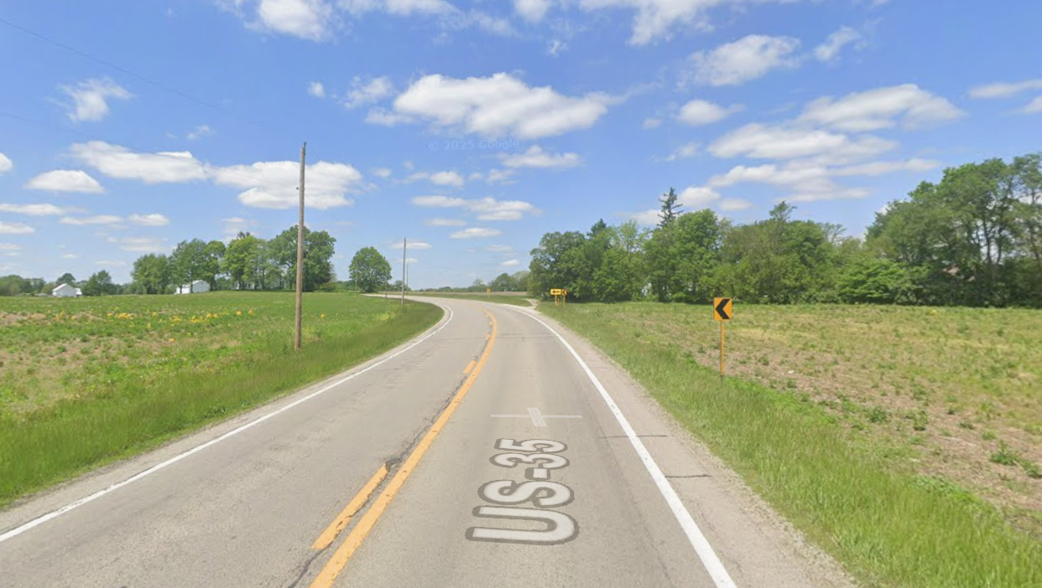
>11,000 State Centerline Miles
>20,000 State Intersections
>128,000,000 State VMT/Day
Limited Time
Limited Staff
Limited Money
Where should we look?

Slide 5
Priorities

Slide 6
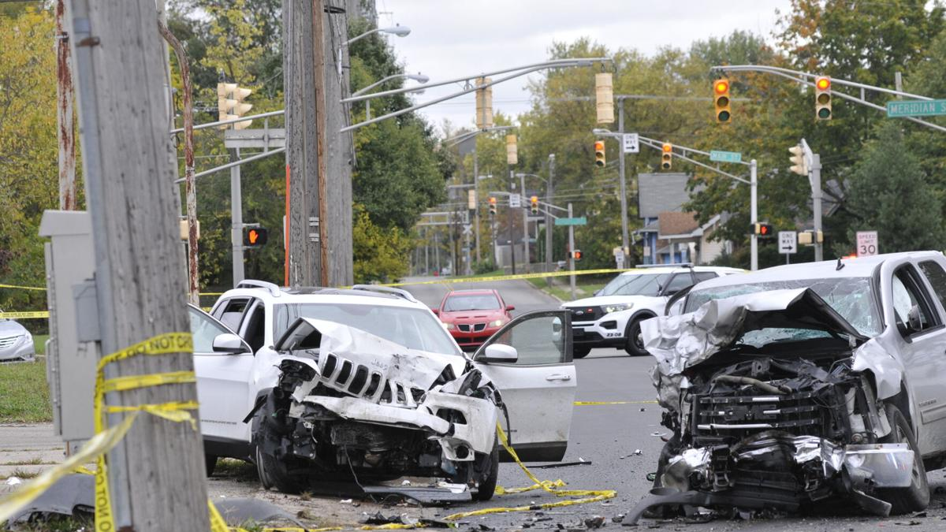
Someone is killed or seriously injured in a crash in Indiana every 93 minutes (2024)
$21.5 Billion
Cost to Indiana (2023)
in Medical Bills, Property Damage & Lost Wages (FHWA Crash Costs, Preliminary)
Notes:
- During this presentation, one person will be killed or seriously injured by a motor vehicle in Indiana. 31 During this conference on average.
- The governor signed the SHSP which states that Deaths and Serious Injuries due to car crashes are unacceptable in Indiana

Slide 7
Indiana Safety Performance
Great Recession & Recovery
Covid-19
843
Goal
2025 is Estimated Value
16,812 Hoosiers Killed by Motor Vehicles Over 20 years
Notes:
What PERFORMANCE MEASURES should we use? Quantity of crashes is too simple.

Slide 8
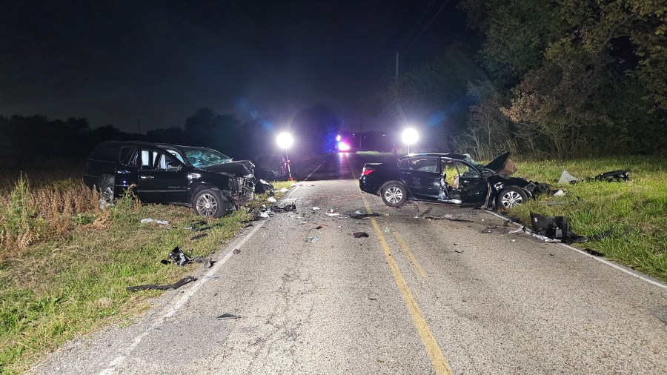
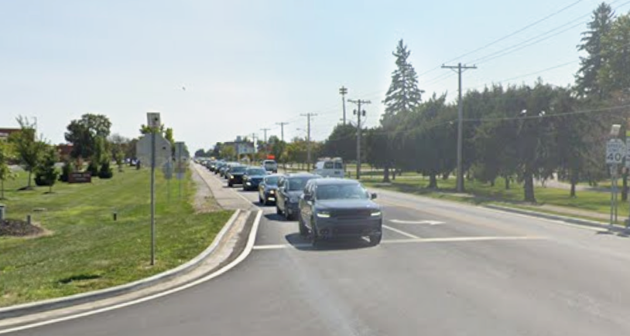
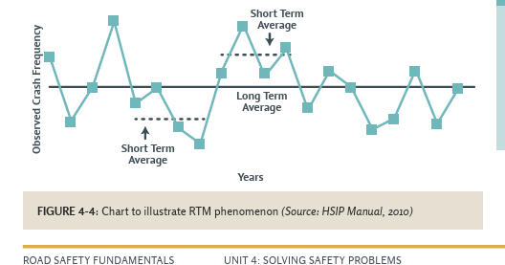
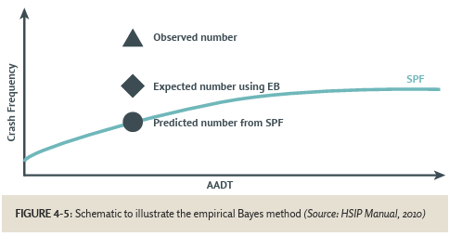
Notes:
Severity – Traffic Volume – Variance in traffic data over time (Regression to Mean) – Empirical Bayes (compares actual crashes to predicted = Expected) adjustment and Safety Performance Functions (PEER GROUPS)

Slide 9
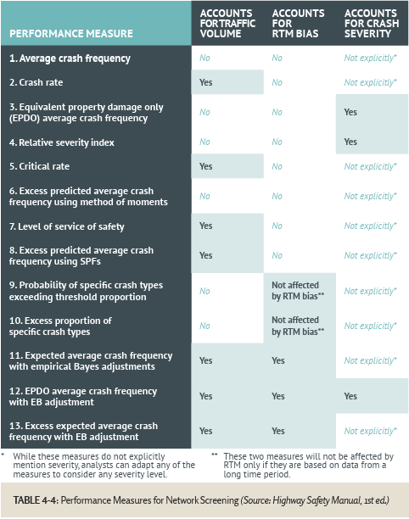
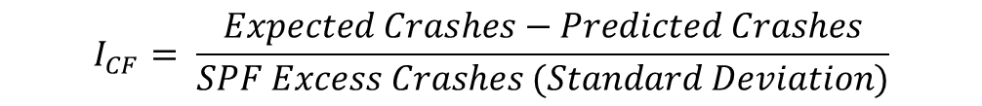

Index of Crash Cost
$$I_{CC}= \frac{Expected EPDO−Predicted EPDO}{SPF Excess EPDO (Standard Deviation)}$$
Index of Crash Frequency
$$I_{CF}= \frac{Expected Crashes−Predicted Crashes}{SPF Excess Crashes (Standard Deviation)}$$
Notes:
Add a splash of standard deviations – FHWA Road Safety Fundamentals

Slide 10
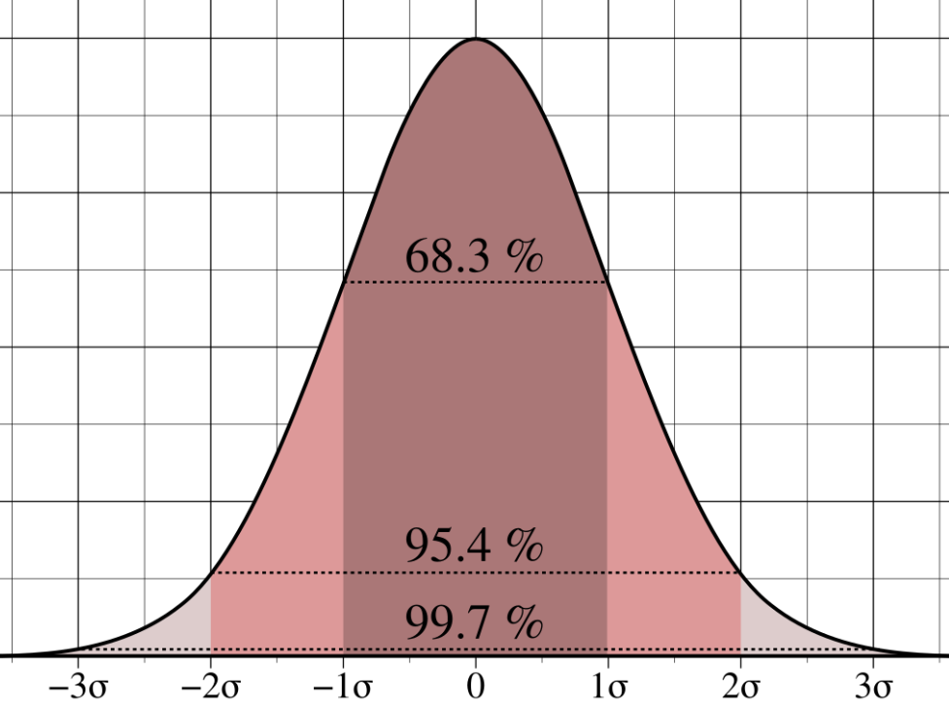
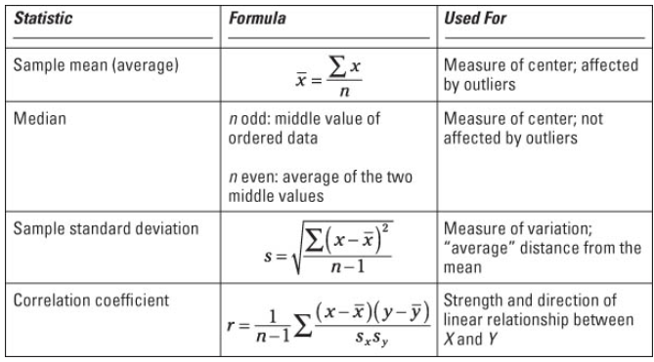


I_{CC} and I_{CF} in AASHTOWare Safety
$$I_{CC}= \frac{Expected EPDO−Predicted EPDO}{SPF Excess EPDO (Standard Deviation)}$$
$$I_{CF}= \frac{Expected Crashes−Predicted Crashes}{SPF Excess Crashes (Standard Deviation)}$$
Notes:
The good news is: you don't have to figure it all out yourself.
In the past, we have used some software developed with Purdue University, and this was great, but there were limitations and we did not have a ton of influence for changes.

Slide 11
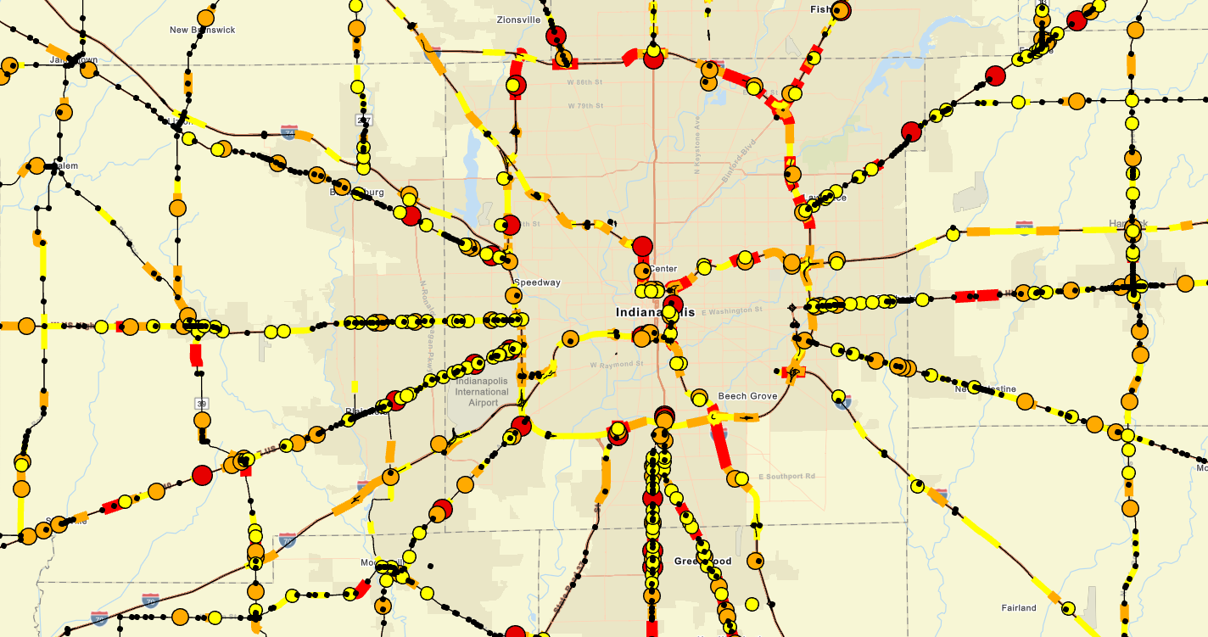
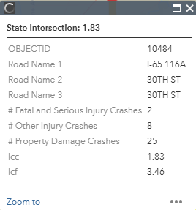
Network Screening: The Old Way

Slide 12
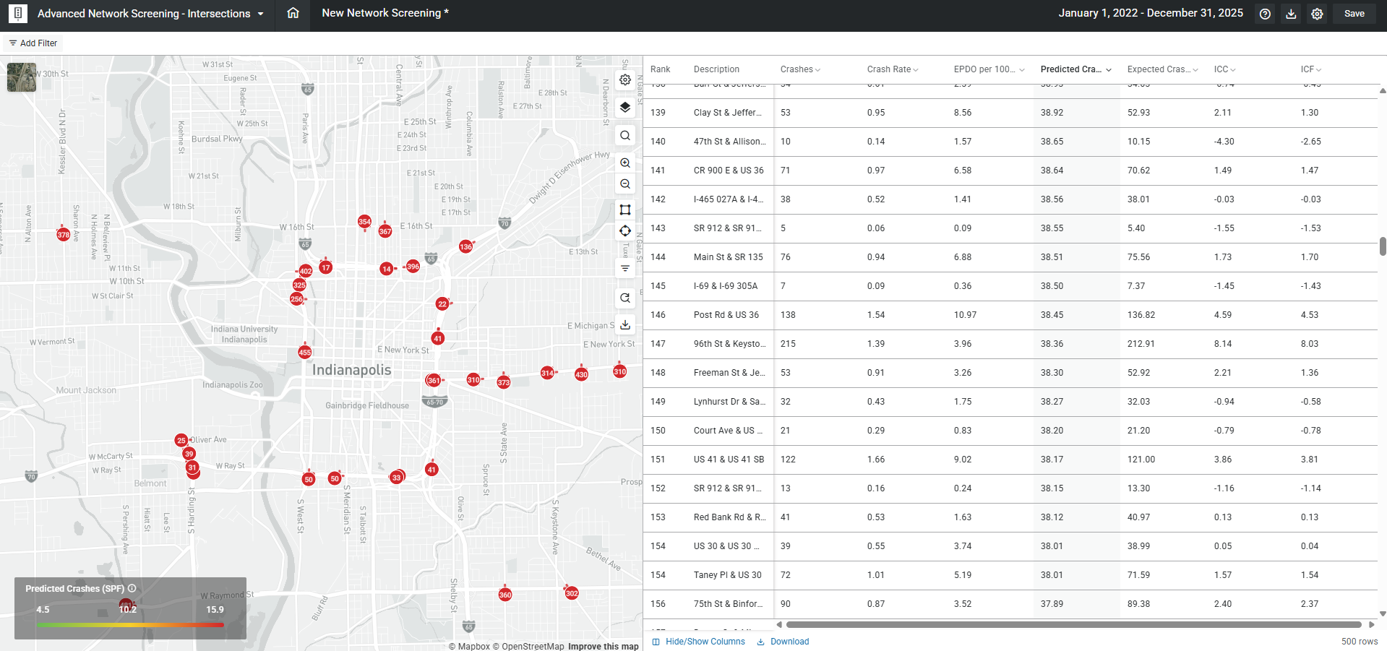
Notes:
All that you need to do is go into the Advanced Network Screening section, and immediately you can see and rank locations by ICC.

Slide 13
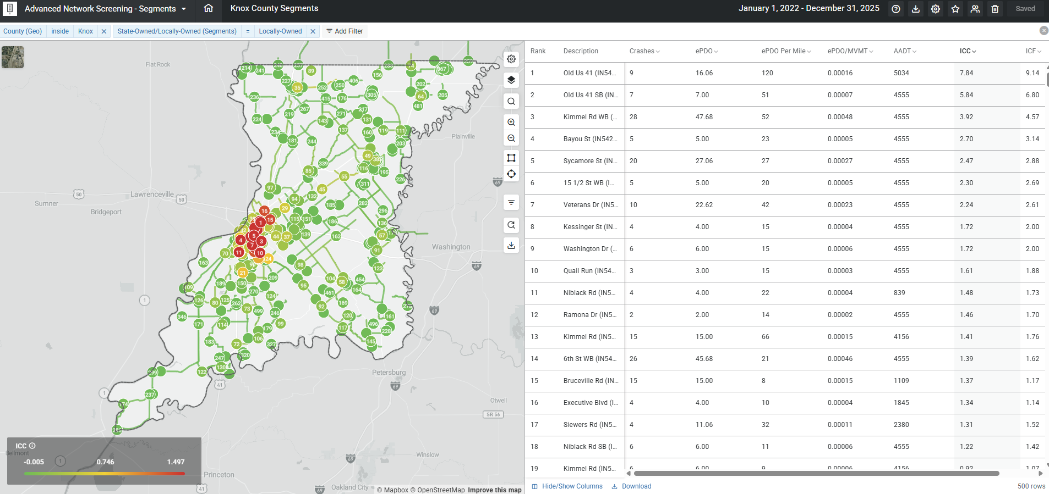
Notes:
This is an example of one way that I might use ICC in AWSafety to help

Slide 14
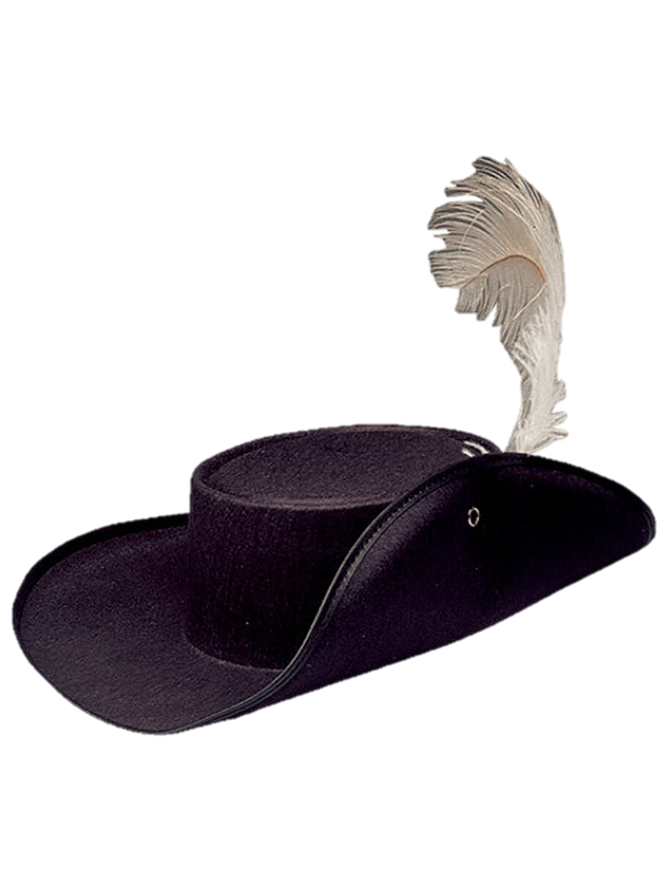
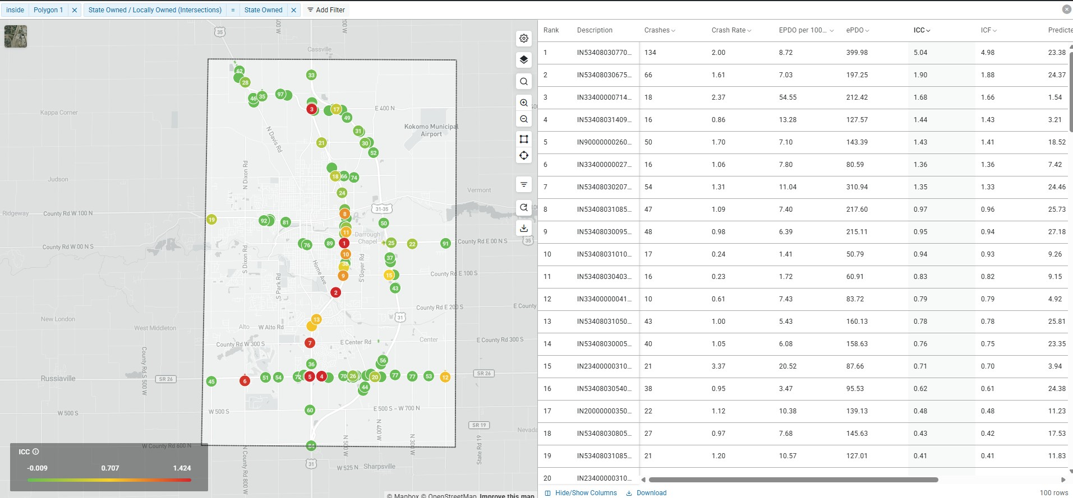
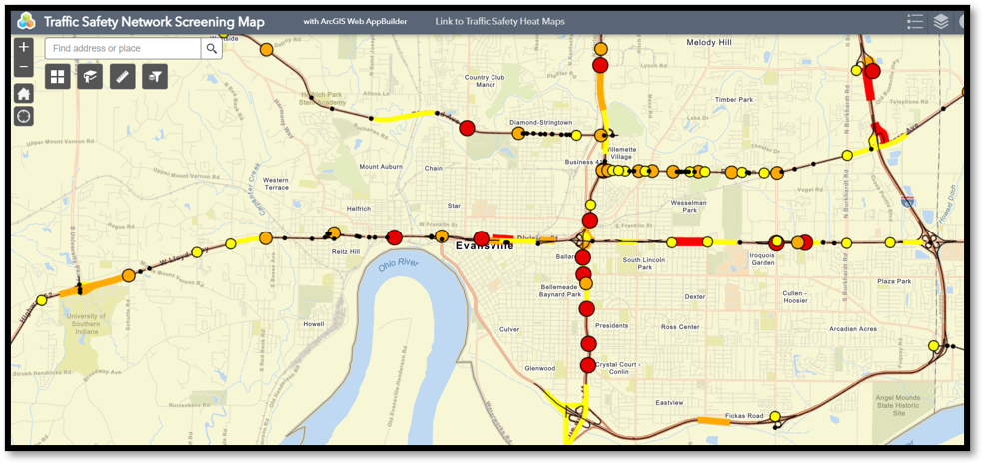
Network Screening
Notes:
The Goals of a Network Screening – Get an organized list of priority locations that is easily parsed and discernable.

Slide 15
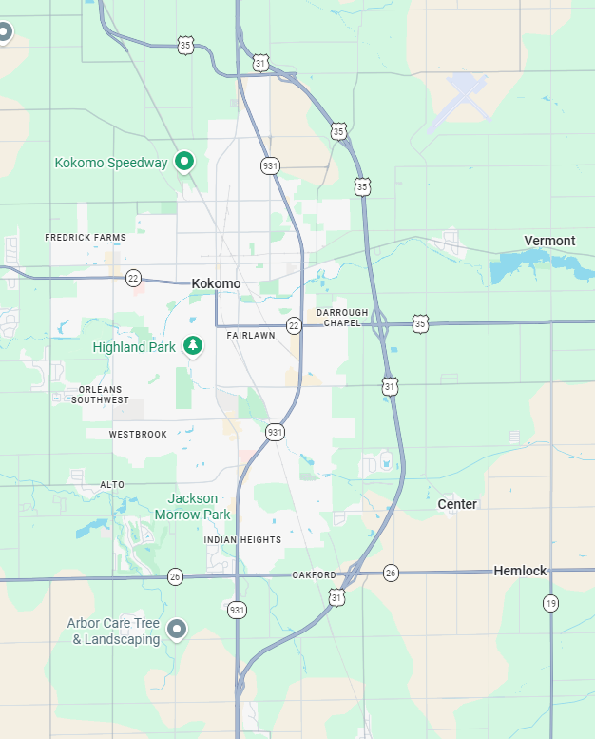

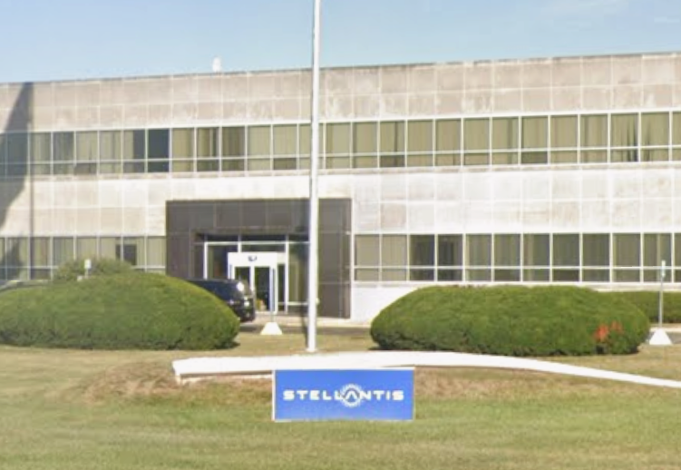


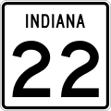
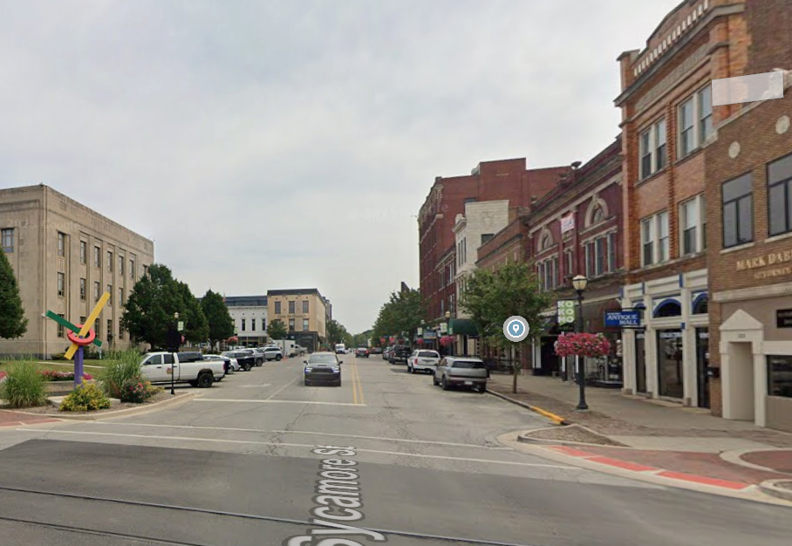
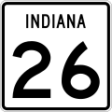
AADT
19k – 24k
Kokomo
18k – 20k
9k – 15k
6k – 7k
Notes:
Kokomo Indiana – Pop nearly 60,000, industrial town with Chrysler and Stellantis battery manufacturing –Not from Beach Boys Song – The bypass not a bypass and the bypass actually a bypass because it’s limited access.

Slide 16
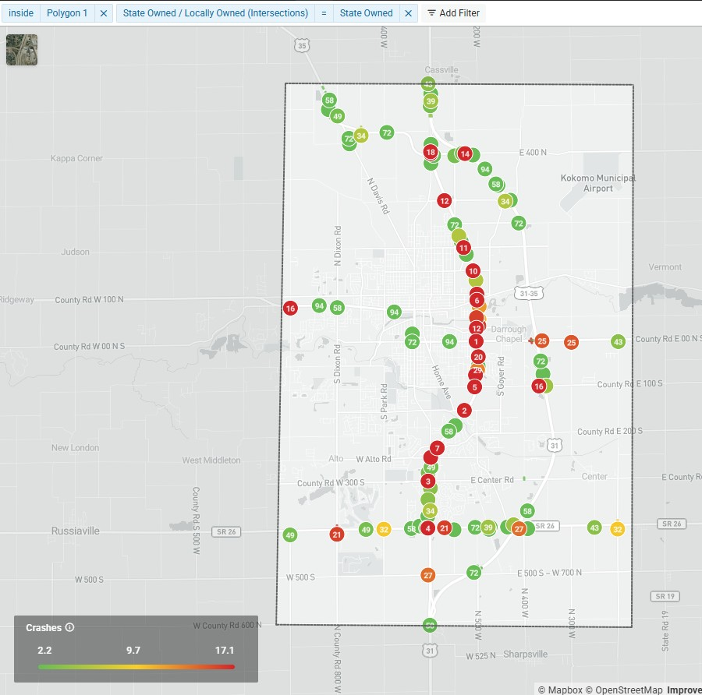
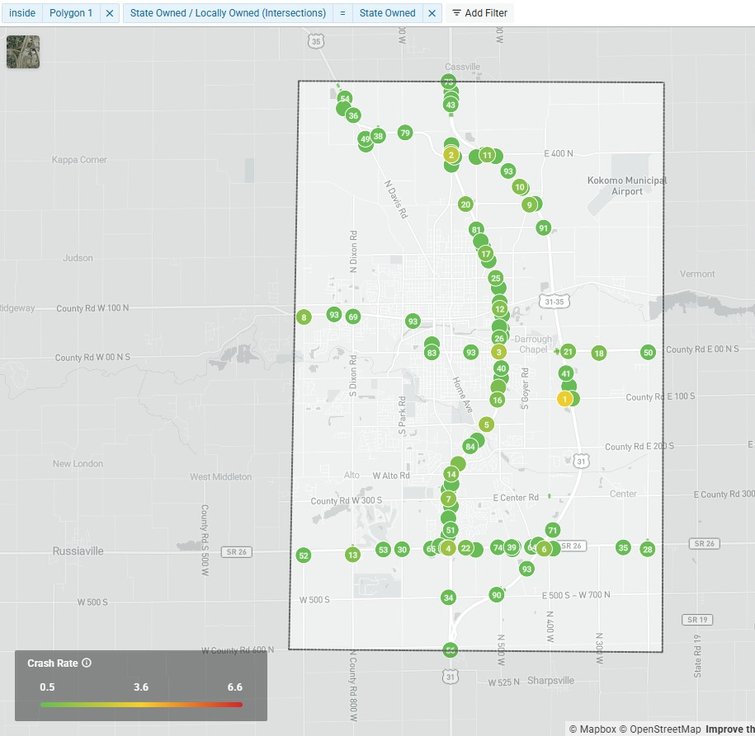
Crashes
Crash
Rate

Slide 17
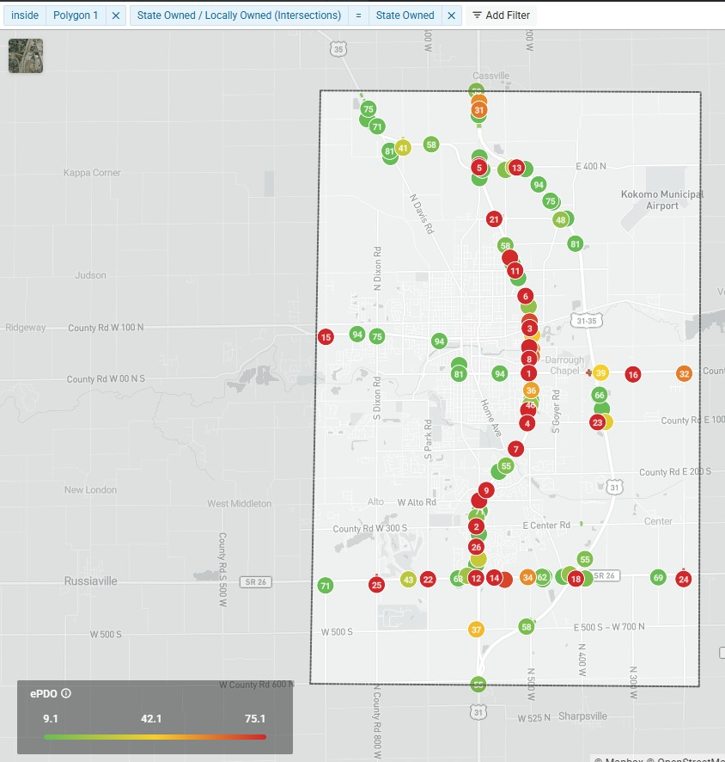
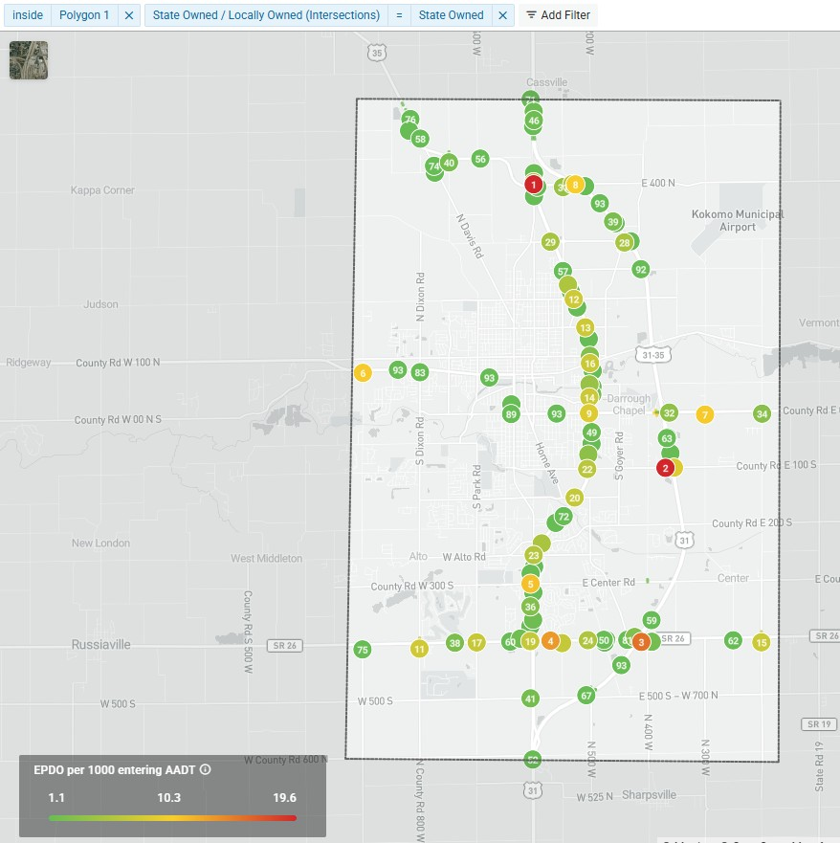
EPDO
EPDO Per 1000 AADT

Slide 18
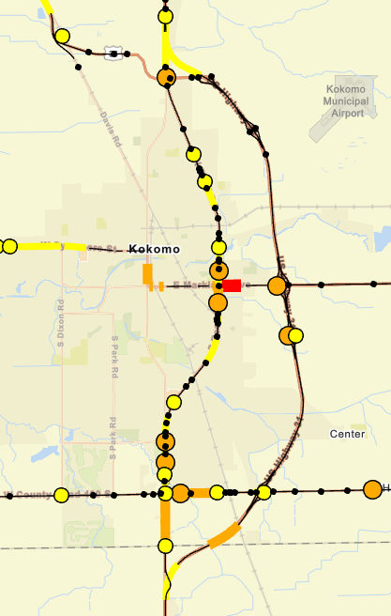
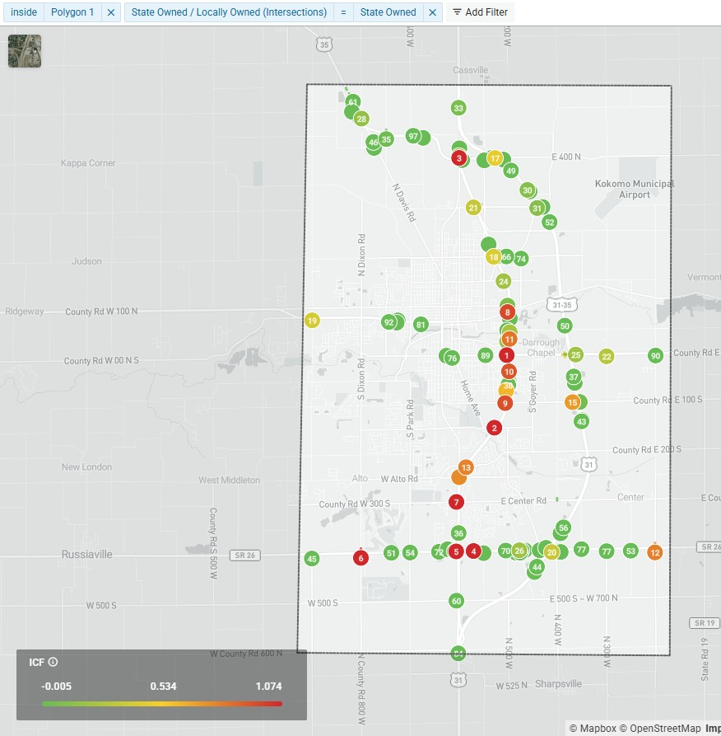
ICC
ICF

Slide 19
How do we use all this INFORMATION?
Notes:
How can we use the information that we now have demonstrated is easily accessible to make better decisions? How do we combat the fact that we all have limited time, staff, and money?
Ultimately, we want to use taxpayer dollars in a way that has the greatest impact to the travelling public.
We can’t simply choose the top 10 highest ICC locations and fund a project there, because there are more factors that influence what makes a good project.

Slide 20
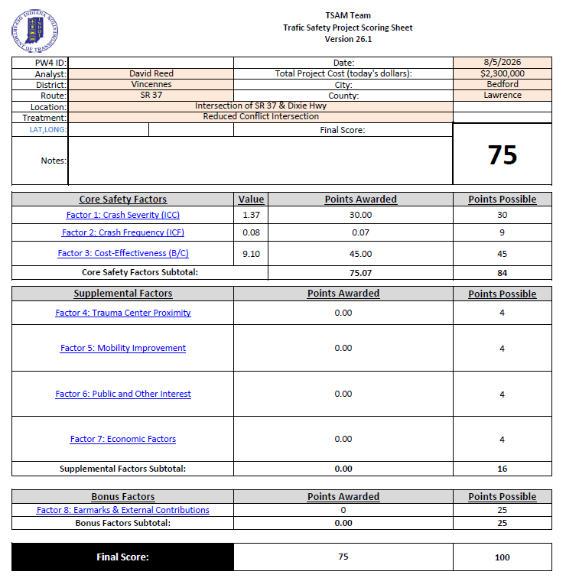
Projects must be ranked objectively to determine where to invest in safety improvements.
Notes:
This is a screenshot of our scoring sheet that we use for our safety projects. In Indiana, we are divided into 6 districts and we all bring our priority projects once a year and the score determines what will fund.
Row 1 & 2: ICC & ICF, which account for 39/100 points. ICC is much higher because we aren’t as worried about a high frequency of minor crashes, we are worried about high severity of crashes.
That still leaves 61 points

Slide 21
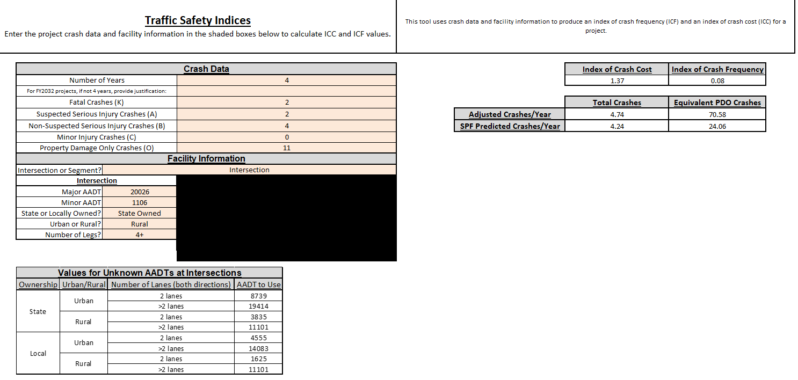
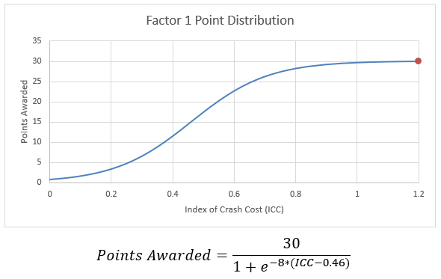
Notes:
Let’s start with ICC & ICF. We have already developed our SPF peer group equations in AASHTOWare, so we were able to copy them in Excel. All you need to do is fill out your crash data and intersection or segment information, and this tab calculates ICC & ICF. We use these to convert to a score which you can see demonstrated on the right. An ICC of 1 nearly maxes out the ICC score.

Slide 22
Project how many crashes will occur in design life of proposed project (20yrs).
Calculate how many crashes the CRF estimates would be prevented.
Convert to cost using crash costs established during ICC development.
Cost / Benefit
Notes:
Cost benefit is the highest proportion of score, but it still takes crash severity into account. I won’t spend too much time since this is not the focus, but these are the main steps we use in calculating. It’s up to you to decide what C:B ratio will maximize points, but

Slide 23
Are we improving mobility?
Do we have public support?
Are we helping those in need?
Notes:
These are essentially tie breaker factors which are not worth a lot of points, but if two projects are otherwise equivalent, these can determine the winner.

Slide 24
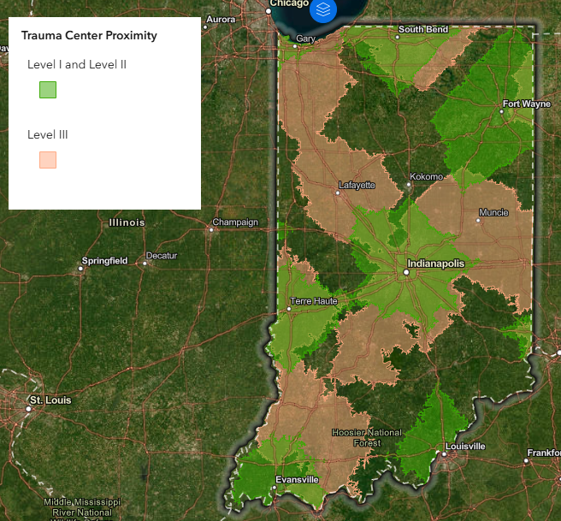
Notes:
Now trauma center proximity is a new factor that we added in this year and I want to focus on this one a bit more since we were able to integrate it into AW Safety.
Did you know that At least 60 percent of all trauma deaths occur in areas of the United States, where only 25 percent of the population resides
The chances or traumatic crashes leading to a fatality increase the further you are from a trauma center.

Slide 25
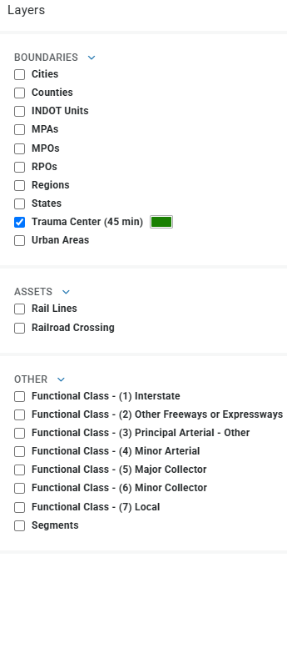
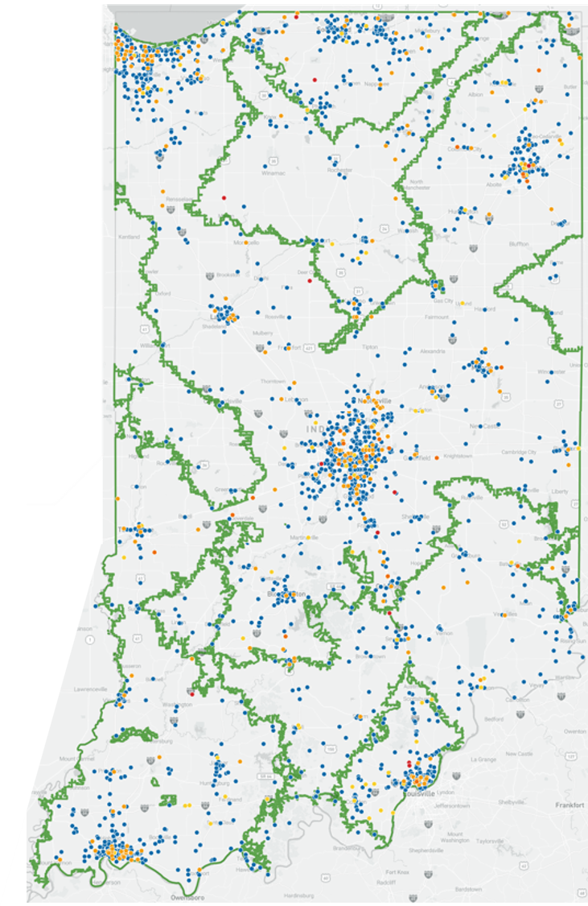
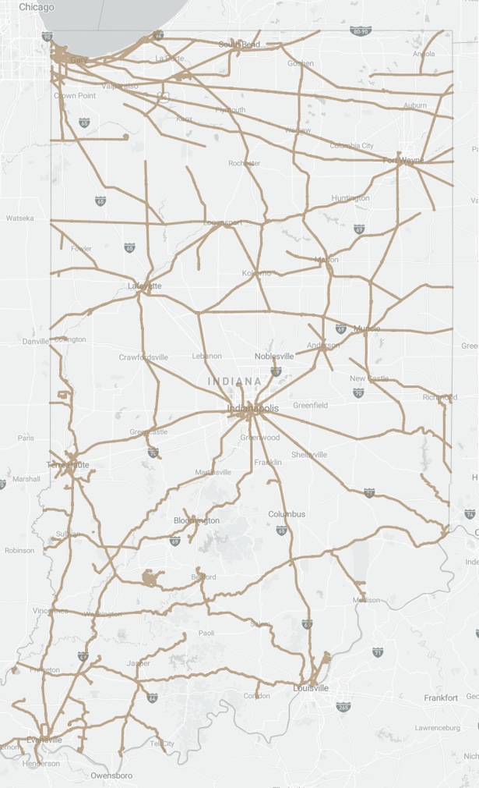
Notes:
At least 60 percent of all trauma deaths occur in areas of the United States, where only 25 percent of the population resides. https://www.in.gov/dA/19184ed19d/PAPER.pdf?language_id=1

Slide 26

Thank you!
Mark Muenz
mmuenz@indot.in.gov
David Reed
dareed@indot.in.gov
FHWA Road Safety Fundamentals

