Slide 1
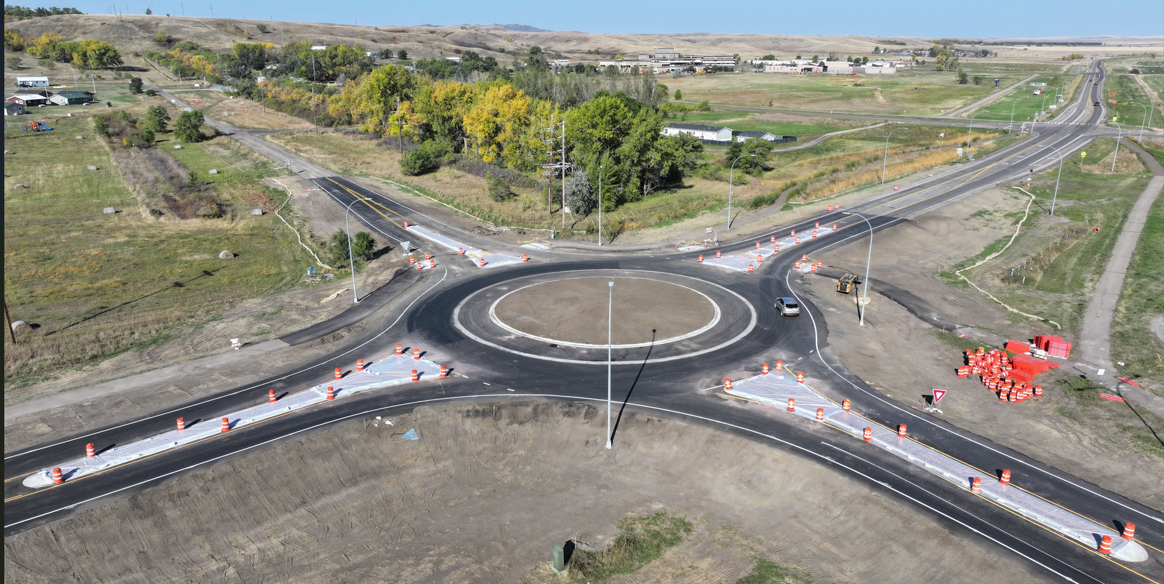

First Year Experience
Transitioning ND’s Processes to AASHTOware Safety

Slide 2
First Year Experience
Transitioning ND’s Processes to AASHTOware Safety
Crash Query
Before/After Study
Network Screening

Slide 3
County
City
Consultants
NDDOT Traffic Operations
Getting Crash Data Before

Slide 4
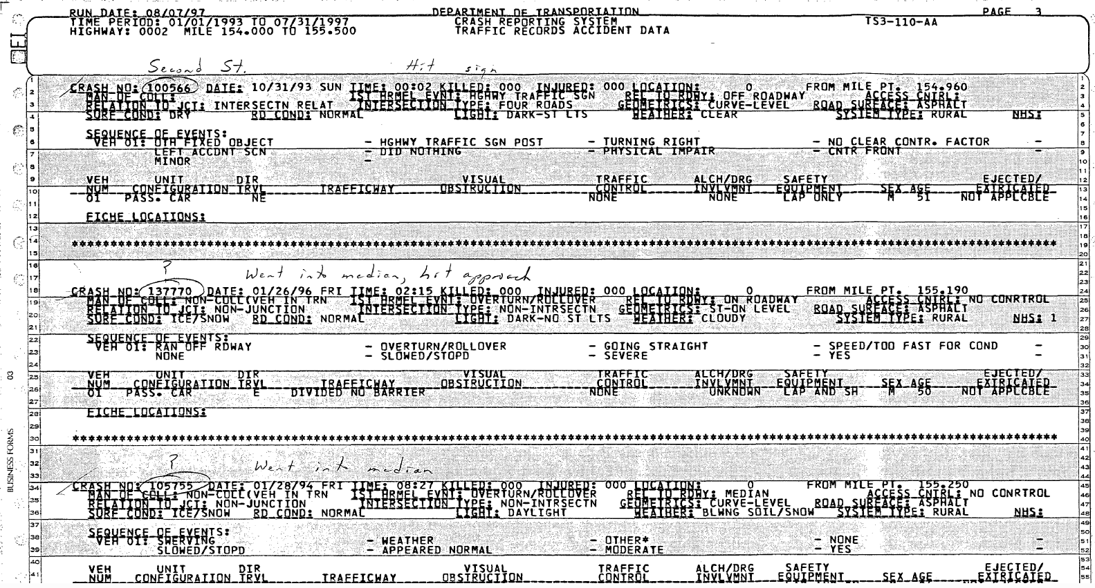

Slide 5
County
City
Consultants
NDDOT Traffic Operations
Getting Crash Data Before
GIS

Slide 6
County
City
Consultants
NDDOT Traffic Operations
Getting Crash Data Before
GIS
EXCEL

Slide 7
County
City
Consultants
NDDOT Traffic Operations
Getting Crash Data Before
GIS
EXCEL
PDF

Slide 8
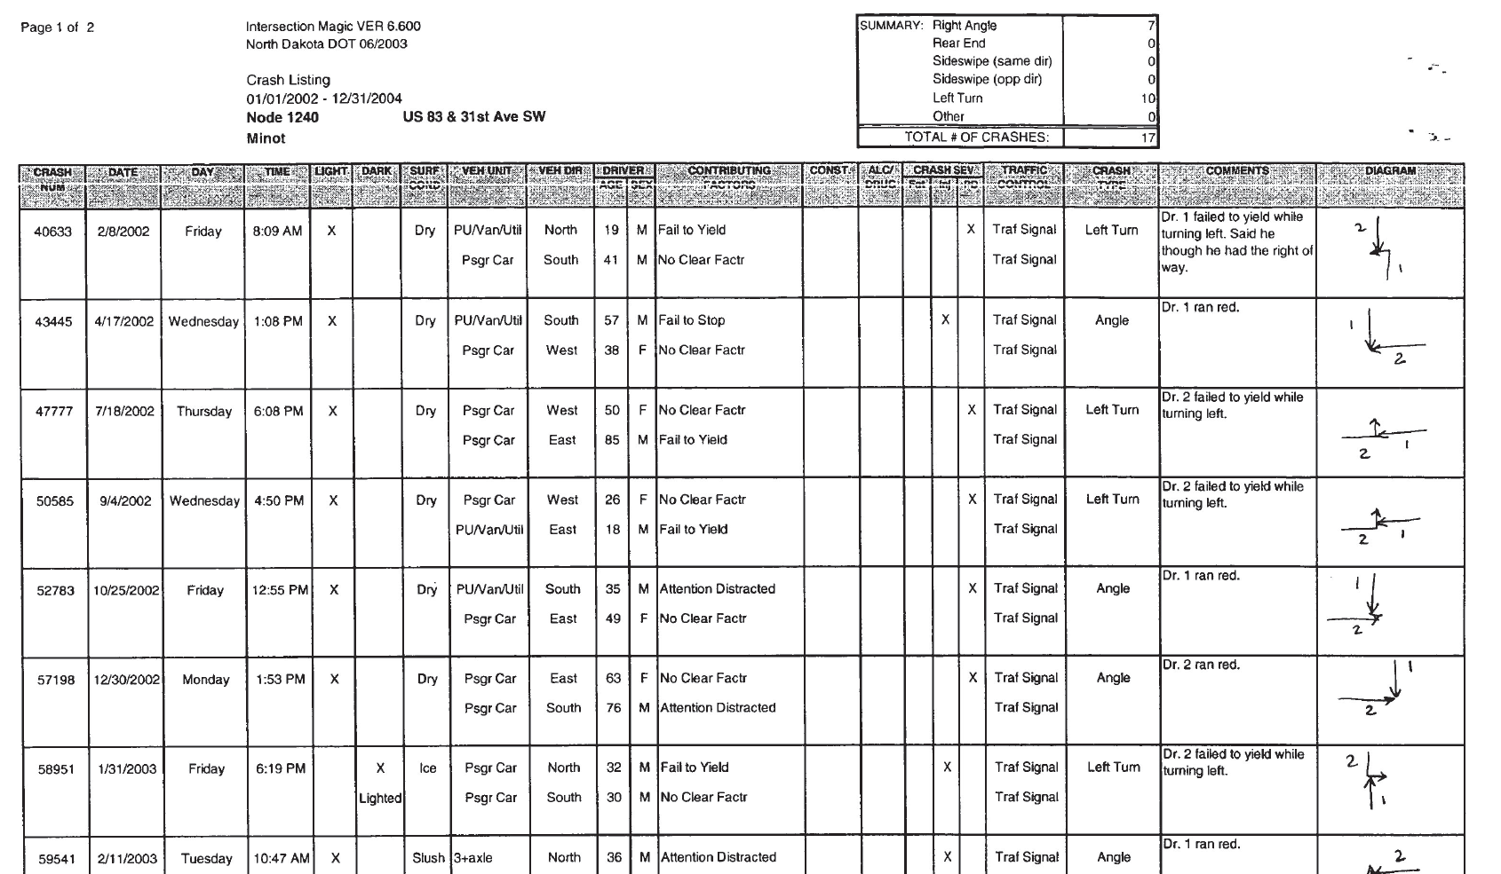

Slide 9
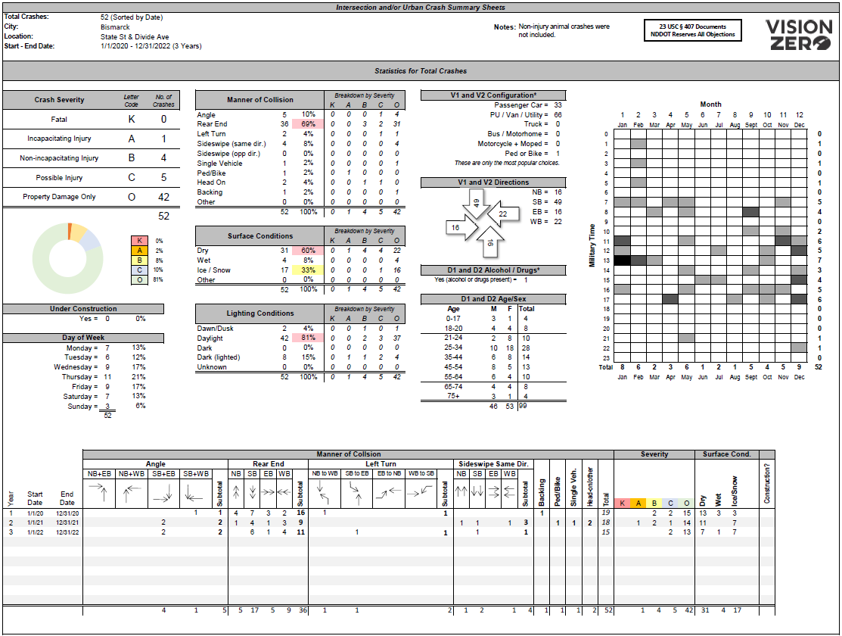

Slide 10

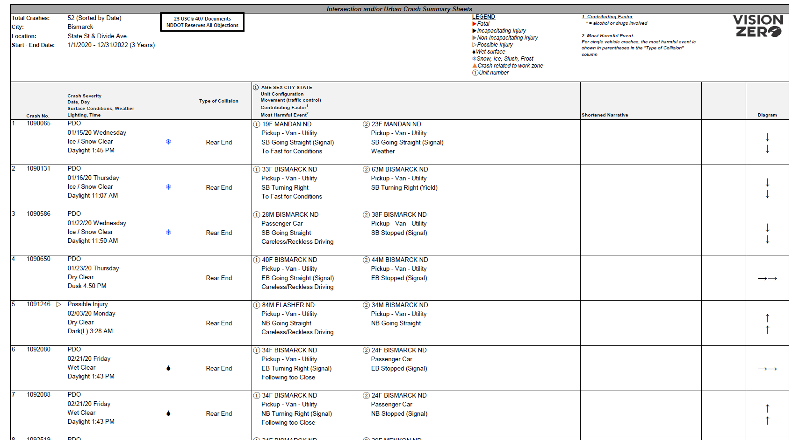

Slide 11
County
City
Consultants
AASHTOWare Safety by Numetric
Getting Crash Data Now

Slide 12
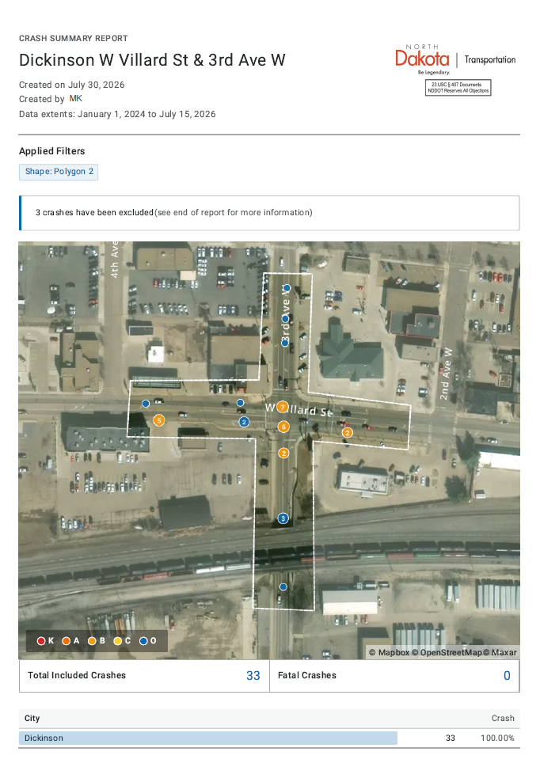
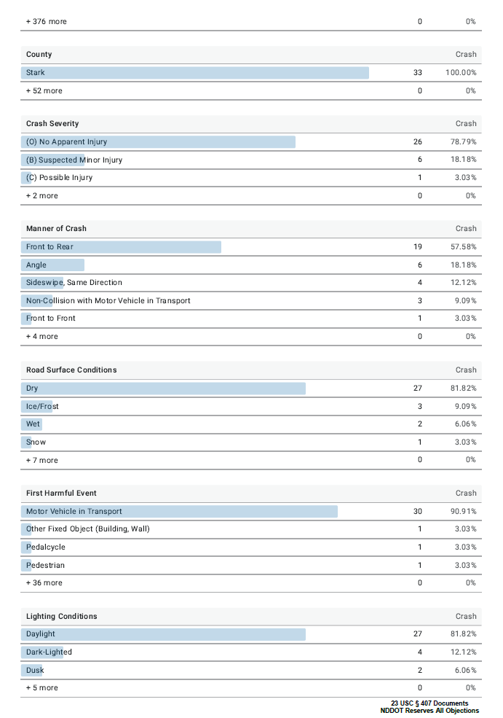

Slide 13
County
City
Consultants
AASHTOWare Safety by Numetric
Getting Crash Data Now
OPTIONAL
NDDOT Traffic Operations
“Crash” Table
EXCEL
PDF

Slide 14
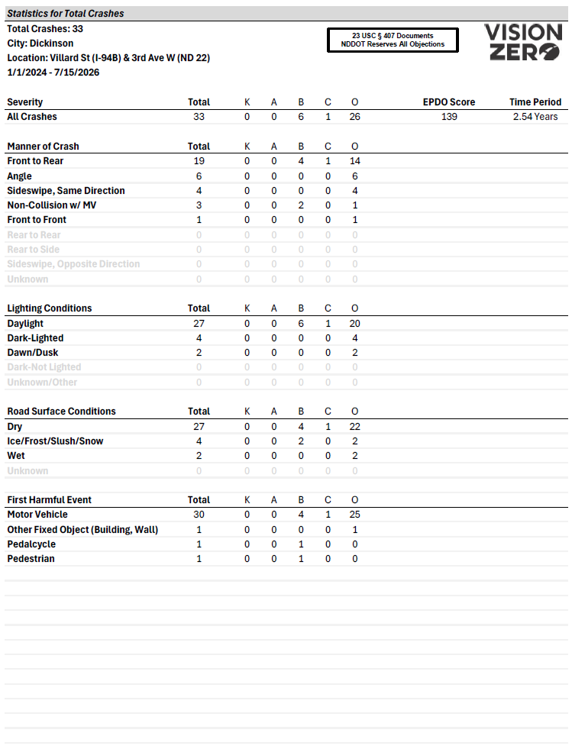
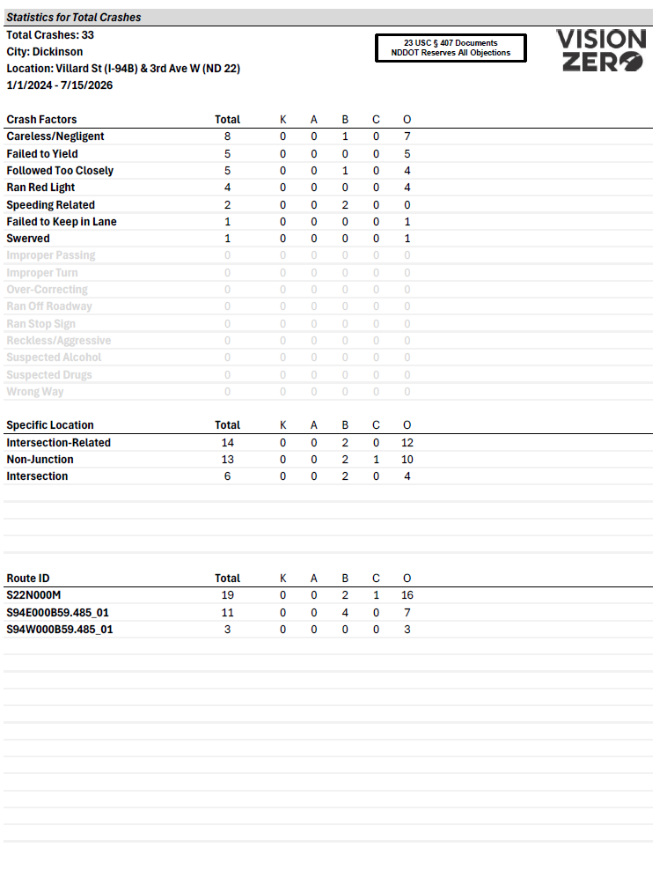

Slide 15
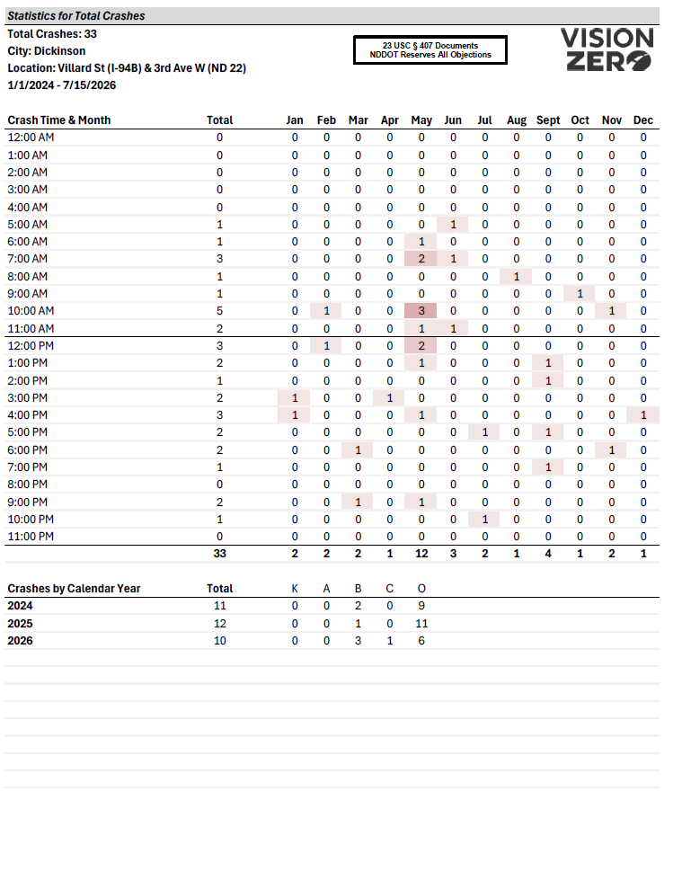
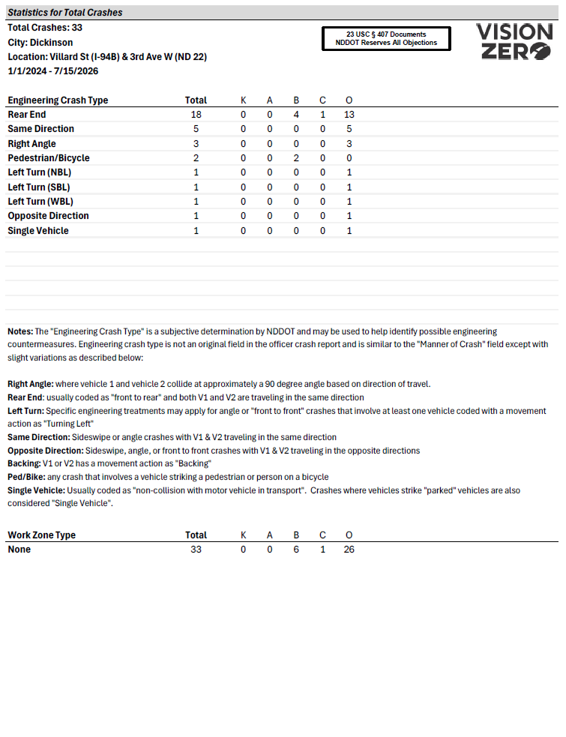

Slide 16
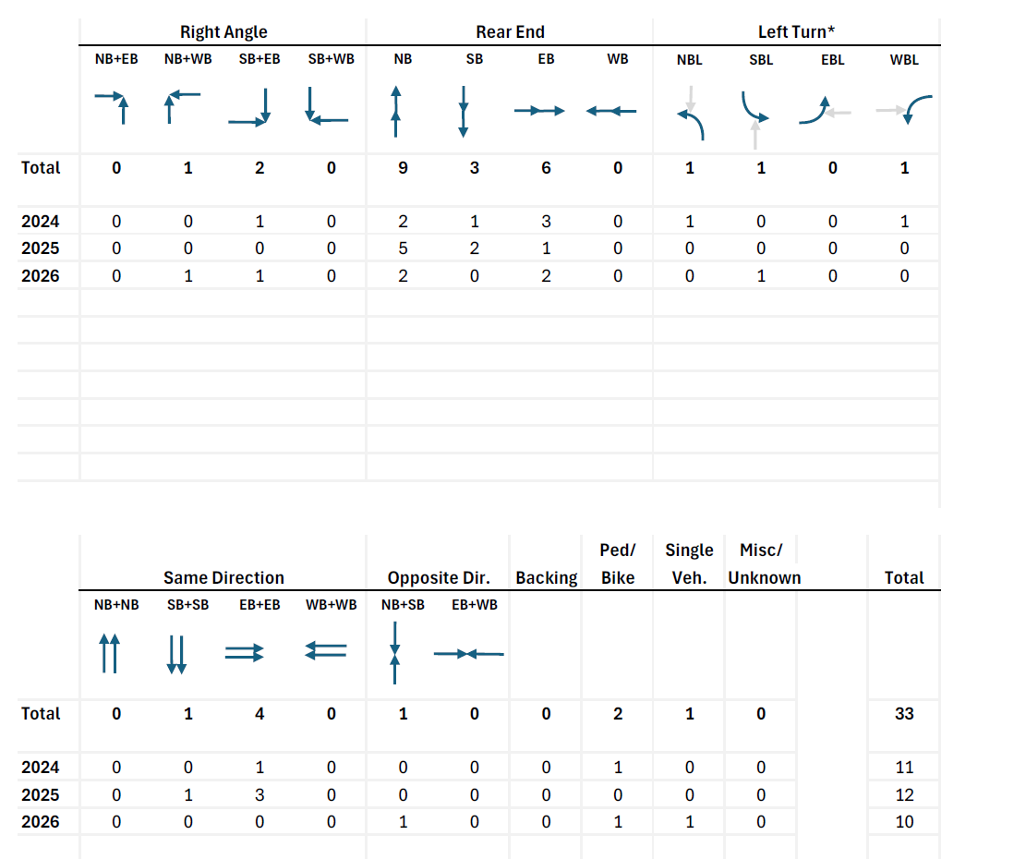

Slide 17
Manner of Crash
Engineering Crash Type
Non-collision with motor vehicle in transport
Single Vehicle

Slide 18
Manner of Crash
Engineering Crash Type
Angle
Right Angle
If vehicle directions:
90°

Slide 19
Manner of Crash
Engineering Crash Type
Angle
(Also: Front to Front, Front to Rear, if vehicle directions are 90° etc.)
Right Angle
If vehicle directions:
90°

Slide 20
Manner of Crash
Engineering Crash Type
Front to Rear
Rear End

Slide 21
Manner of Crash
Engineering Crash Type
Front to Rear
Sometimes: Angle, Rear to Side, etc. if vehicle directions are the same
Rear End

Slide 22
Manner of Crash
Engineering Crash Type
Sideswipe, Same Direction
Angle
Same Direction

Slide 23
Manner of Crash
Engineering Crash Type
Sideswipe, Opposite Direction
Opposite Direction
Angle
Front to Front

Slide 24
Manner of Crash
Engineering Crash Type
Sideswipe, Opposite Direction
Opposite Direction
Angle
Front to Front
Includes “Head-On” Crashes!

Slide 25
Manner of Crash
Engineering Crash Type
Angle
Front to Front
Left Turn
If at least one vehicle movement action = Turning Left

Slide 26
Manner of Crash
Engineering Crash Type
Any
Ped/Bike
Any crash involving a vehicle striking a pedestrian or person on bicycle

Slide 27
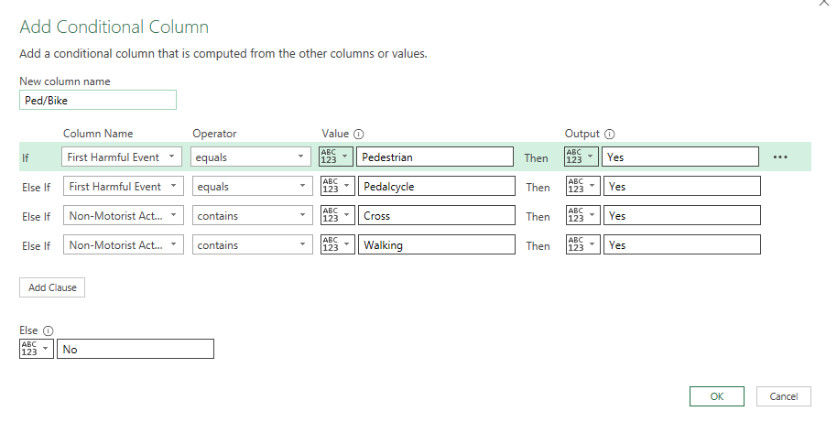

Slide 28
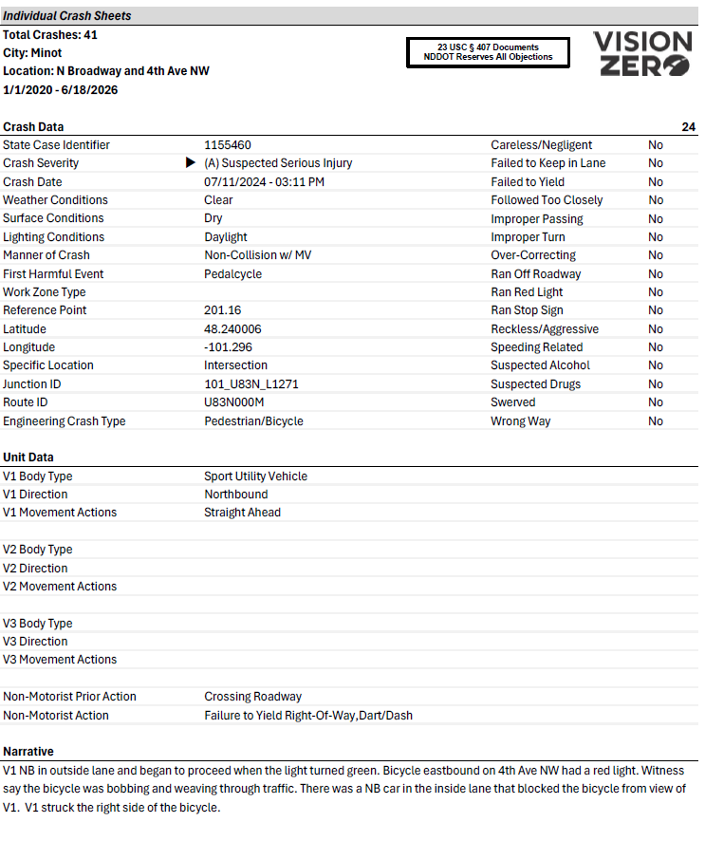

Slide 29
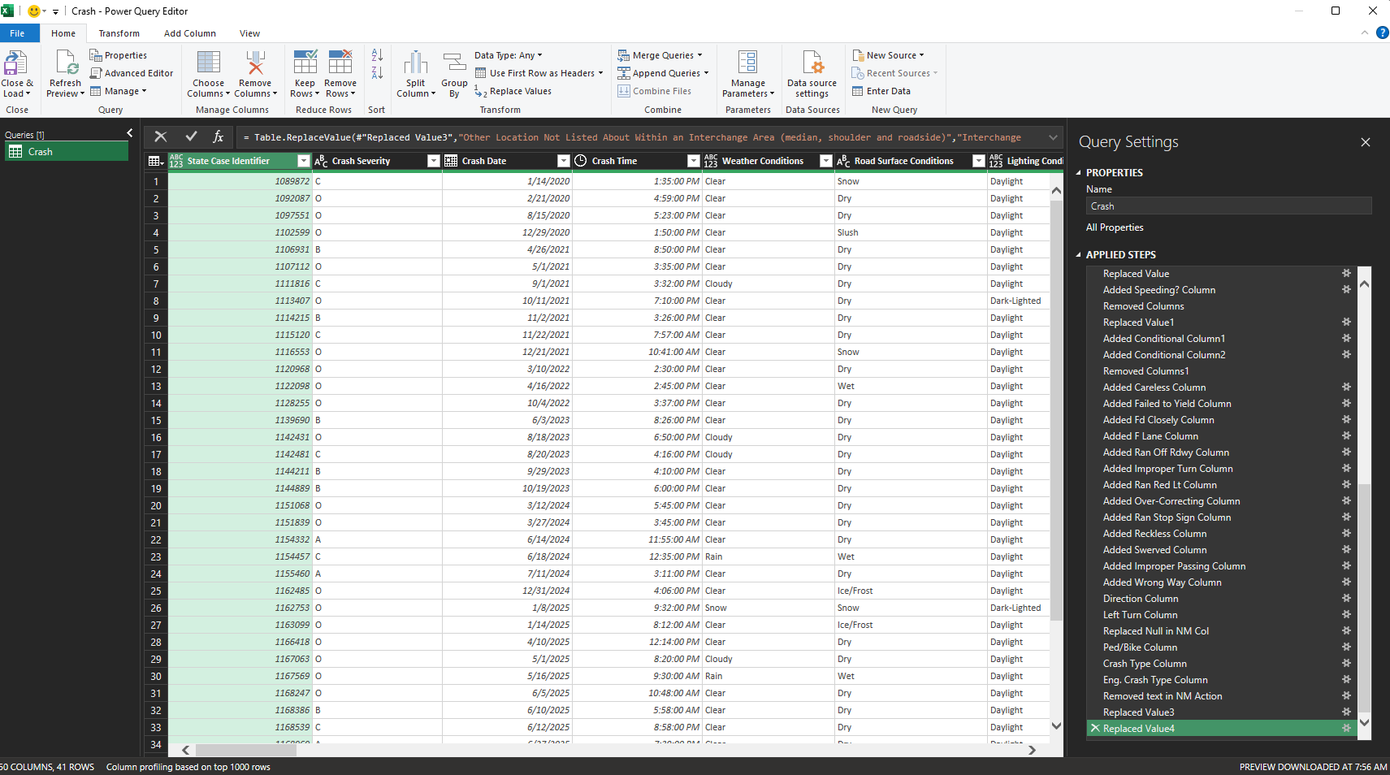

Slide 30
Pros:
Custom formatting
Raw data edit for crash errors
Crash Narratives
Cons:
Complex formulas and steps
Fragile (easy to break)

Slide 31
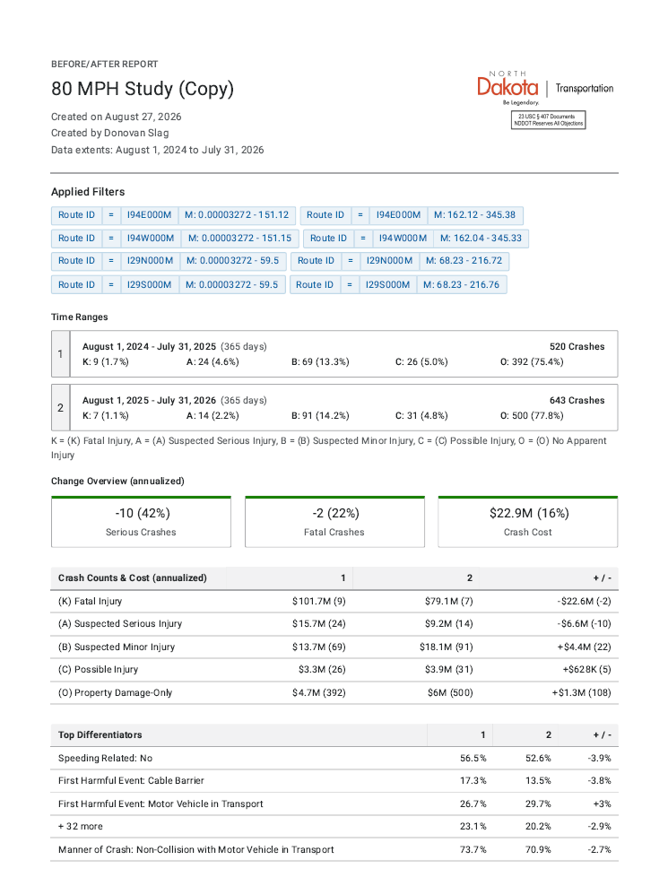
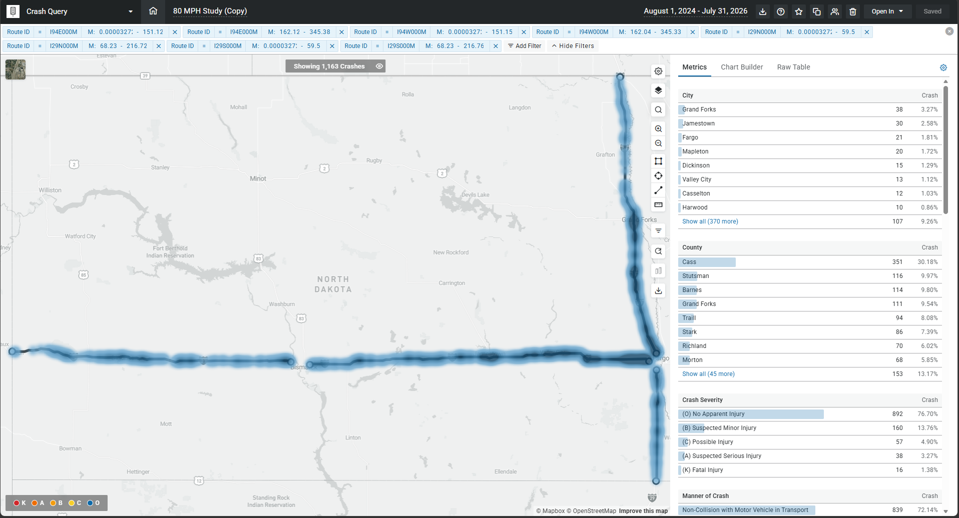
Before / After Speed Study

Slide 32
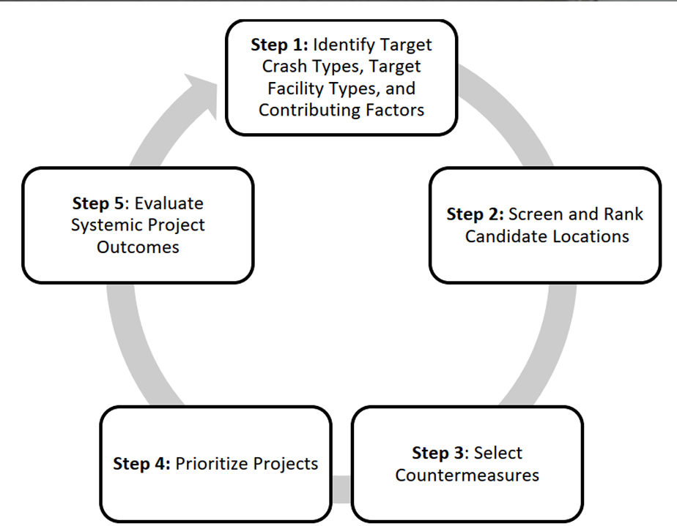
Network Screening

Slide 33
Network Screening
Right Angle Crashes,
One-lane approach, failing to yield
Before/After Studies
Network Screening
HSIP Process
Roundabout

Slide 34

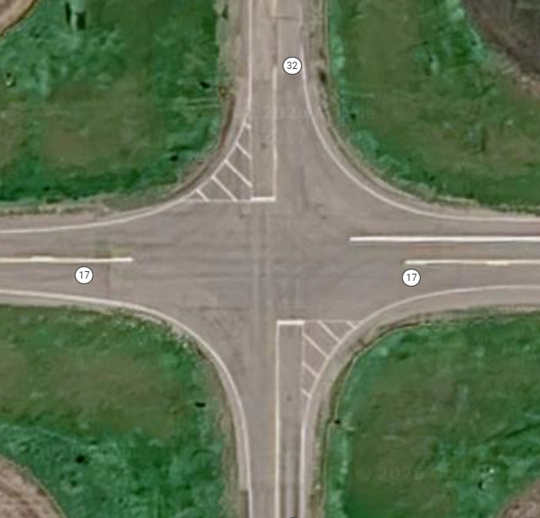

State system (major road)
One through-lane on each approach (i.e. no divided highways)
Two-way stop or all-way stop controlled
Total AADT greater than 1000
Speed limit 40 mph or greater on any approach leg

Slide 35
AASHTOWare Safety
State system (major road)
One through-lane on each approach (i.e. no divided highways)
Two-way stop or all-way stop controlled
Total AADT greater than 1000
Speed limit 40 mph or greater on any approach leg

Slide 36
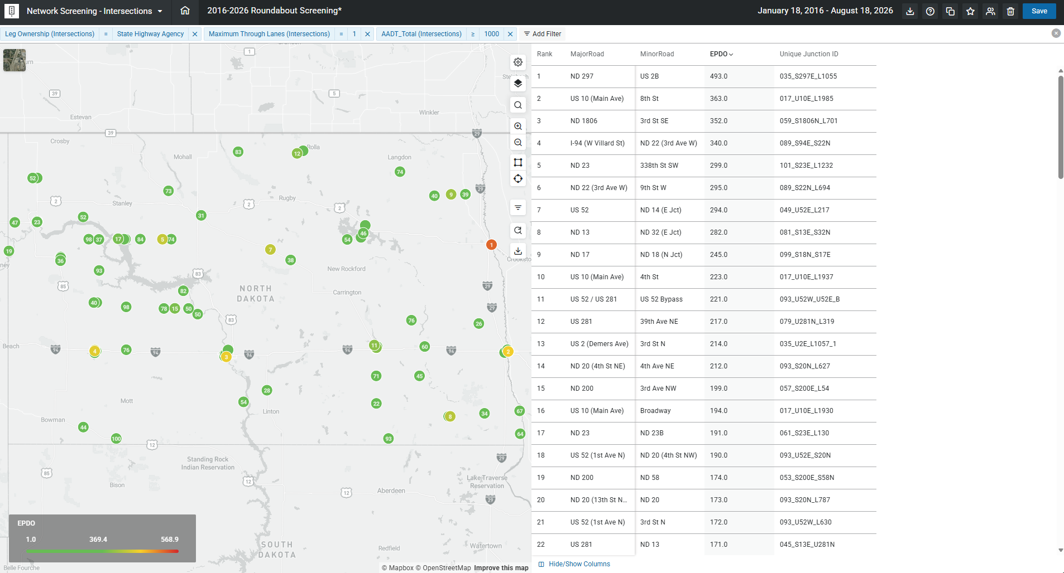

Slide 37
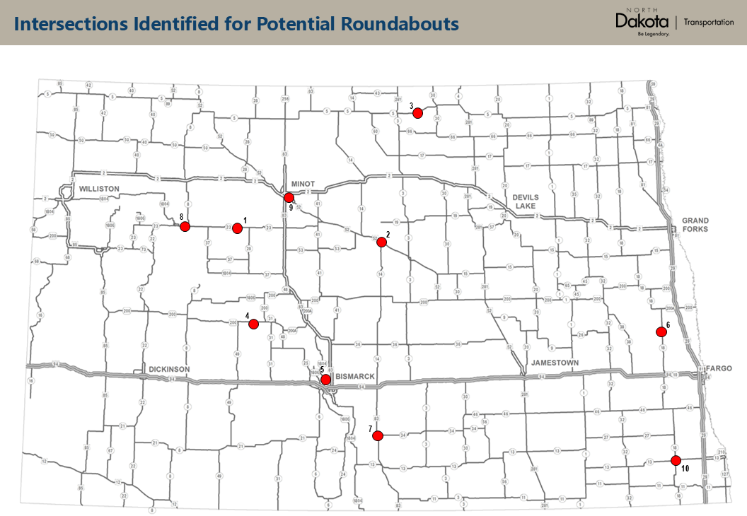

Slide 38
First Year Experience
Transitioning ND’s Processes to AASHTOware Safety
Lessons Learned
Accept that there may be minor data errors
Train users - queries
Raw data export – one table to Excel
Don’t be afraid to share your ideas with Numetric

