Slide 1
Integrating AASHTOWare Safety Tools into TDOT’s Design Process
2026 AASHTOWare Safety User Experience Advisory Committee Meeting

Slide 2
TDOT’s Experiences with AASHTOWare Safety
Summer 2020
Started discussions with AASHTOWare Safety
Aug. 2021
Partnership and Implementation Project Began
Nov. 2022
End-User Rollout Training
Sep. 2023
Application Rollout
2025
Local Outreach Initiative
2026
Alternative Design Implementation

Slide 3
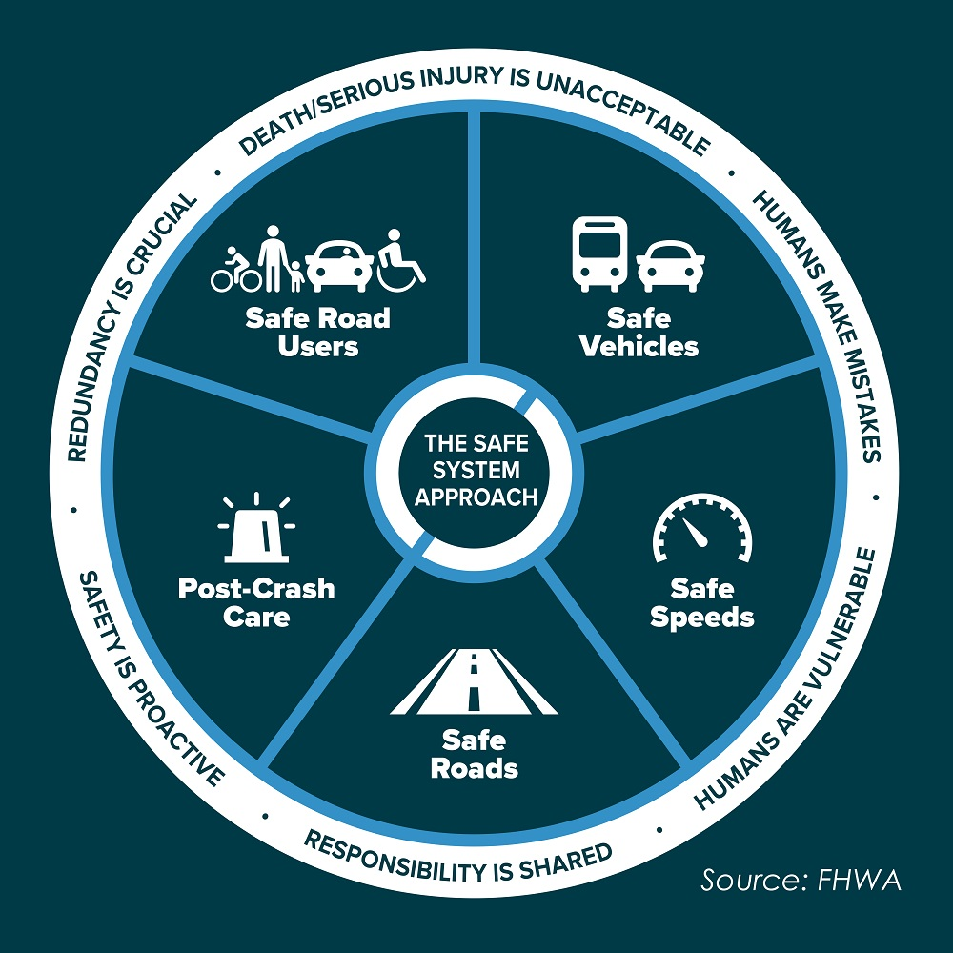
Data Driven Decision Making
TDOT uses data-driven strategies to manage traffic, plan road projects, and safety projects
By analyzing real‑time performance and historical trends, we can target safety improvements and address congestion across the state
Compare innovative concepts/alternatives against realistic data and application

Slide 4
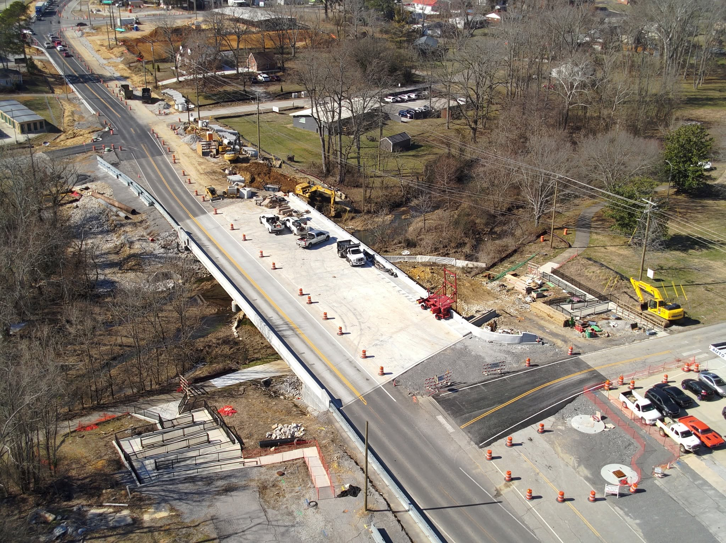
TDOT Project Delivery Network (PDN)
The PDN was developed to provide consistency and transparency throughout the project delivery process, enabling project teams to improve reliability and efficiency.
The PDN outlines the stages, activities, tasks, deliverables, and (links to) references to accomplish these ends.

Slide 5
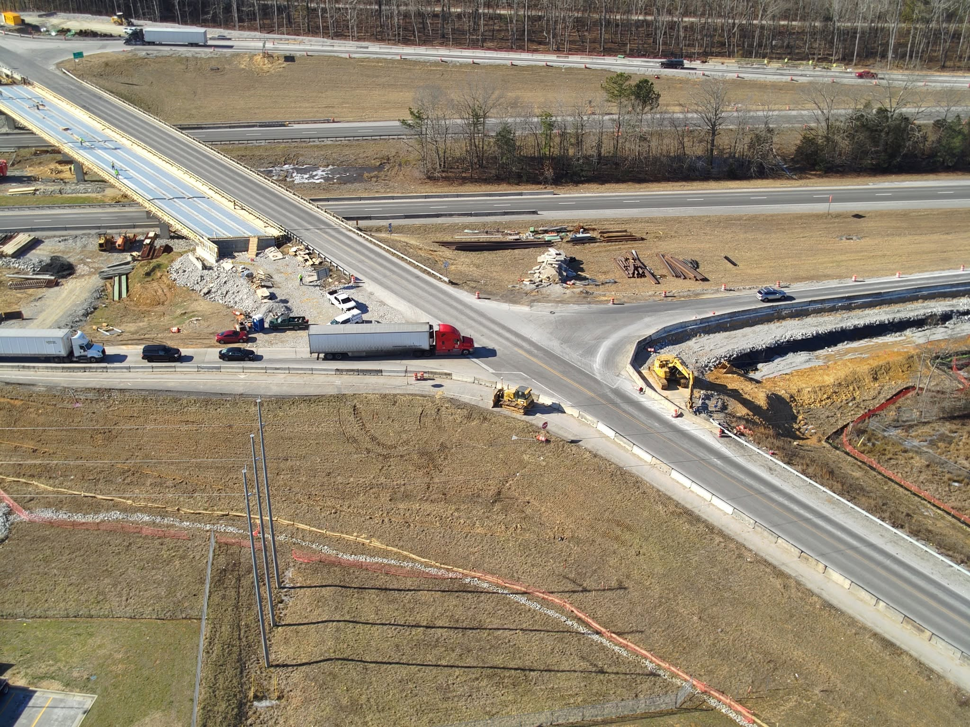
Future Project Development
A safety analysis is done on all projects that go through the PDN process (traditional design)
  Use AASHTOWare Safety Analysis
The alternative design tool to be used for safety projects and large designs to finalize the build option

Slide 6
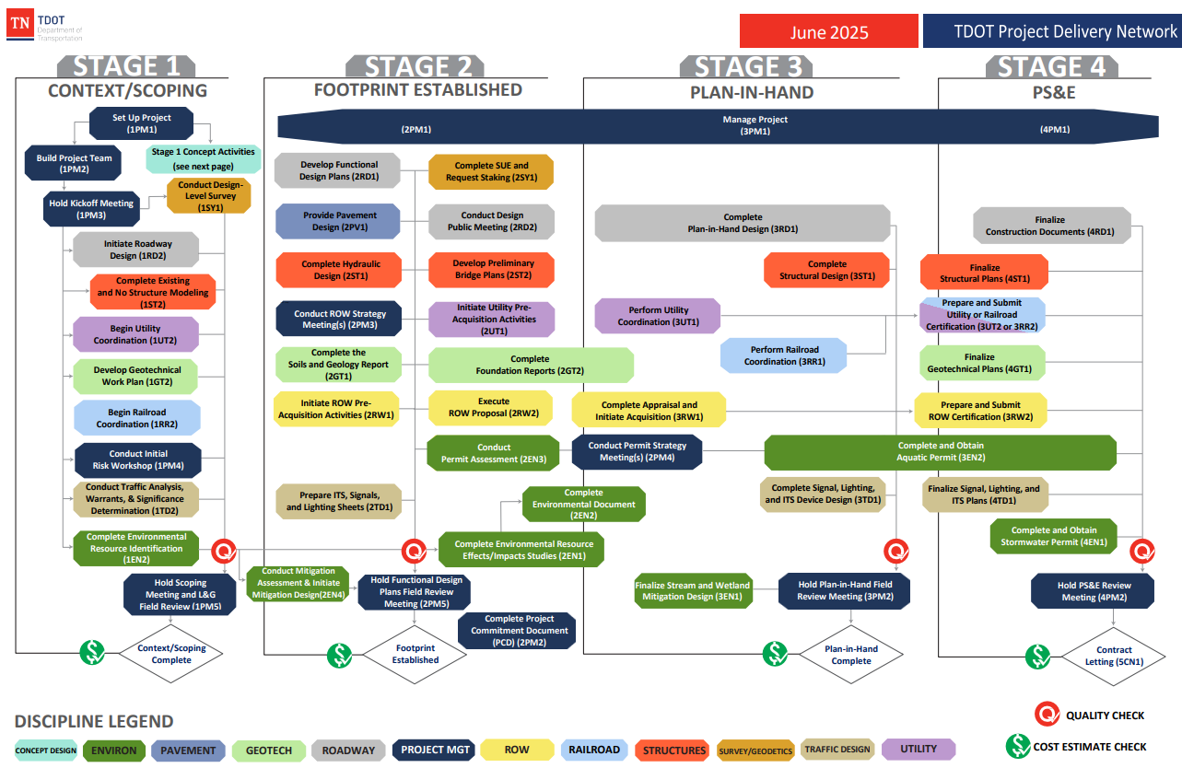
TDOT Project Delivery Network

Slide 7
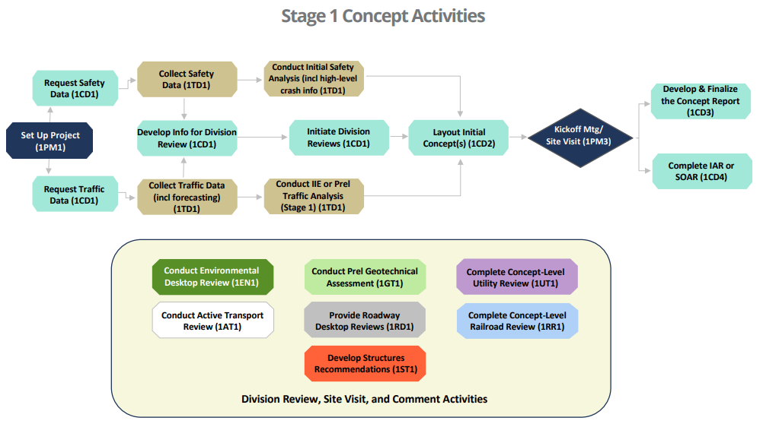
TDOT Project Delivery Network (PDN)
In Stage 1 Context/Scoping
2
1

Slide 8
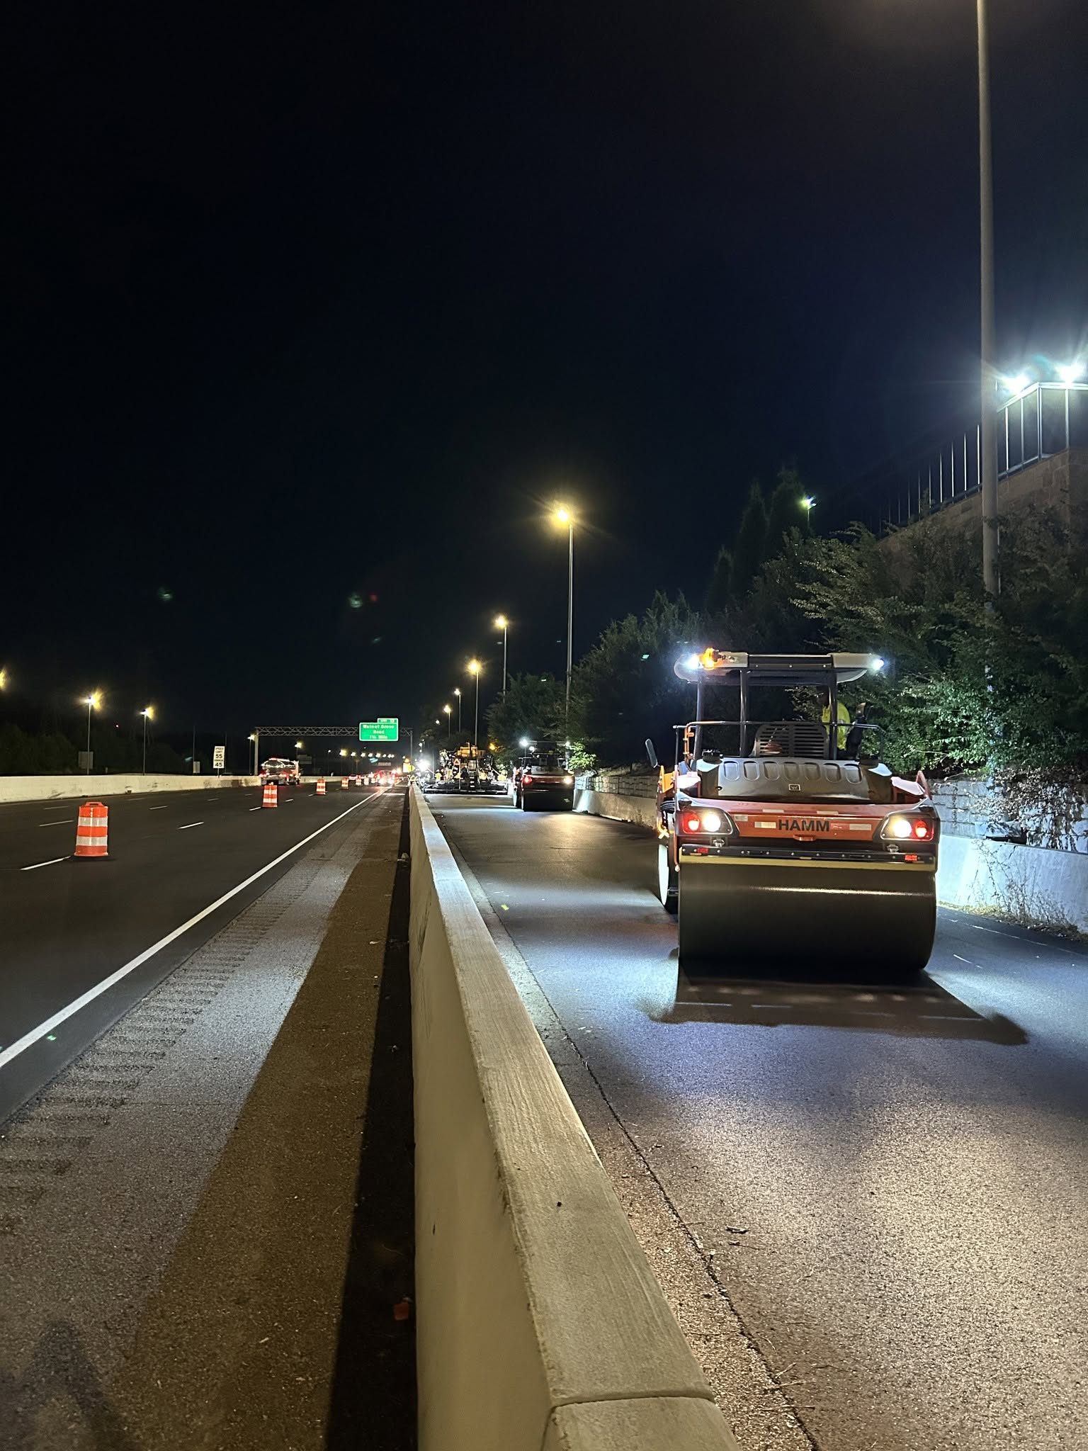
Initiate Concept Evaluations
Analyzing high-level safety data associated with the project location to help determine the project’s scope and related recommendations to improve safety and operations.
  We use the AASHTOWare Safety Analysis Tool
Once the data is received, the Concept Design Lead reviews the crash information to inform potential conceptual layout(s) and estimate(s) from a safety perspective.

Slide 9
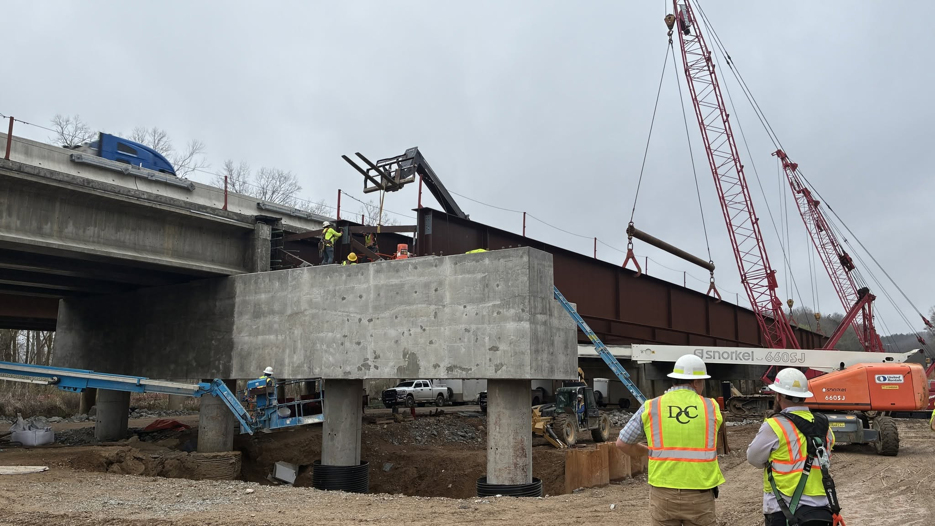
Project Scoping (Big project)
Developing the preliminary purpose and need
Determining the feasibility of various improvement alternatives
Creating a conceptual layout to move forward in the design development process
Benefit-cost and predicted crash rate with different options
Notes:
When we have 2 or more options. To vet innovative concepts/alternatives against realistic data and application.

Slide 10
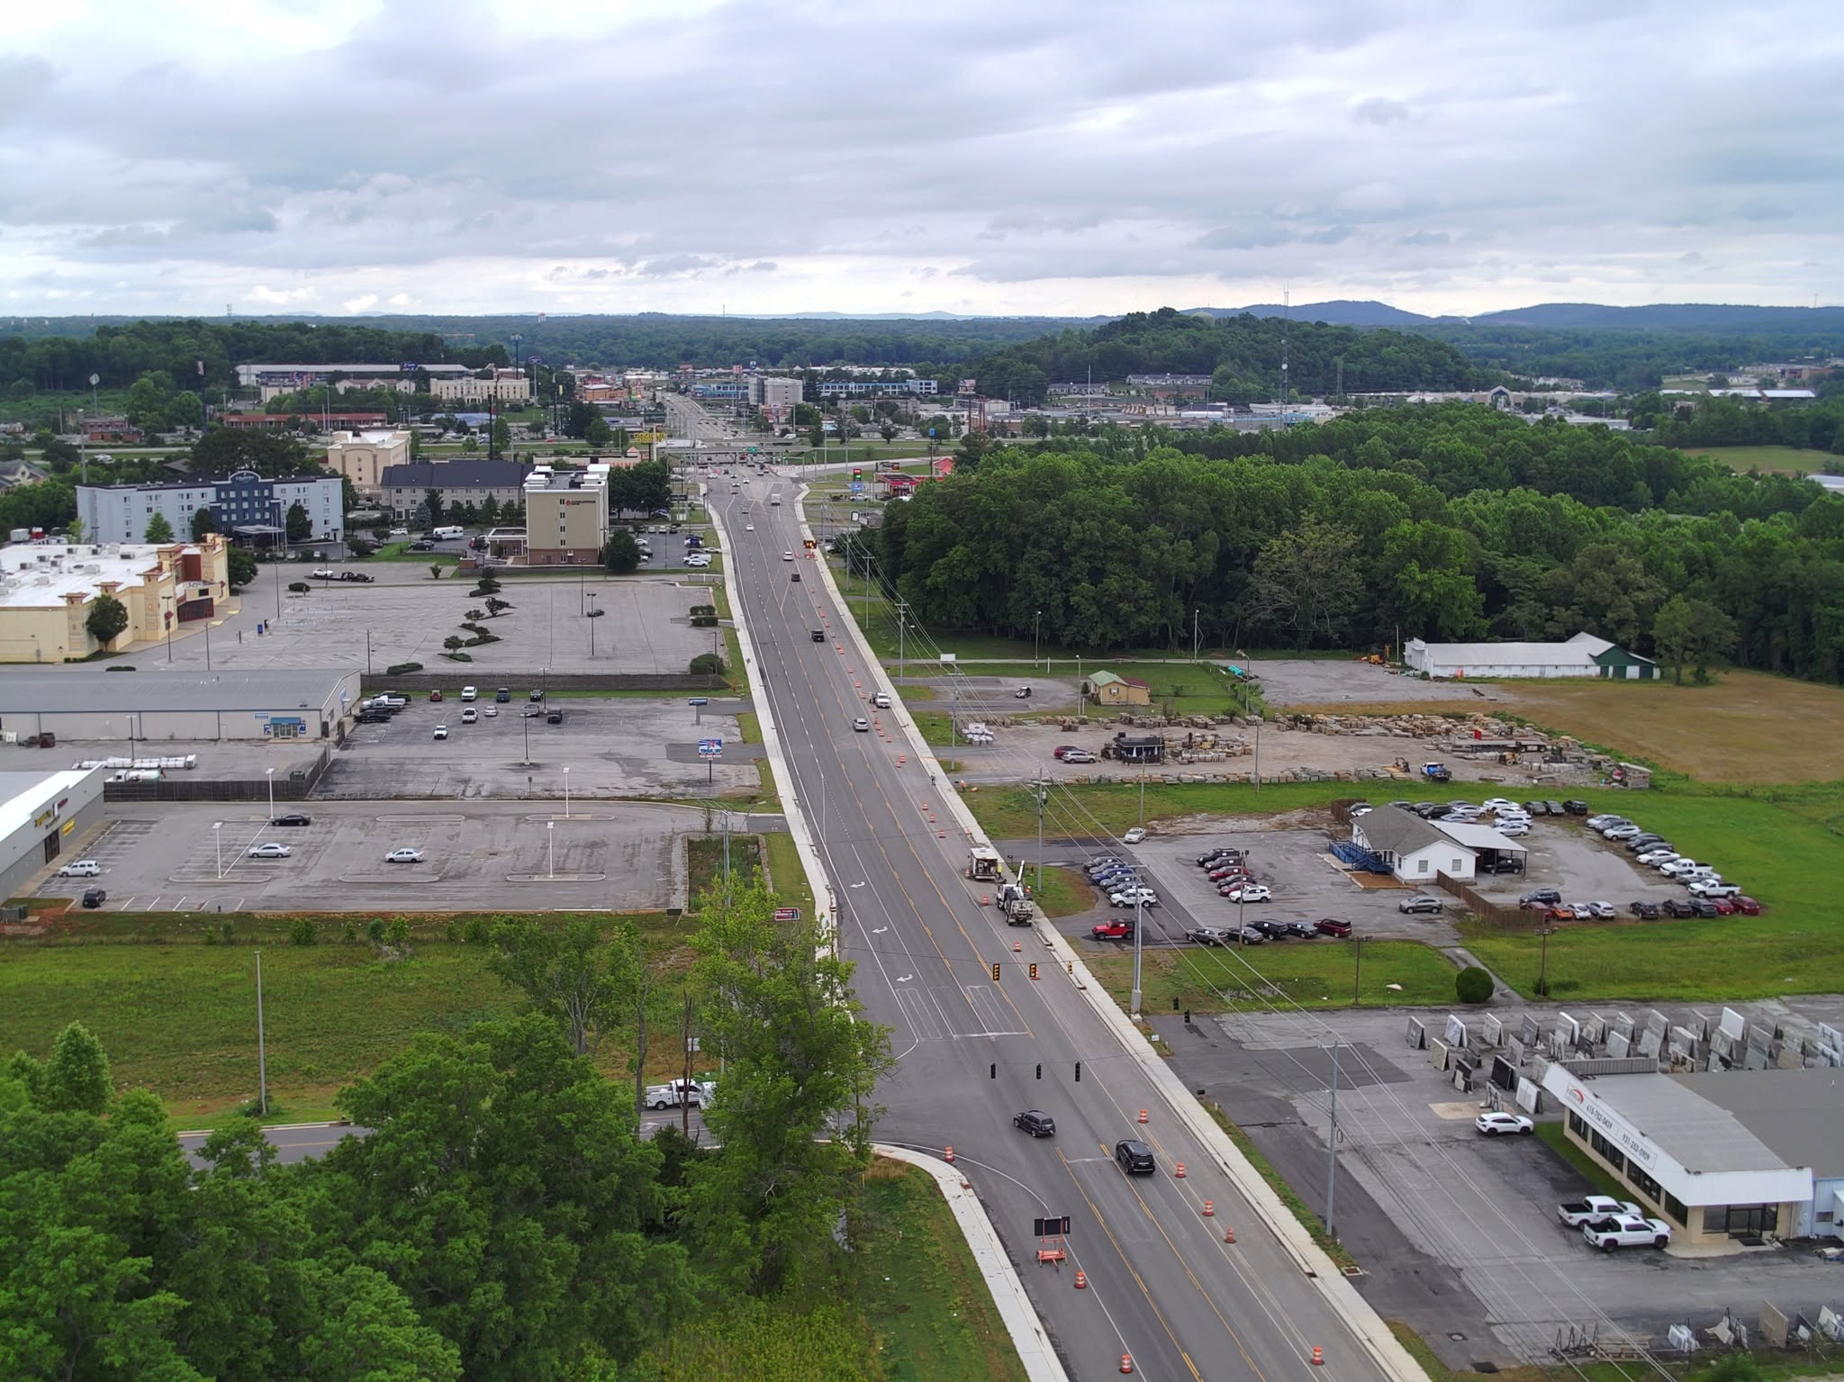
Alternative Design Tool
The tool is intended to help make informed decisions about safety during the conceptual design phase.
It enables us to analyze the safety impacts simultaneously. Different design choices.
The tool helps users understand how changes to roadway characteristics affect safety performance.
  Examples
    lane width
    shoulder size
    lighting

Slide 11
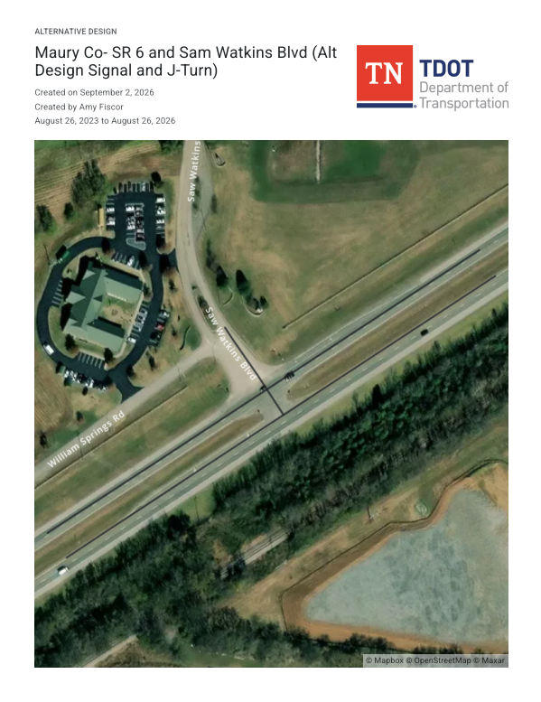
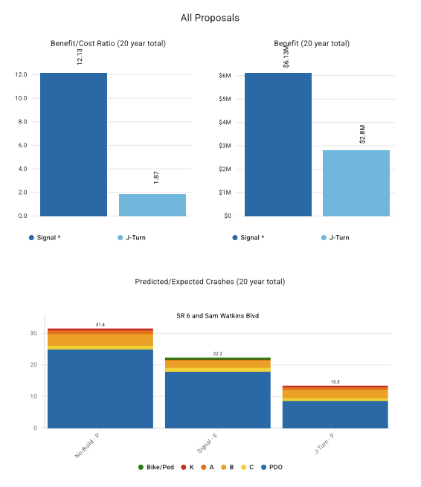
Alternative Design Example

Slide 12
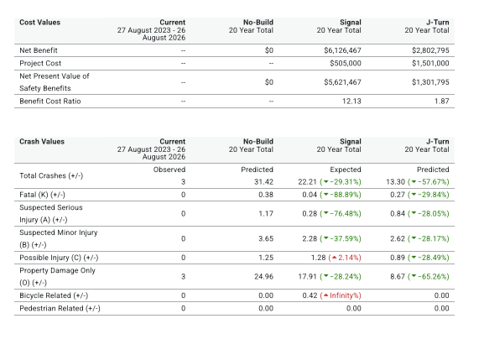
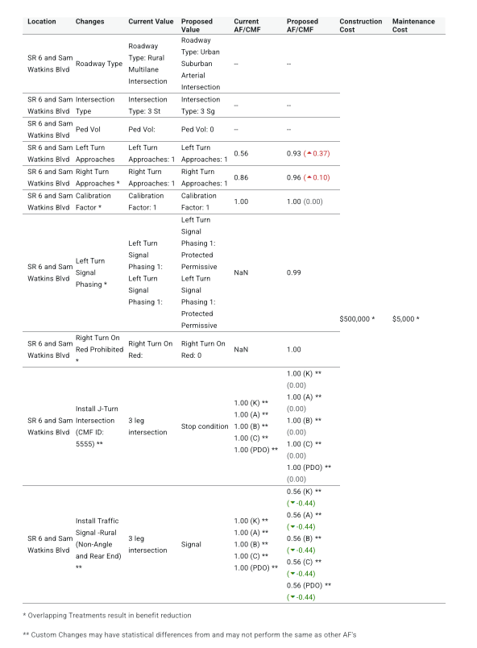
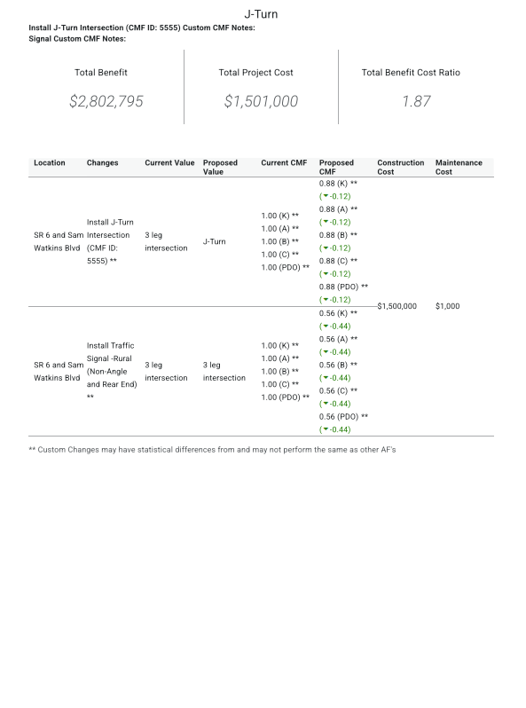
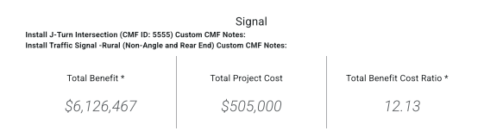
Alternative Design Example- Continued

Slide 13
Alternative Design Tool - Key Features
Cost-Benefit Analysis-Calculates benefit-cost ratios to prioritize safety improvements.
Crash Reduction Projections-Estimates the number of crashes that might be avoided by implementing different design options.
Multiple Alternative Comparisons-Allows for simultaneous comparison of various design scenarios.
User-Friendly Interface-The tool is designed with a simple interface to facilitate ease of use and understanding.
Integration with the Highway Safety Manual (HSM): The tool is based on the safety prediction methods outlined in Part C of the Highway Safety Manual.

Slide 14
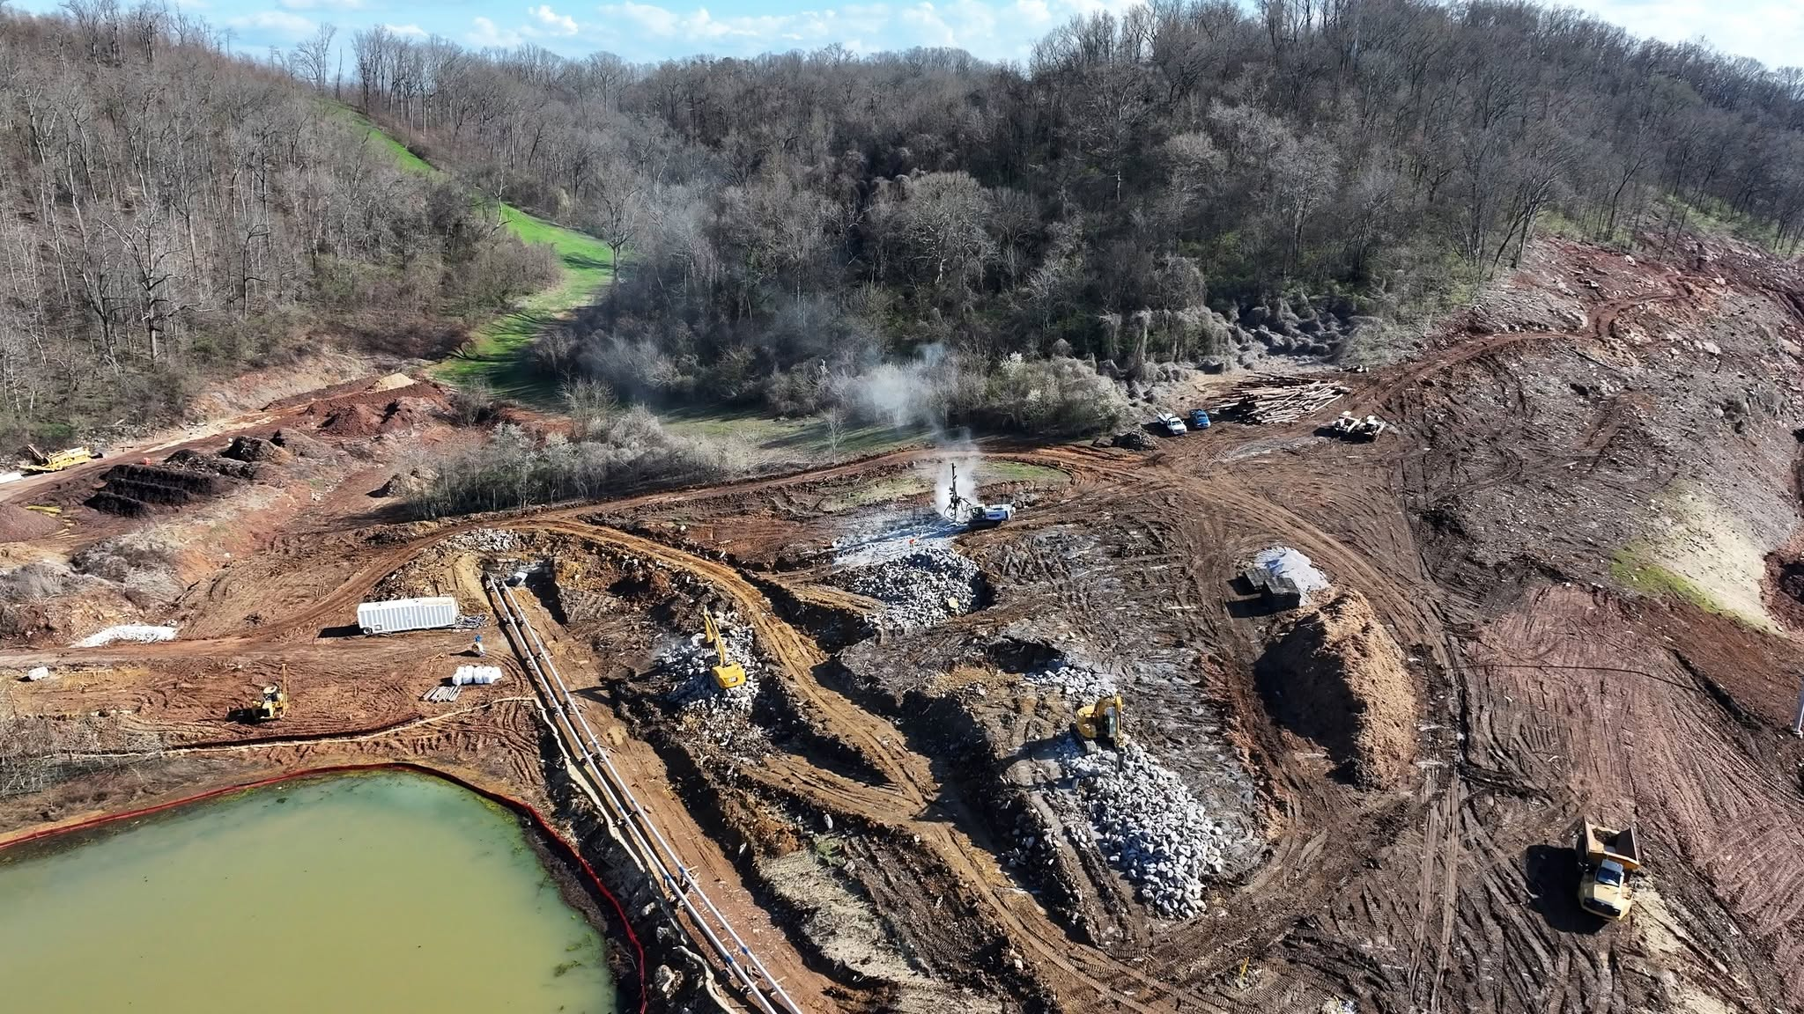
Who is Using the Tools?
TDOT Traffic Design for in-house design projects
Consultants who are designing TDOT projects
TDOT Regional Operations for safety projects requesting federal or state funding

Slide 15
AASHTOWare/TDOT Accomplishments
Unlimited Access- Over 700 registered users
Statewide Endeavor
Non-state Employees account for approximately twice as many users as State Employees
Conduit for crash data with DOSHS (State Highway Safety Office)
TDOT uploads 600-700 crashes daily-statewide
Approved users- direct access to “Crash Reports” via AASHTOWare (direct click)
AASHTOWare Support at the Tennessee Highway Safety & Operations Conference, Nashville 2022-2026.
TDOT has attended and actively participated in the AASHTOWare Safety User Experience Committee meeting every year since 2022

Slide 16
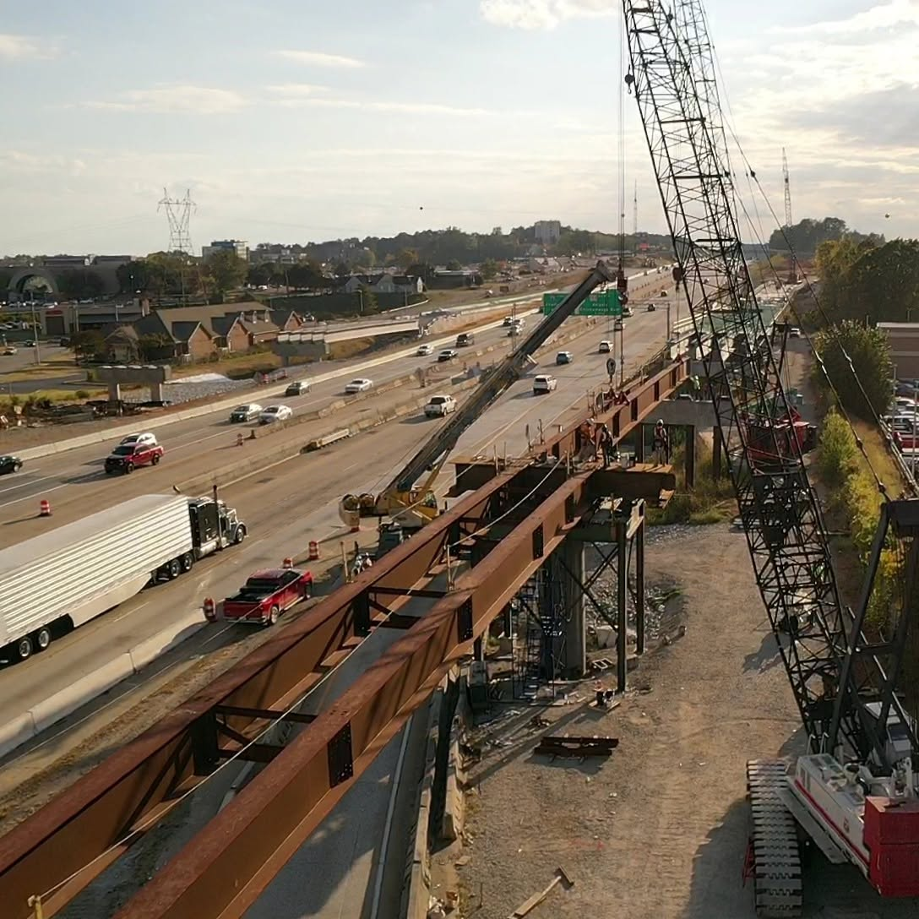
What’s Next?
  HSIP-Strategic Highway Safety Plan -Dashboard Development
  HSM 2 segment and intersection options (January 2027)
  Staff Training:
        Alternative Design
        Crash Query -refresher
        Network Screening
        Collision Diagrams
  Continue the implementation of Alternative Design in our program

Slide 17
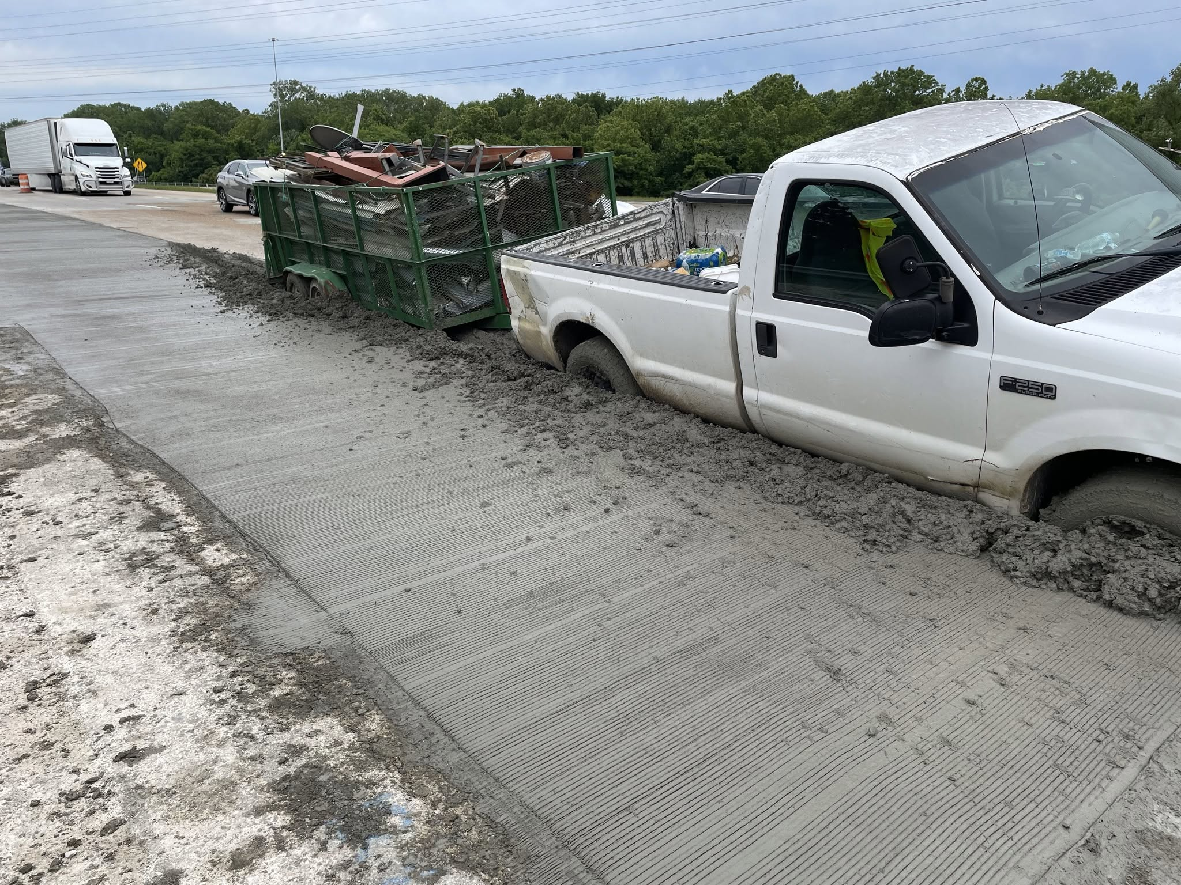
Questions
Amy Fiscor
TDOT Statewide Traffic Safety Engineer
Amy.Fiscor@tn.gov
Brandon Darks
TDOT Statewide Technical Specialist- Traffic Design
Brandon.Darks@tn.gov

