Slide 1
Developing a Statewide High-Injury Network:
Scaling Up a Proven Safety Program

Slide 2
What is a High-Injury Network?
A data-driven identification of locations where fatal and severe traffic crashes are concentrated.
It maximizes safety impacts by targeting investments, improvements, and countermeasures exactly where the greatest risk exists.

Slide 3


NJ Target Zero Commission
Signed into Law in January 2025
Cabinet-level membership
Goal: Zero FSI by 2040
14 Specific requirements – examples:
  An initial Action Plan was due in the first 12 months (completed in 10)
  A progress report is due to the Governor and Legislature annually
  Development of a statewide high-injury network

Slide 4
High-Injury Network
Methodology Development
Methodology working group
  NJDOT
  MPOs
  Advocates
  SHSO
  FHWA (non-voting)
Regular meetings
  Exchange of ideas
  Different perspectives
  Strong opinions
  Programmatic implications
  Compliance with the TZC Law
  Resource constraints
  Necessary tools

Slide 5
HIN Methodology
All public roads
ALL road users
One-mile road segments, inclusive of intersections
Ranked by total FSI (in line with SSA)
Limited to 100-200 segments (to really focus the safety efforts)
Three-years of crash data (2021-2023)
Three-year renewal cycle
Notes:
THIS TOOK 6 MONTHS TO DEVELOP!

Slide 6
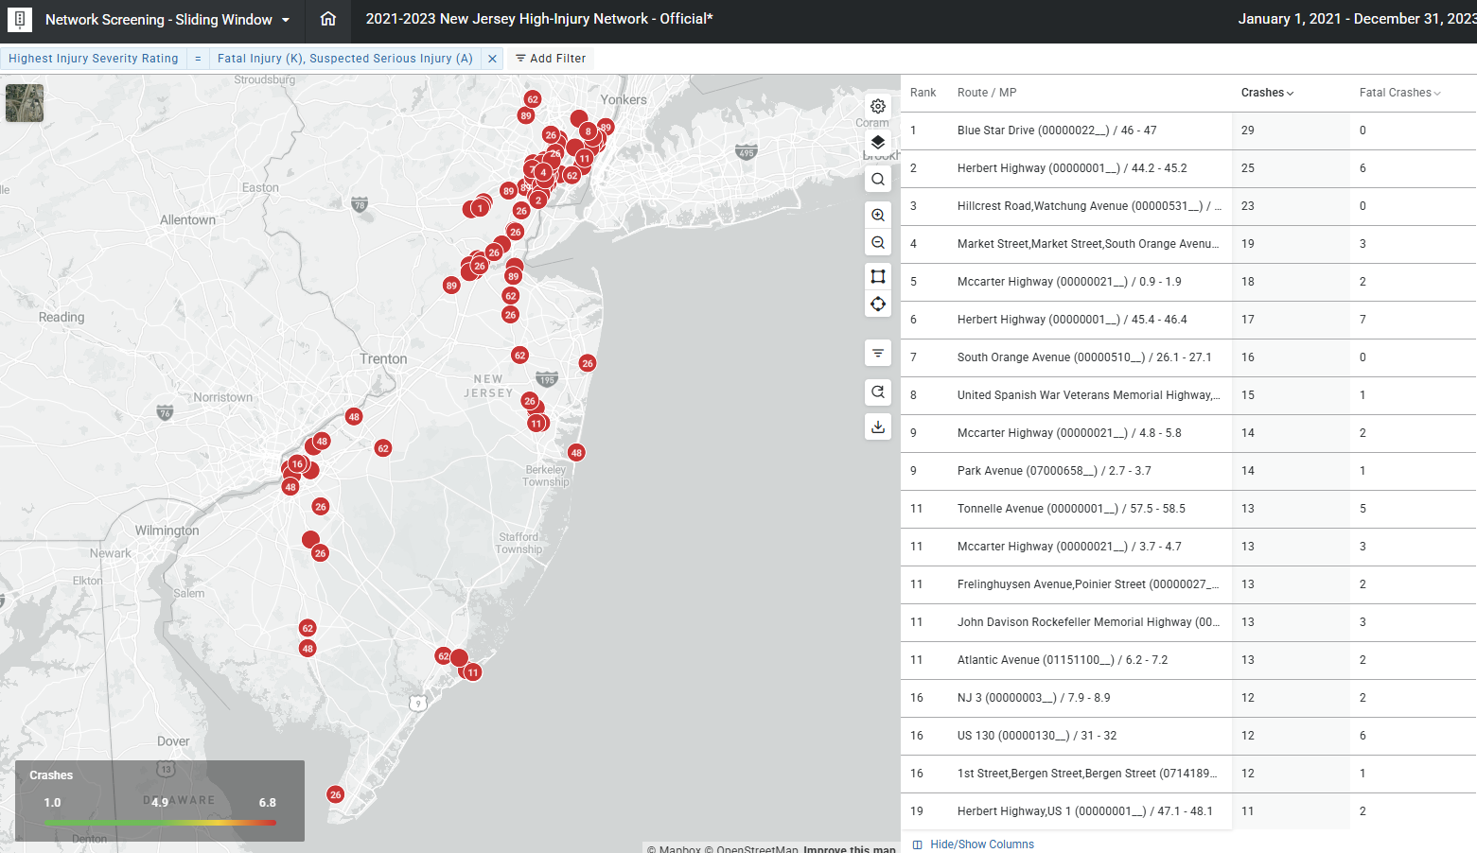
AASHTOWare Safety Powered by Numetric
Notes:
THIS TOOK ABOUT 90 SECONDS TO DEVELOP!

Slide 7
NJ Statewide High-Injury Network
NJDOT-Developed
TZC-Owned
6+ FSI crashes in 3-years
Public-facing
145 one-mile road segments
  NJDOT: 88 (60.7%)
  County: 41 (28.3%)
  Municipal: 15 (10.3%)
  Authorities: 1 (0.7%)

Slide 8
Focused
0.4% of public roads
11% of fatal crashes
15% of serious injury crashes

Slide 9
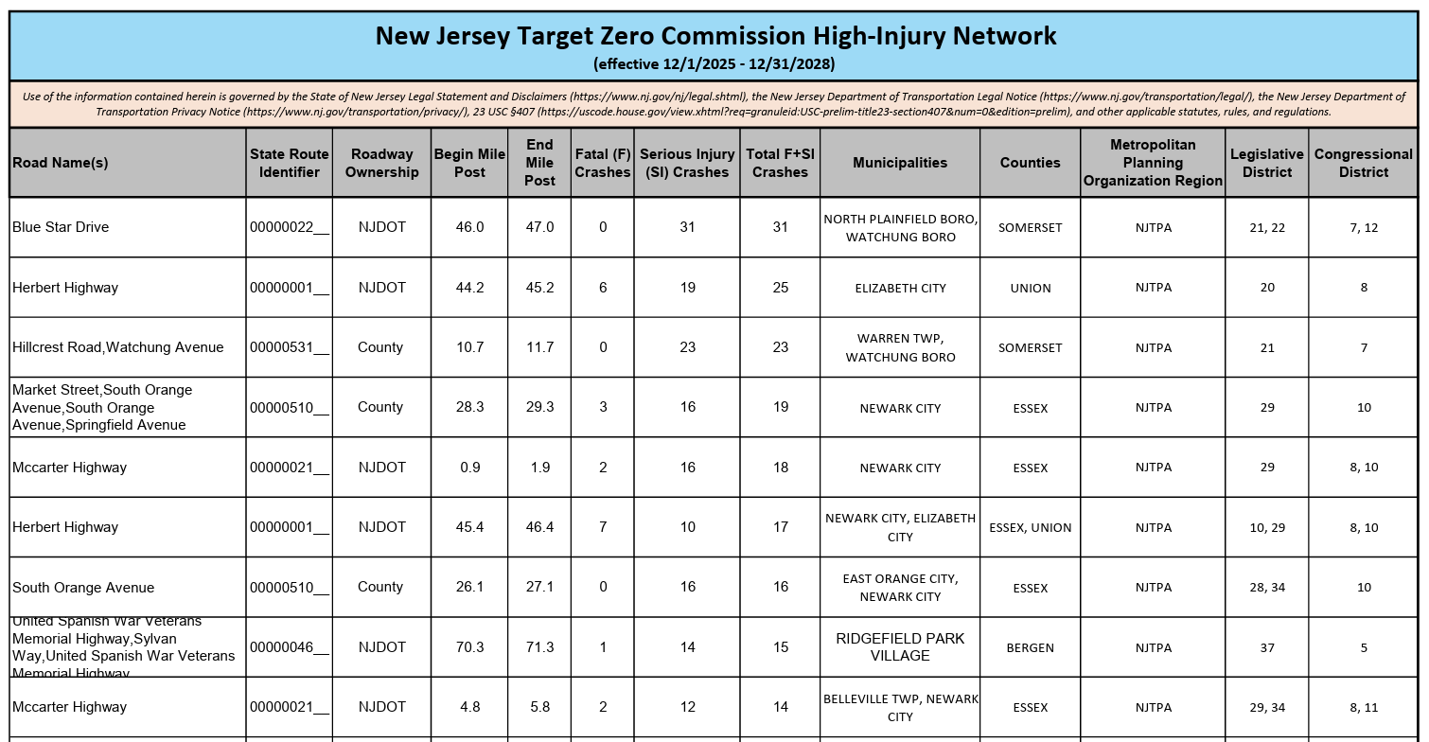
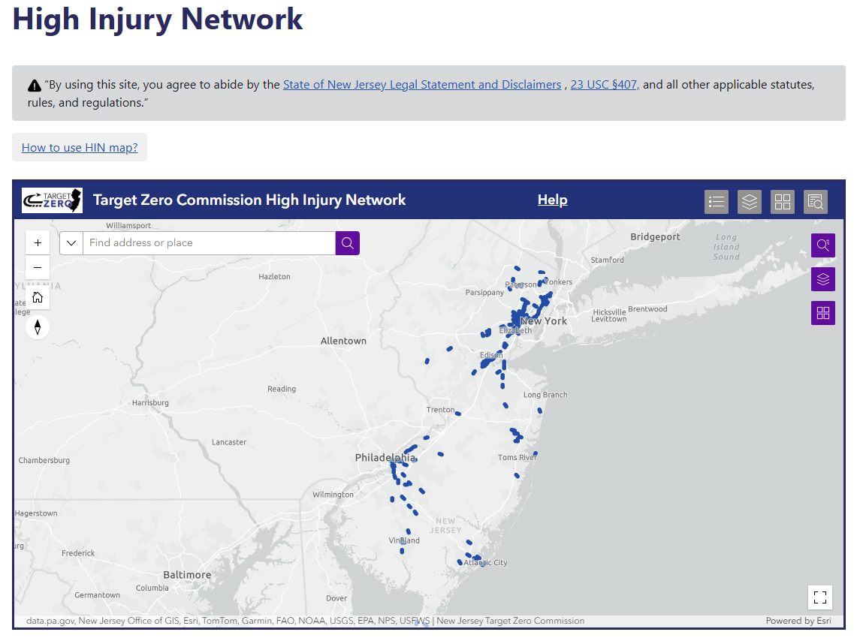
New Jersey Statewide High-Injury Network
dot.nj.gov/targetzero

Slide 10
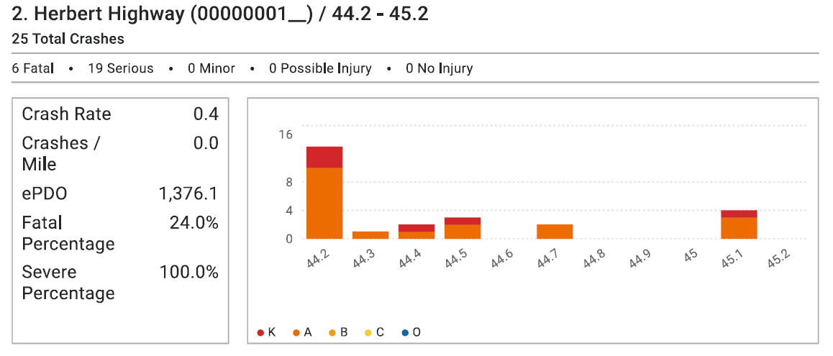
HIN Segment Details

Slide 11
Summary
High-Level Support
Advocacy-Driven
Safe System Approach
Hyper-Focused
Actionable
Transparent

Slide 12
Lessons Learned & Next Steps

Slide 13
Lessons Learned
Senior Department and governmental leadership buy-in is a requirement – full stop.

Slide 14
Lessons Learned
If you are going to put out an HIN, make sure you have a plan on how to address it FIRST

Slide 15
Lessons Learned
A long HIN that you cannot address in a reasonable amount of time will destroy your credibility

Slide 16
Lessons Learned
Ensure the Department is ready to include safety elements on all projects, especially those on the HIN, or public outcry will be fierce

Slide 17
Lessons Learned
An HSIP-eligible HIN must be State-developed.
Counties, locals, and regions wanted the State developed list to align with theirs – all of them

Slide 18
Lessons Learned
Engineering and design buy-in is crucial, but can be challenging with some “old school” folks still primarily focused on speed and capacity

Slide 19
Lessons Learned
Start small, then scale up as resources allow

Slide 20
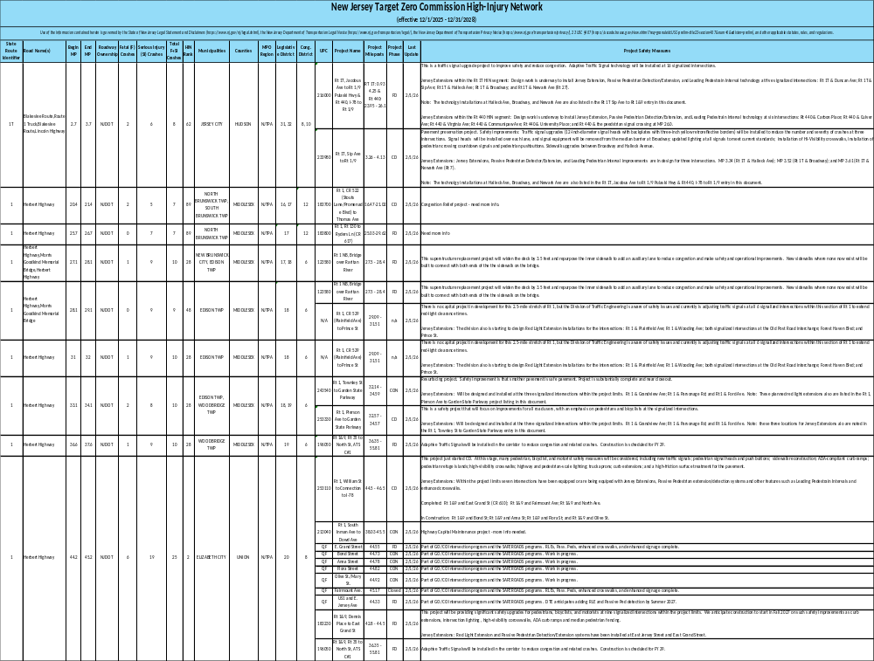
Next Steps
Tracking & reporting on 200+ projects on HIN segments –
in addition to existing HSIP portfolio

Slide 21

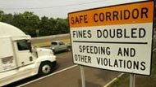
Next Steps
Continued alignment of internal and external safety programs with the HIN

Slide 22
Next Steps
 | Quick-Fix | Safety Accelerator Pilot | Capital
Funding source | Transp. Trust Fund (State) | Highway Safety Improvement Program | Multiple sources
Available funding | Very limited | Moderate | Significant
Delivery time | > 2 years | 2-3 years | 3-10+ years
Safety required | No | Yes | No
Project scope | Limited by funding | Limited | Virtually unlimited
Develop a quicker delivery model for essential safety improvements
In Development

Slide 23

Next Steps
Highlight progress

Slide 24
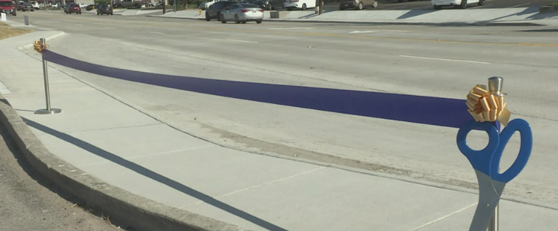
Next Steps
PROJECT DELIVERY!!!

Slide 25
Target Zero Commission
High-Injury Network
Highway Safety Improvement Program
Expedited Safety Project Delivery
Report to Governor & Legislature

Slide 26

Division of Safety Programs and Transportation Data
Safety-Focused, Data-Driven, Toward Zero
Frank Neary, Director
frank.neary@dot.nj.gov

